Slide 1


Make ITSM wholesome

Slide 2






18+ years of
IT management solutions expertise
180,000+
customers
ManageEngine
2,500+ employees
A division of Zoho Corporation,
a bootstrapped, private, and
profitable company
90+ products and free tools for IT management
190+ countries

Slide 3


The
common
challenges
faced by ITSM teams

Slide 4






Inconsistent service delivery
Process
automation
gaps
Suboptimal customer
experience
Siloed
approach
to service management
Taking service management
beyond IT
Complying
with privacy regulations

Slide 5
The absence of a wholesome service delivery experience for
all stakeholders involved: users, agents, and management
The result

Slide 6
Move service delivery from operational to strategic
with intelligent automations and predictions, standardized workflows,
and deep insights into data
Bridge the gap between business and IT
The difference that a wholesome
ITSM tool brings to the table
through streamlined service management across the enterprise, and contextual integrations with business apps
Be the epicenter of IT infrastructure management,
offering deep integrations with other IT management software
Transform customer experience
by creating new and effective channels for support and collaboration
Achieve unrestricted extensibility
with last-mile customizations for IT and business processes

Slide 7





Service management
IT & enterprise service management
with ManageEngine
Service management for MSPs
IT asset management
Customer support

Slide 8




In the market
since 2005
Used by 100,000+ organizations worldwide
ServiceDesk Plus
Available in
29 languages
facts
Offered as on-premises
& cloud versions
Hosted in ManageEngine-owned data centers

Slide 9




On-premises
ServiceDesk Plus
Deployment options
Cloud
Amazon Web Services
Microsoft Azure

Slide 10

Why
ServiceDesk Plus?

Slide 11






Best practice process workflows and features available out-of-the-box
Highly customizable and scalable for different process maturities
Tight, contextual integrations with other
IT management and
business apps
A flexible and easy-to-use interface, resulting in a low learning curve
The latest in technology, including virtual assistants and AI capabilities
Flexible choice between the on-premises and cloud versions, with
easy switching

Slide 12

The six ways ServiceDesk Plus makes your
ITSM wholesome

Slide 13

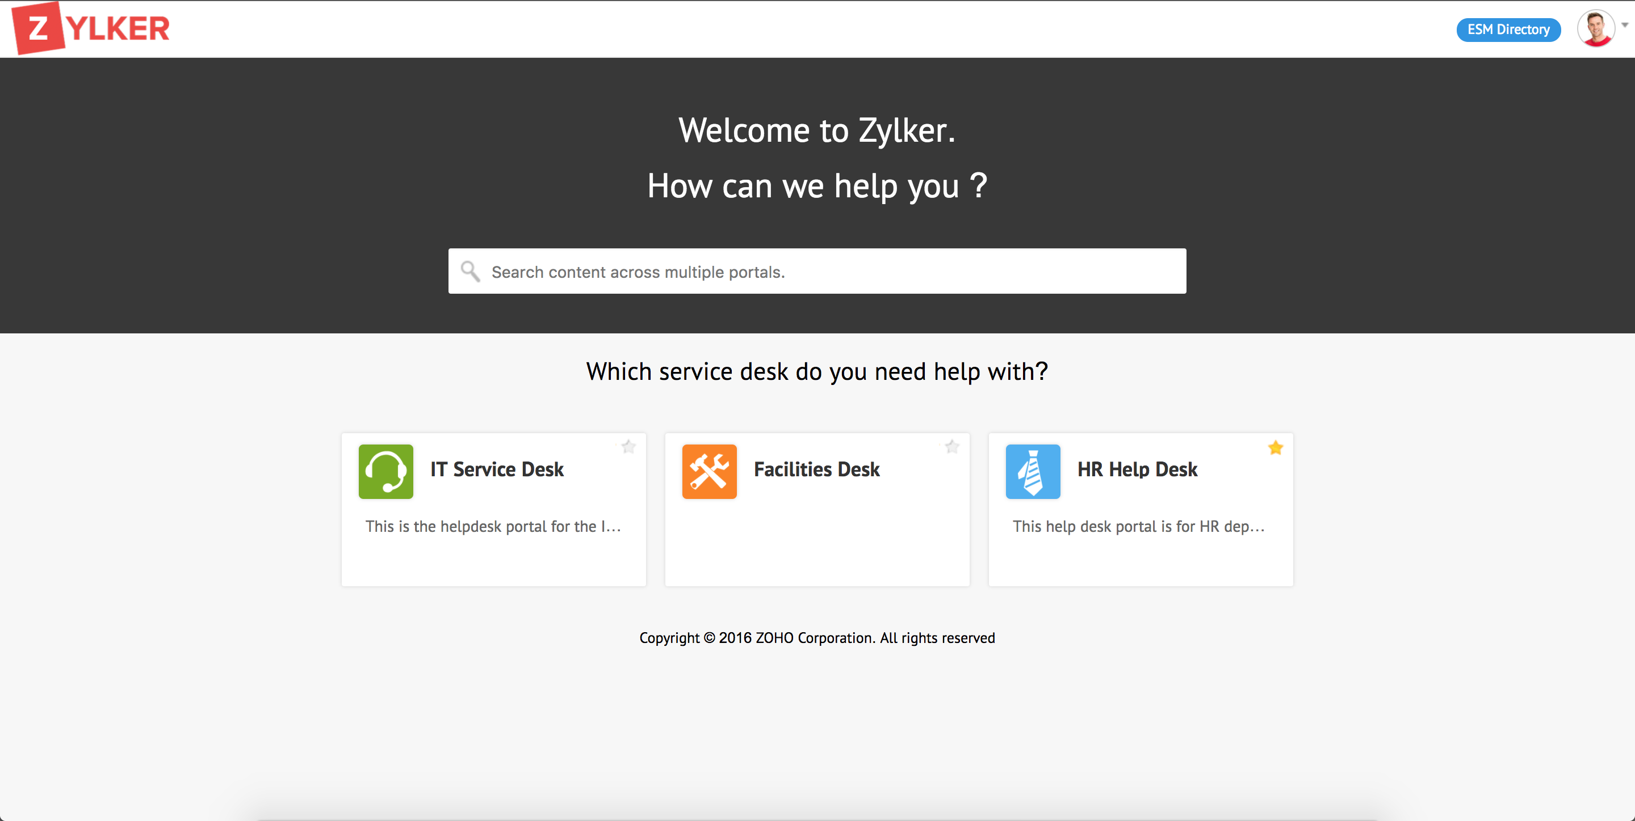
1
Make service management cross the boundary between IT and business with the enterprise service desk

Slide 14

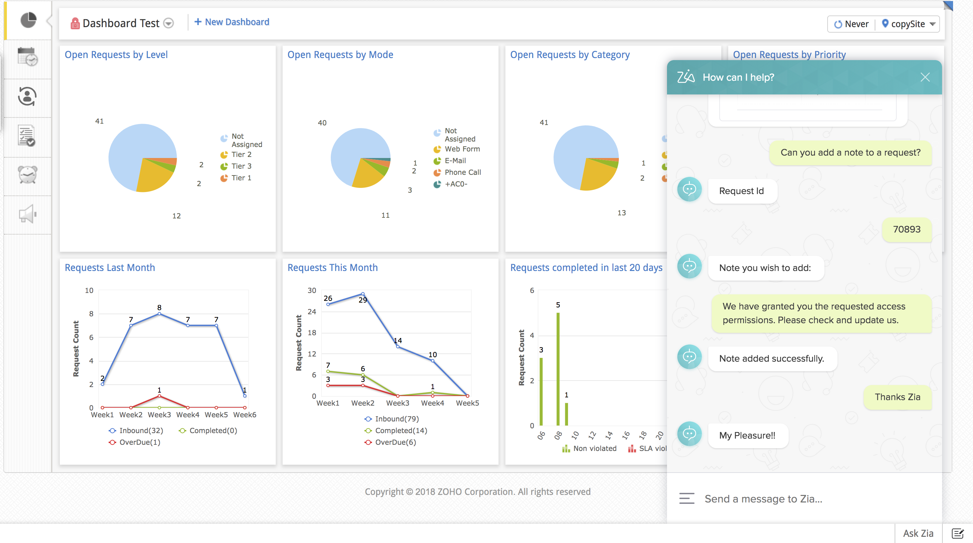
2
Leverage intelligent technology with
AI-based automations

Slide 15

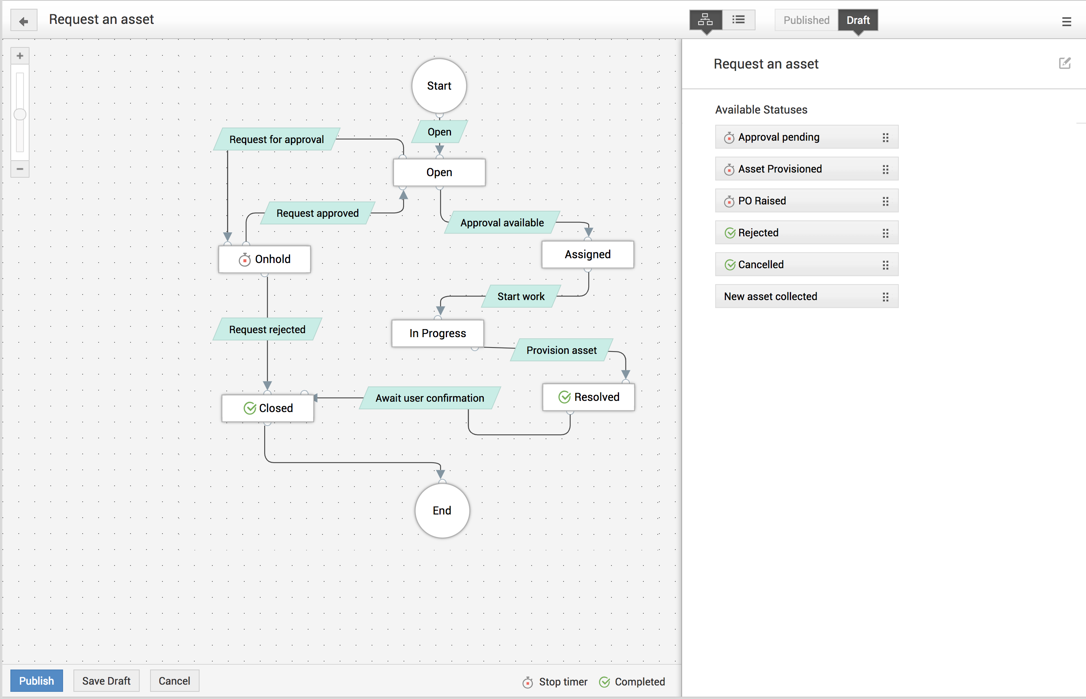
3
Standardize service
delivery with visual
process workflows

Slide 16

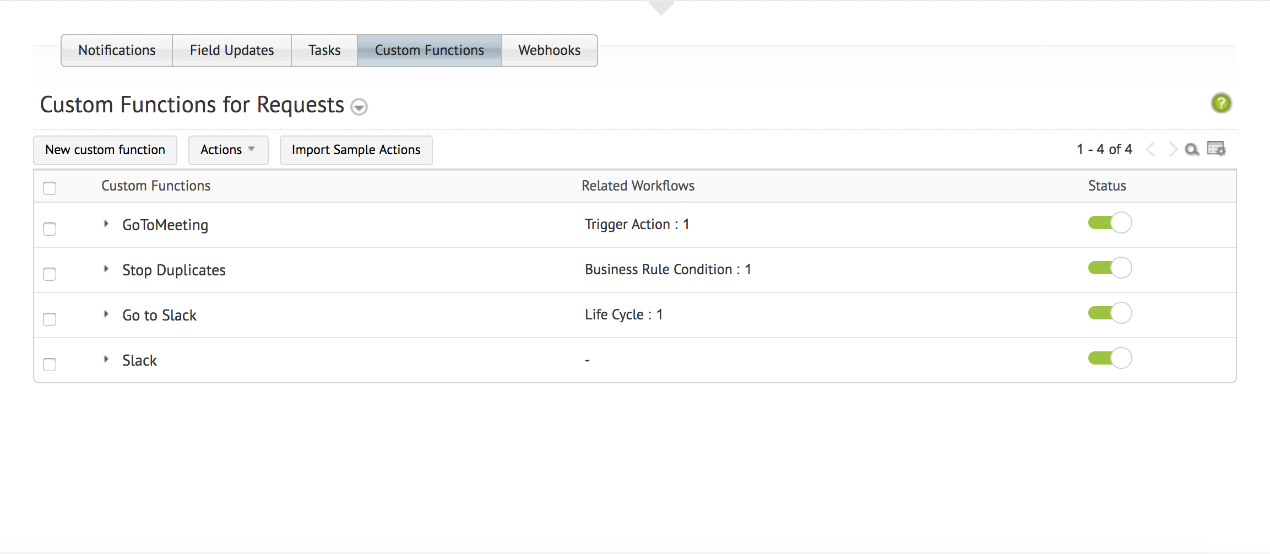
4
Make ITSM work
your way with last-mile customizations

Slide 17

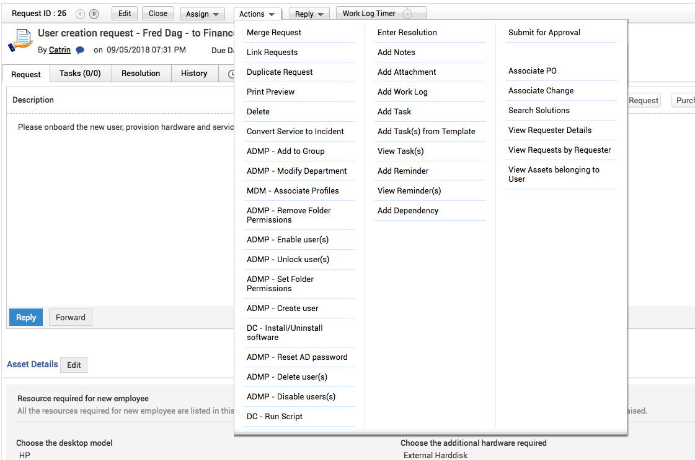
5
Build an integrated approach to service management with
360-degree IT integrations

Slide 18

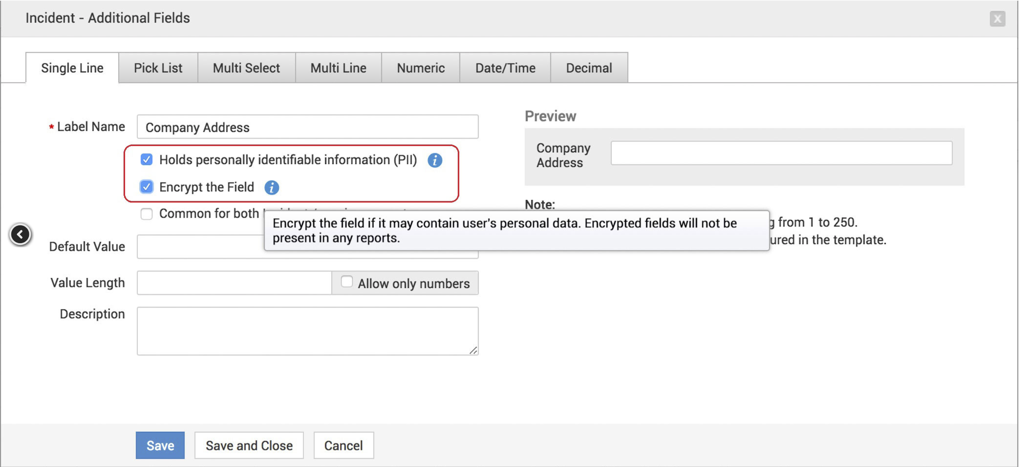
6
Weave privacy into service desk operations

Slide 19

Top ITSM
Enterprise service management
Incident and problem management
Change management
IT asset and configuration management
Configuration management database (CMDB)
Purchase and contract management
Project management
Service requests and request fulfillment
Knowledge management
Reporting and SLA management
Process and visual workflow design
Integration with IT management apps
capabilities

Slide 20


Standard
Professional
Enterprise
Editions
help desk+change+asset+Project
IT help desk software
help desk + asset management
®
Incident management
Self-service portal
Knowledge base
Multi-site support
SLA management
Help desk reports
Help desk management
IT asset discovery
Software asset management
Asset inventory reports
Purchase &
contracts management
Incident management
Problem management
Change management
IT project management
Service catalog
Asset management
CMDB
The perfect starter kit to get your ticketing right.
The right package for integrated IT asset management.
The complete full-stack ITSM suite with all the features an IT service desk needs.

Slide 21

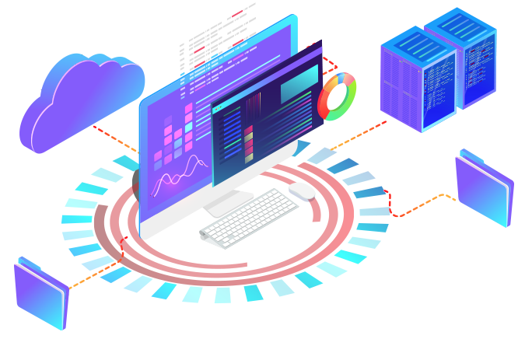


Windows Server 2012-2016
Windows 7/8/10
RHEL 8 & above
Ubuntu 14.0 & above
Supported databases, browsers,
& OSs
MSSQL 2017
MSSQL 2016
MSSQL 2014
MSSQL 2012
MSSQL 2010
MSSQL 2008
PostgreSQL
Internet Explorer 11
Microsoft Edge
Mozilla Firefox
Google Chrome

Slide 22


Customers

Slide 23



Customer
reviews
ServiceDesk Plus is a game changer!
Overall, we're completely satisfied with ServiceDesk Plus. This product not only helps track incidents in the IT department, but we've been able to scale the system to include all other departments in our company.
In comparison to our last help desk solution, ServiceDesk Plus is light years away from where we were.
IT operations manager | Industry: Finance | Role: Infrastructure and operations | Firm Size: 3B - 10B USD

Slide 24




ServiceDesk Plus
recognition

Slide 25

How
ServiceDesk Plus
enables best practice ITSM
for support operations

Slide 26

Incident
management

Slide 27
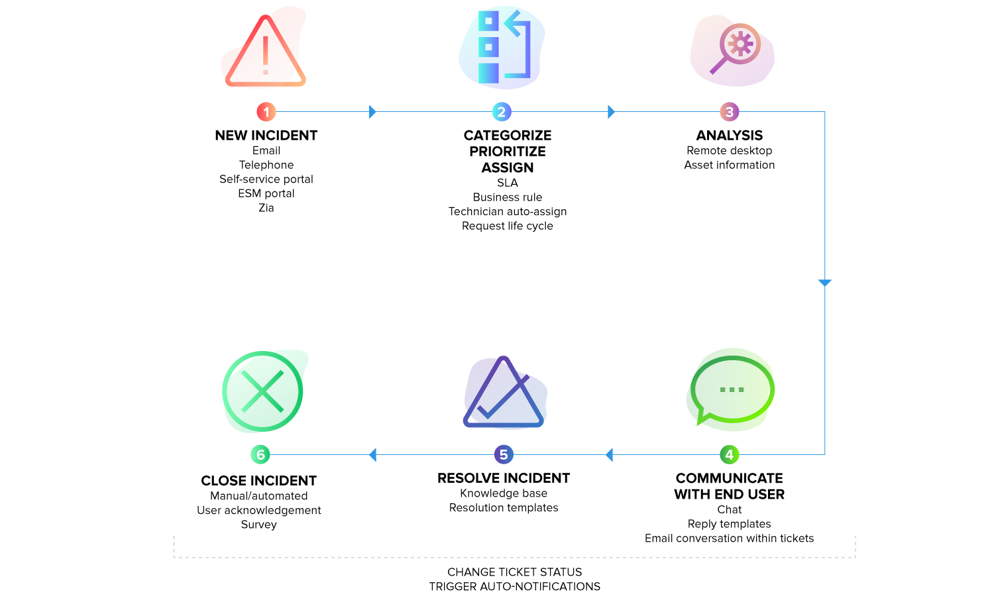
Incident management
workflow

Slide 28


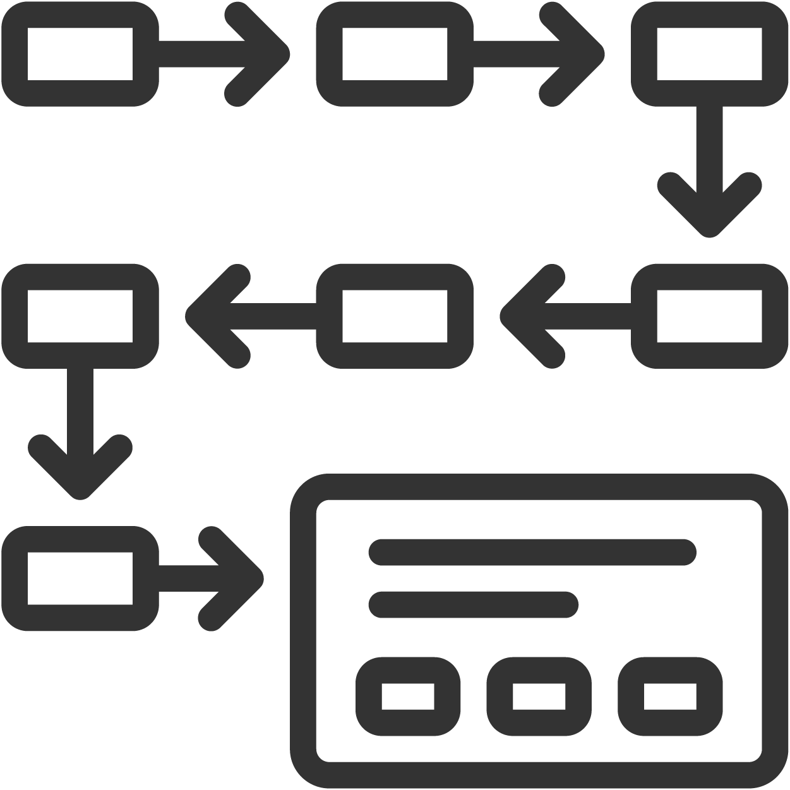

Best practice incident management with
ServiceDesk Plus
Enable multiple channels
for reporting issues
Collect comprehensive information on the issue during ticket logging
Multimodal ticket creation via email, phone, self-service portal, virtual agent, and business apps
Customizable incident templates
Perform hands-free categorization,
prioritization, and assignment
Move to a shift-left model for L1 tickets
Self-service portal | Solution auto-suggest | Zia
Business rules | Technician auto-assign | Priority matrix

Slide 29





Best practice incident management with
ServiceDesk Plus
Minimize resolution times
Track and manage SLAs
Request life cycle | Integrated knowledge base | Resolution templates | Request sharing and collaboration
Response and resolution SLAs | SLA escalations, and actions
Ensure prompt and relevant communication on ticket progress
Reduce reopen rates and incident backlogs
Automated ticket closure | Incident KPIs | Custom reports | Advanced analytics
Notification rules | Canned responses | Notes
Maximize end-user satisfaction levels
User surveys

Slide 30

Service request
management

Slide 31
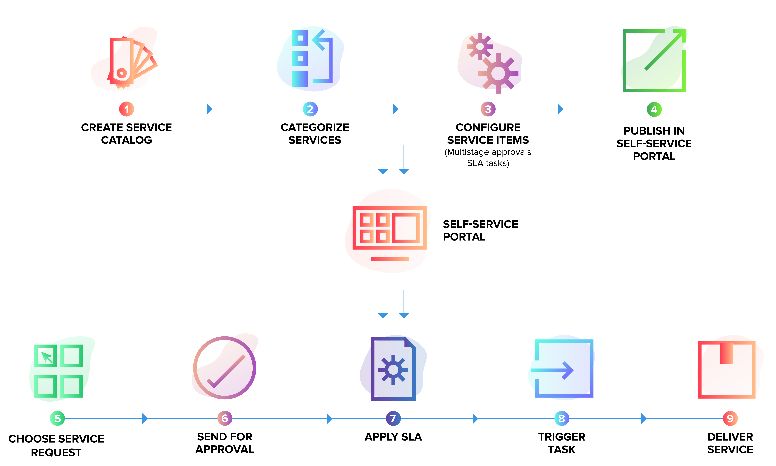
Technicians
Service request management
workflow
End users

Slide 32




Best practice
service request management with
ServiceDesk Plus
Showcase the wide range of IT services offered and improve IT visibility
Present the right services to the right users
Role-based user access | User groups
Service categories | Service templates | Resources
Involve the right stakeholders
Increase the efficiency of service delivery
Technician groups | User groups | Organization roles | Service request approvers
Business rules | Request life cycle | Tasks

Slide 33
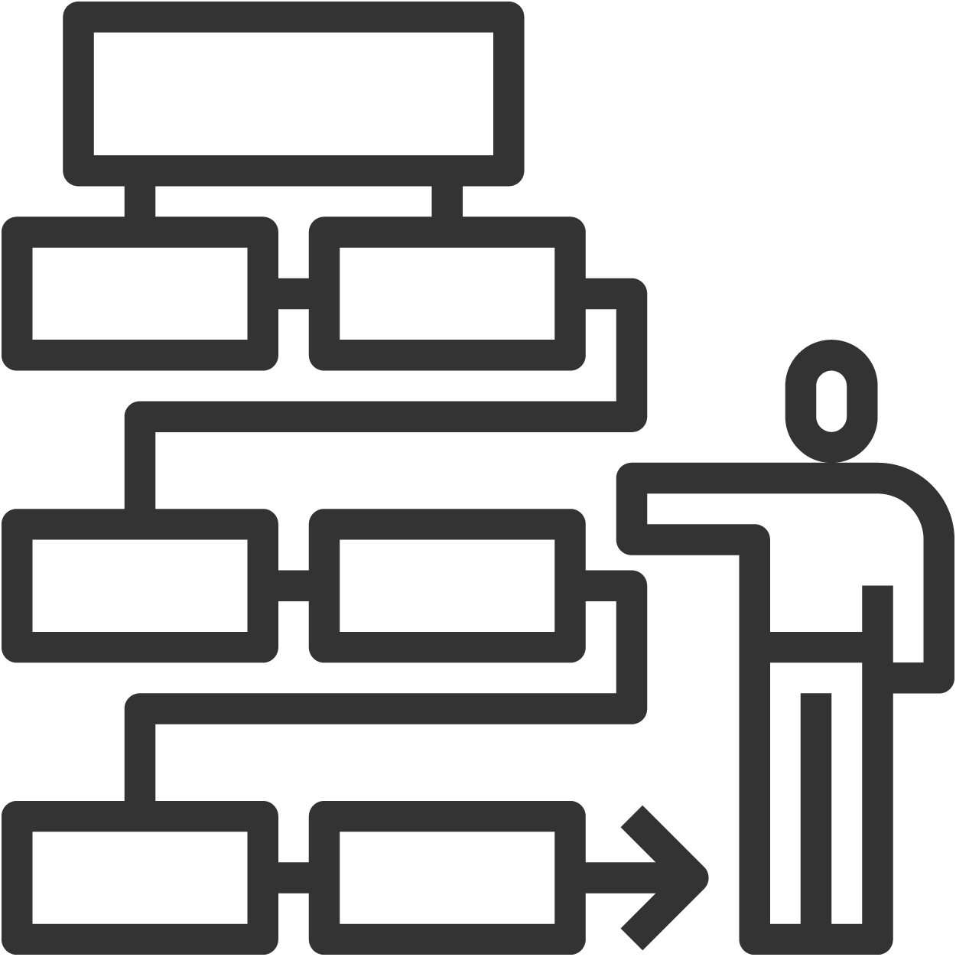


Best practice
service request management with
ServiceDesk Plus
Define authorization, escalation, and notification policies
5-stage approval process | SLAs | Notification rules
Set the right service level expectations for end users and technicians
Response and resolution SLAs | SLA escalation notifications, and actions
Track service delivery costs
Service costs | Resource costs

Slide 34

Knowledge
management

Slide 35
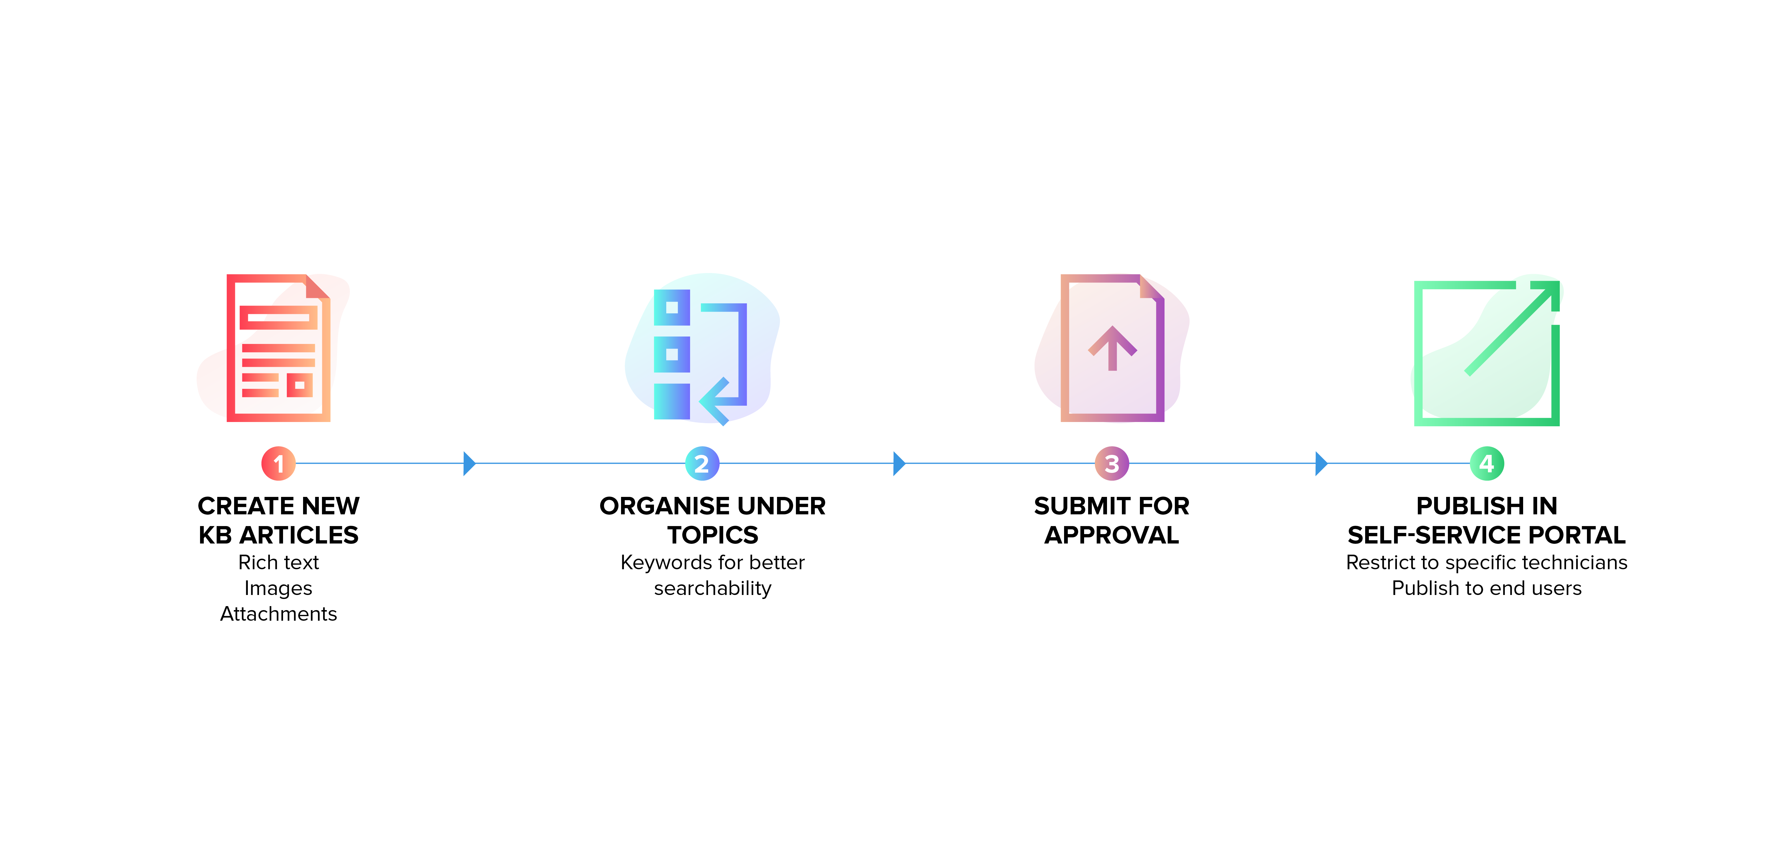
Knowledge management
workflow

Slide 36




Best practice knowledge management with
ServiceDesk Plus
Structure and organize the knowledge base
Maintain authorship and version information
Rich text editor | Topics | Keyword search
Solution owner | History
Keep a review and approval process in place
Define access privileges on knowledge artifacts
Solution review and approvals | Solution expiration
Technician roles | User groups

Slide 37
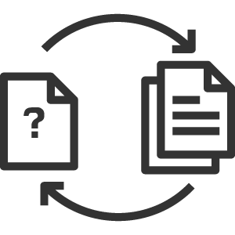


Best practice knowledge management with
ServiceDesk Plus
Preserve knowledge from incidents and problems
Convert resolutions into knowledge base articles
During ticket creation, provide end users with contextual suggestions from the knowledge base
Solution auto-suggest | Self-service portal
Track usage and efficiency metrics
Requests resolved by a specific solution

Slide 38

Problem
management

Slide 39
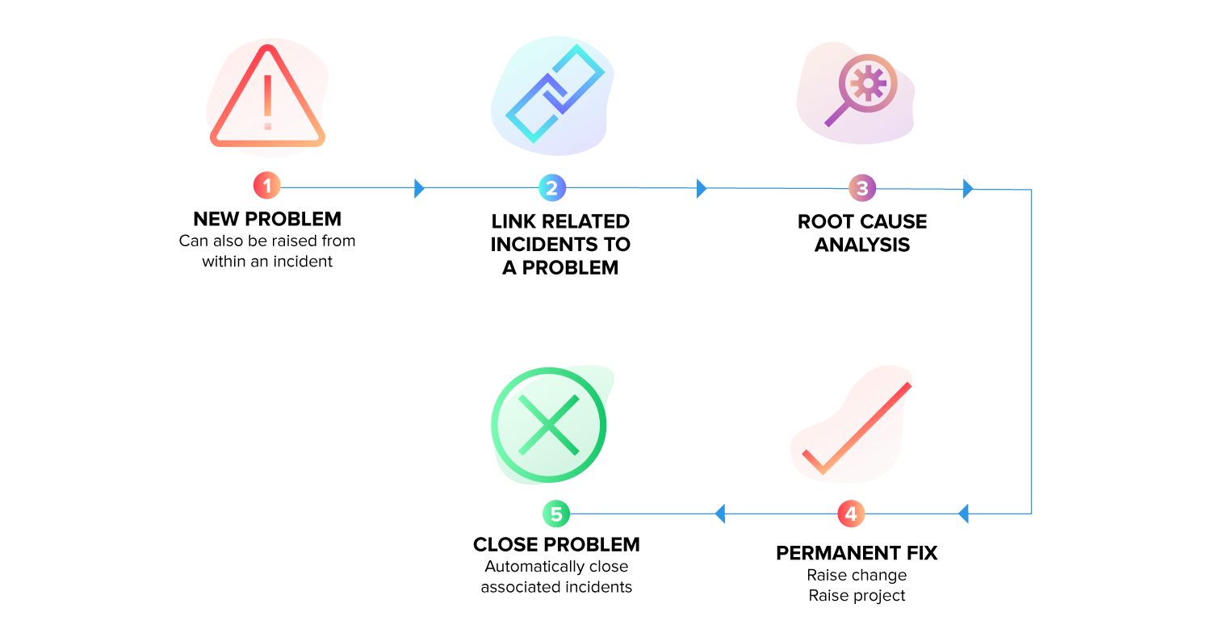
Problem
management
workflow

Slide 40



Best practice problem
management with
ServiceDesk Plus
Identify incidents that require a root cause investigation
Precisely define each major problem and quantify the business impact
Create a problem ticket from an incident | Problem logging
Services affected | Add assets involved in templates
Standardize the format for defining problems
Identify the problem owner
Problem templates
Problem roles | Technician

Slide 41




Best practice problem management with
ServiceDesk Plus
Assign solution implementation to specific users with due dates
Maintain a known error database
Label a problem as a known error
Tasks
Track solution implementation and effectiveness
Keep notification mechanisms in place to keep stakeholders informed
Analysis | Workarounds | RCA
Notification rules | Announcements

Slide 42

Best practice problem management with
ServiceDesk Plus
Make problem management work in tandem with other ITSM processes
Associate incidents and changes with problems

Slide 43

Change
management

Slide 44
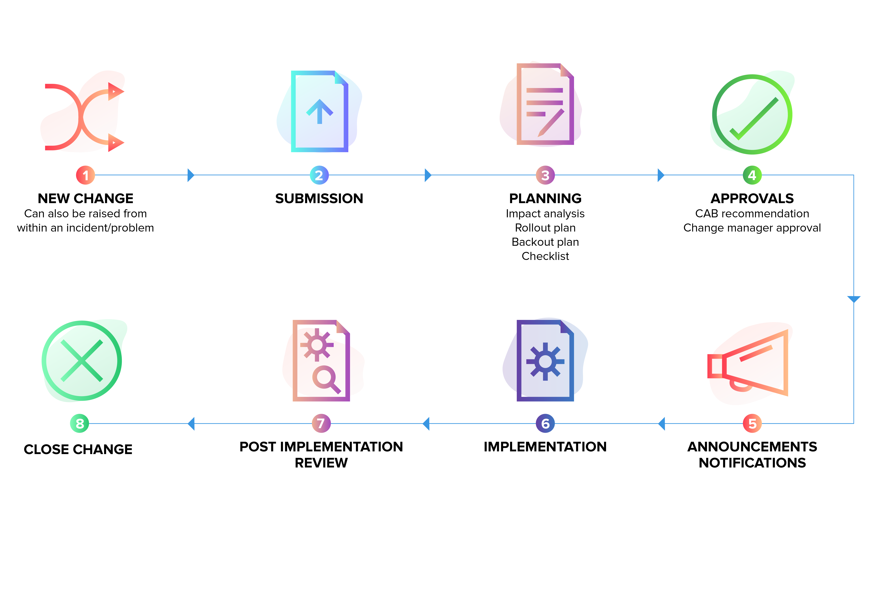
Change
management
workflow

Slide 45




Best practice change management with
ServiceDesk Plus
Identify the type of change
Define key roles and responsibilities
Change types
Change roles
Design processes for different change types
Log, manage, and prioritize change proposals
Change workflows | Visual change life cycle with multistage processes
Custom change templates | Logging from incident or problem records | Change calendar

Slide 46




Best practice change management with
ServiceDesk Plus
Gain clear insights on risks and the impact of changes
Communicate schedules and any downtime to stakeholders
Risks | Change planning, including impact analysis and rollout plans | CMDB integration for downstream impact
Downtime schedule | Announcements
Put an effective approval mechanism in place
Measure the progress and effectiveness of change implementations
CAB | Change manager
Implementation checklist | Tasks | Project association

Slide 47



Best practice change management with
ServiceDesk Plus
Keep contingency plans in place
Implement continual service improvement
Post-implementation reviews | Change KPIs
Back-out plans
Make change management work with other ITSM processes
Integration with incident, problem, asset, project management, and CMDB

Slide 48

Project
management

Slide 49
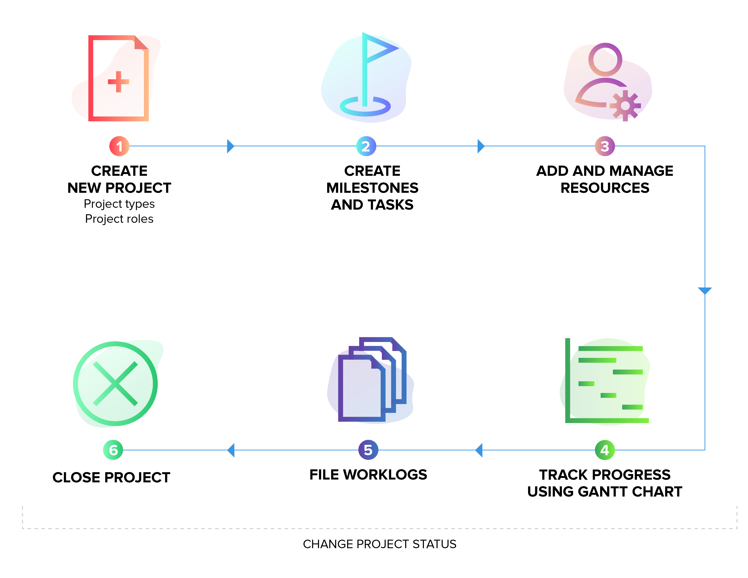
Project
management
workflow

Slide 50


Best practice project management with
ServiceDesk Plus
Collect all relevant information beforehand to identify the scope, budget, and time needed
Break down your projects into subactivities
Milestones | Tasks
Project templates
Define different roles and responsibilities
Effectively track the progress of projects
Project roles | Members
Project status | Gantt charts

Slide 51


Best practice project management with
ServiceDesk Plus
Keep track of the effort spent at a granular level
Use data to make better decisions on-the-go
Project overview map | Project reports
Worklog
Integrate project management with other ITSM modules
Associate requests and changes with projects

Slide 52

Asset
management

Slide 53
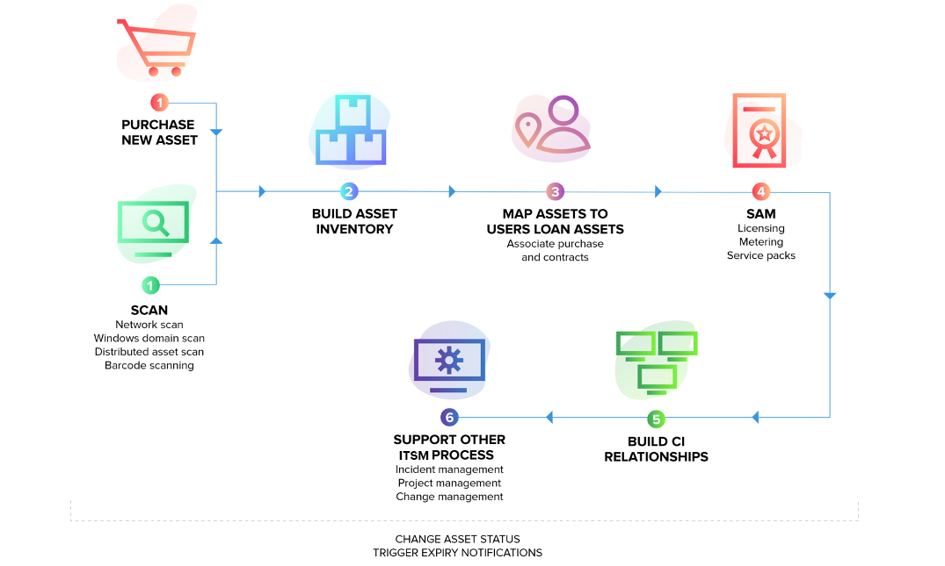
Asset
management
workflow

Slide 54



Best practice asset management with
ServiceDesk Plus
Gain control over all hardware and software inventory
Classify asset and product types
Multi-source discovery modes (Agents, Windows/network/ distributed scans) | Barcode-based discovery
Asset types | Product types
Track assets across their life cycle from requisition to retirement, along with ownership
Map relationships between assets and business services
CMDB | CI types | CI relationships | Business views
Asset states | User-workstation mapping | Asset loans

Slide 55


Best practice asset management with
ServiceDesk Plus
Keep track of asset depreciation and other costs
Manage all your software license investments
Depreciation | Cost center | GL codes
Software, license, and agreement types
Track software usage and compliance
Stay on top of your IT purchases
Software metering | Software and license dashboards
Purchase management | Vendor list | Approvals | Invoice and payment | Associated assets

Slide 56


Best practice asset management with
ServiceDesk Plus
Centralize the asset contracts management process
Contract details | Renewal details | Child contracts | Expiry notifications | Associated assets
Ensure that your ITAM supports other ITSM process
Asset information in incidents, problems, changes, and projects, and mapping to CMDB

Slide 57

Reporting

Slide 58
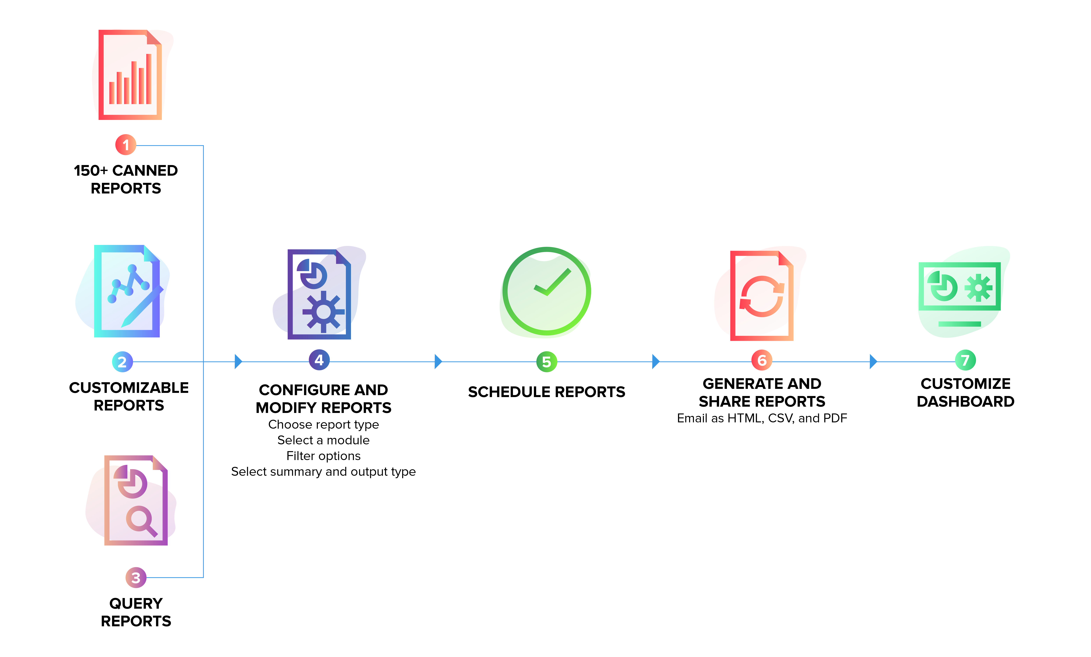
Reporting in
ServiceDesk Plus
Enable multiple channels to report issues
Multimodal ticket creation via email, phone, self-service portal, virtual agent, and business apps

Slide 59



Keep tabs on your key service desk metrics
Keep key stakeholders and CXOs informed periodically
Reporting in
ServiceDesk Plus
Out-of-the-box reports | Live dashboards | Custom dashboard widgets
Scheduled reports | Email reports automatically | Export reports as HTML, PDF, XLS, and CSV files
Enable multiple channels to report issues
Mine information about your service desk from the available data
Multimodal ticket creation via email, phone, self-service portal, virtual agent, and business apps
Custom reports (tabular, matrix, summary, and audit reports) | Query reports | Custom CI reports

Slide 60

Integrations

Slide 61
Integrations in
ServiceDesk Plus

Slide 62




Integrations in
ServiceDesk Plus
Convert network alarms into tickets, and have them automatically categorized and assigned to technicians
Continuously monitor servers and databases, and log any alarms instantly as service desk tickets

Slide 63





Integrations in
ServiceDesk Plus
Enable automated patch deployment, software installation and uninstallation, remote control sessions, and mobile device management—all right from the service desk
Allow end users to unlock their AD accounts and reset passwords from within the self-service portal

Slide 64



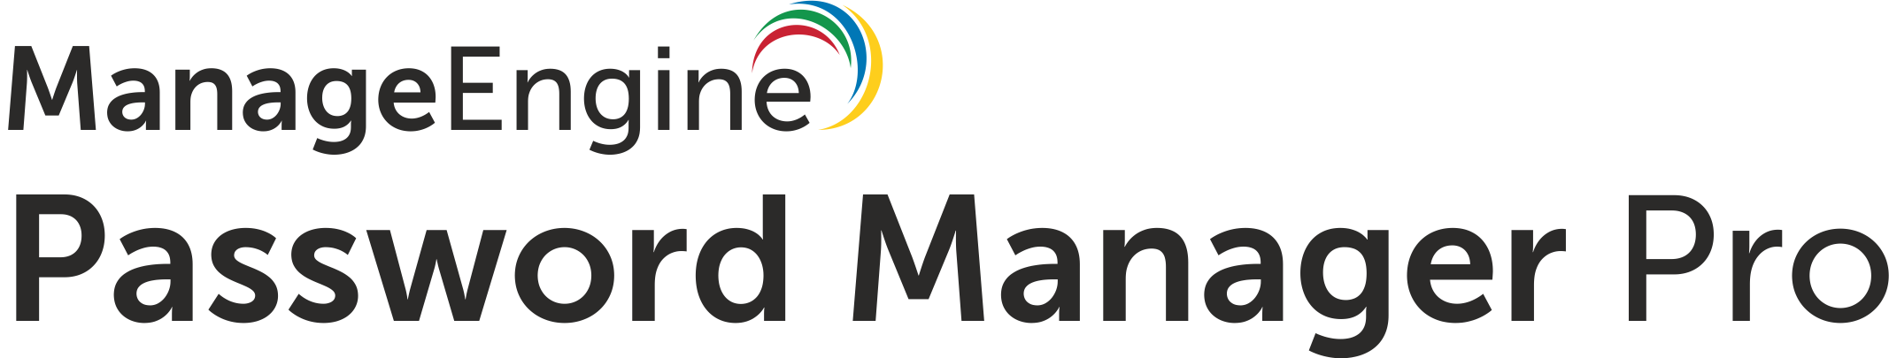
Integrations in
ServiceDesk Plus
Empower service desk teams to perform a wide variety of AD management tasks, like adding, deleting, enabling, or disabling AD accounts right from within ServiceDesk Plus
Allow service desk technicians to remotely access users' accounts and devices securely from their service desk without any manual logging

Slide 65



Integrations in
ServiceDesk Plus
Gain better insights into your IT service desk operations by creating powerful reports and dashboards instantly without the hassle of writing complex database queries

Slide 66

hello@servicedeskplus.com
www.servicedeskplus.com

