Slide 1
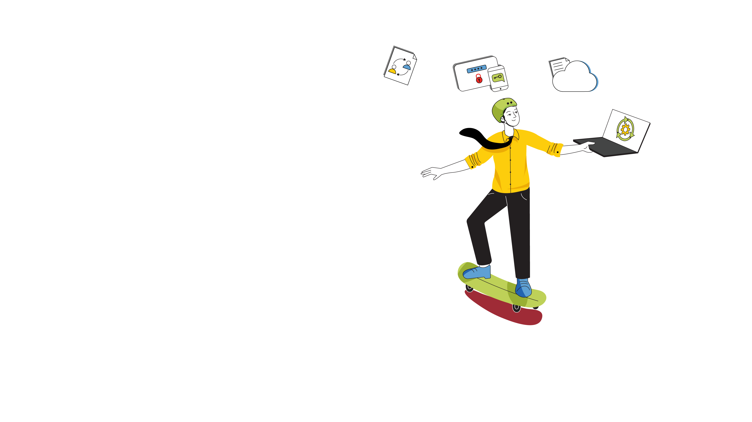

Keep pace with
digital disruptions
through organizational
changes without the risk

Slide 2




The change
conundrum
‌The dawn of the new decade has brought along with it a slew of technology disruptions that require companies to upgrade their IT infrastructures
Some of these are due to the evolution of technology while others have to do with preempting cyberattacks
A global health insurance firm with offices across three continents decides to move its on-premises applications to the cloud to make it easy for its employees to work from anywhere
But it also recognizes that some downsides need to be covered, such as unauthorized access or malware attacks

Slide 3

Charting an
ambitious course
of action
The IT operations manager decides to create two RFCs:
Migration of on-premises applications and databases to the cloud
Rollout of MFA once the the migration is complete

Slide 4
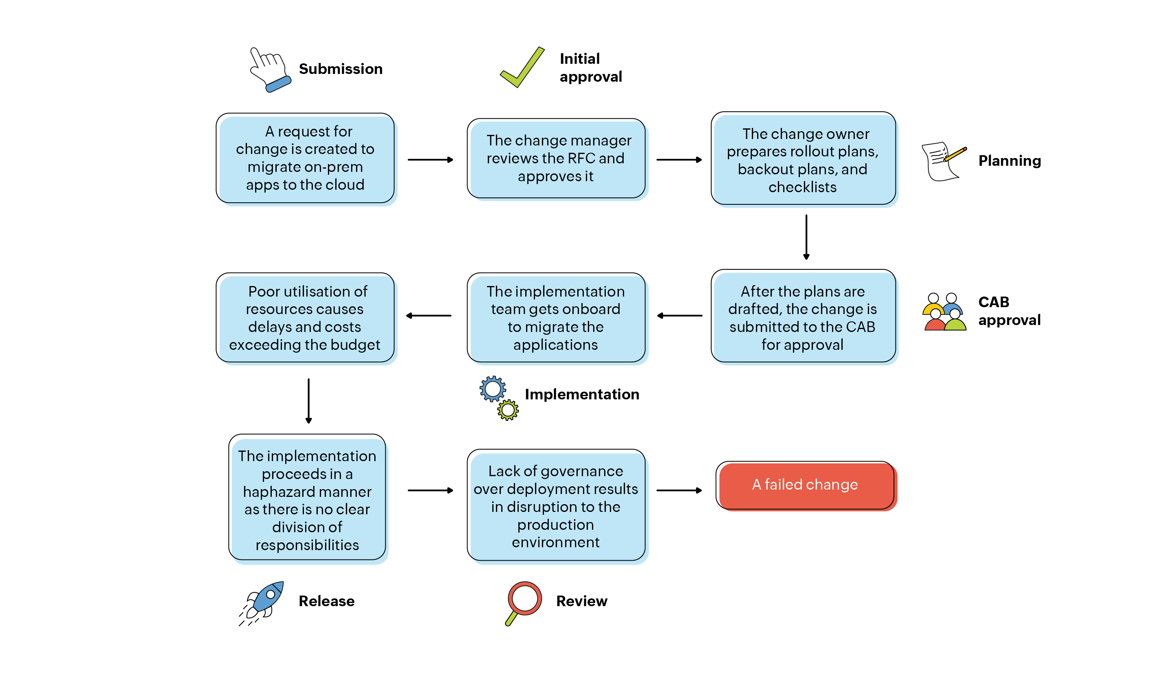
The trap of a one-size-fits-all approach
The IT team uses a normal change management strategy to implement this transition.
The second RFC
‌As the migration fails, the second change could not be implemented

Slide 5


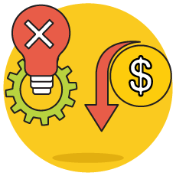
The domino effect: Unstructured change management
Inefficient usage of resources leads to implementation delays and costs exceeding the budget
Siloed deployment operations lead to lack of organizational control over the change
Failure to implement the changes results in mounting business losses

Slide 6

Future-proof your
IT infrastructure with a blended change management strategy!

Slide 7
Finding the right equation with ServiceDesk Plus
The pain points
The right remedies
The ServiceDesk Plus platform
Adopting a project management approach
Tracking implementation timelines with division of responsibilities
Monitoring manpower availability
Inefficient usage of resources leads to implementation delays
and costs exceeding
the budget
Project management
Project roles
Gantt charts
Tasks
Resource management
Siloed deployment operations lead to lack of organizational control over the change
Establishing accountability for different stakeholders
Managing development and deployment with visual workflows
Release management
Release templates
Release roles
Release workflows
Release calendar
Failure to implement the changes results in mounting business losses
A single pane of glass to bring multiple moving parts together
An integrated change-release project environment
Associate releases, projects,
& changes

Slide 8
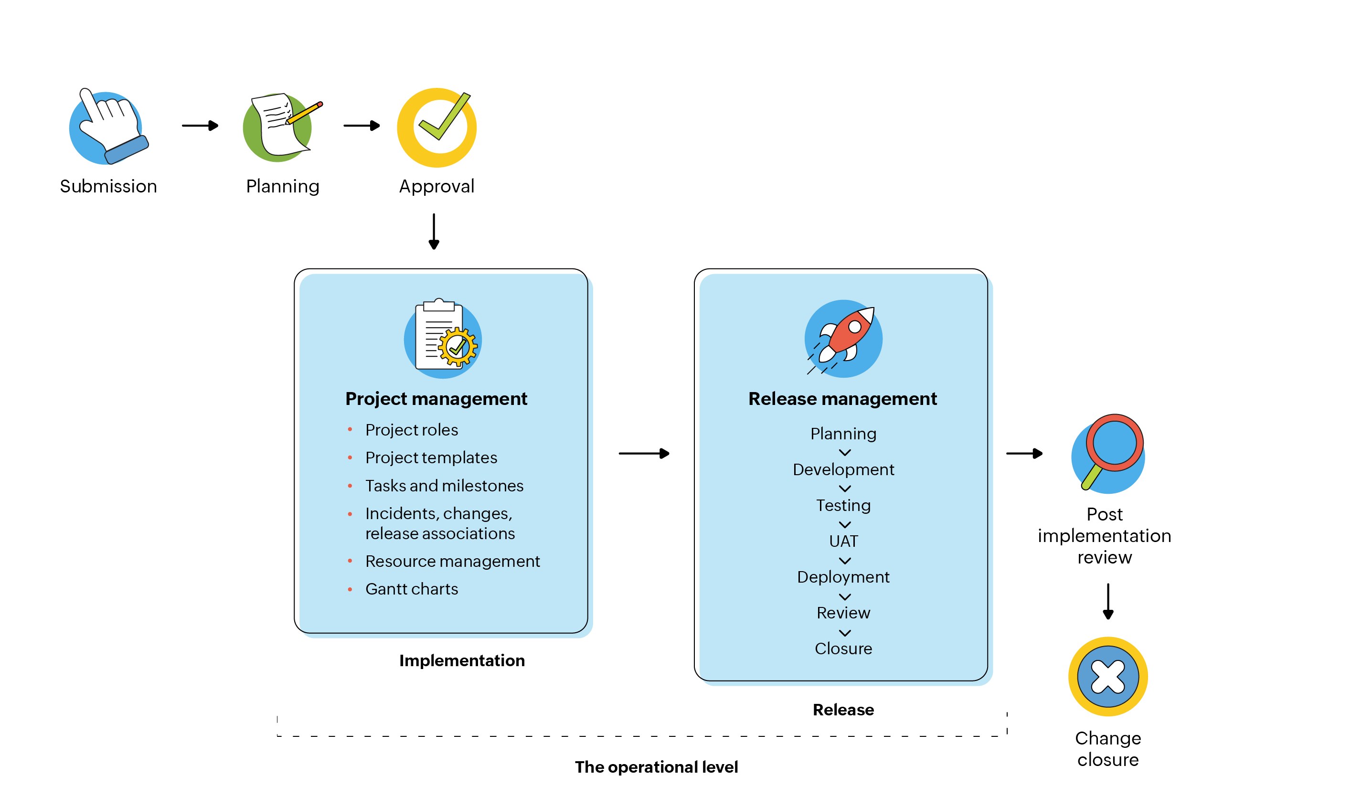
The ServiceDesk Plus perspective
The strategic level
‌Change management acts as the gatekeeper to authorize and manage pre- and post-deployment tasks

Slide 9
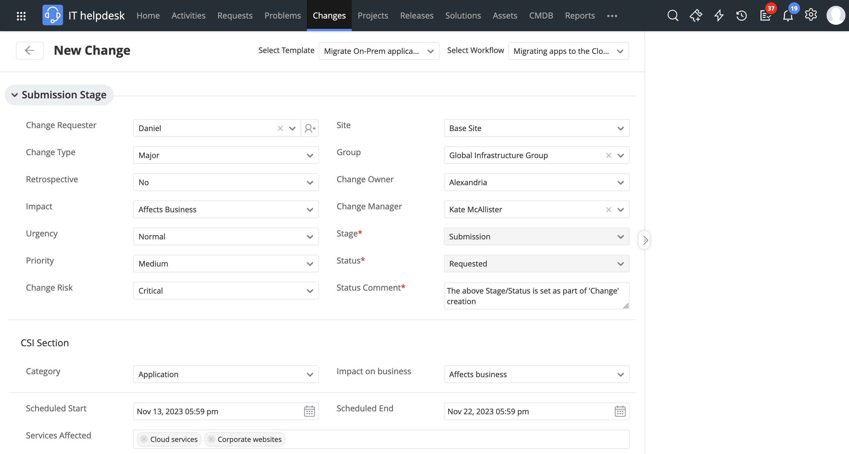
A Request For Change is created to migrate the On-Premises apps to the Cloud

Slide 10
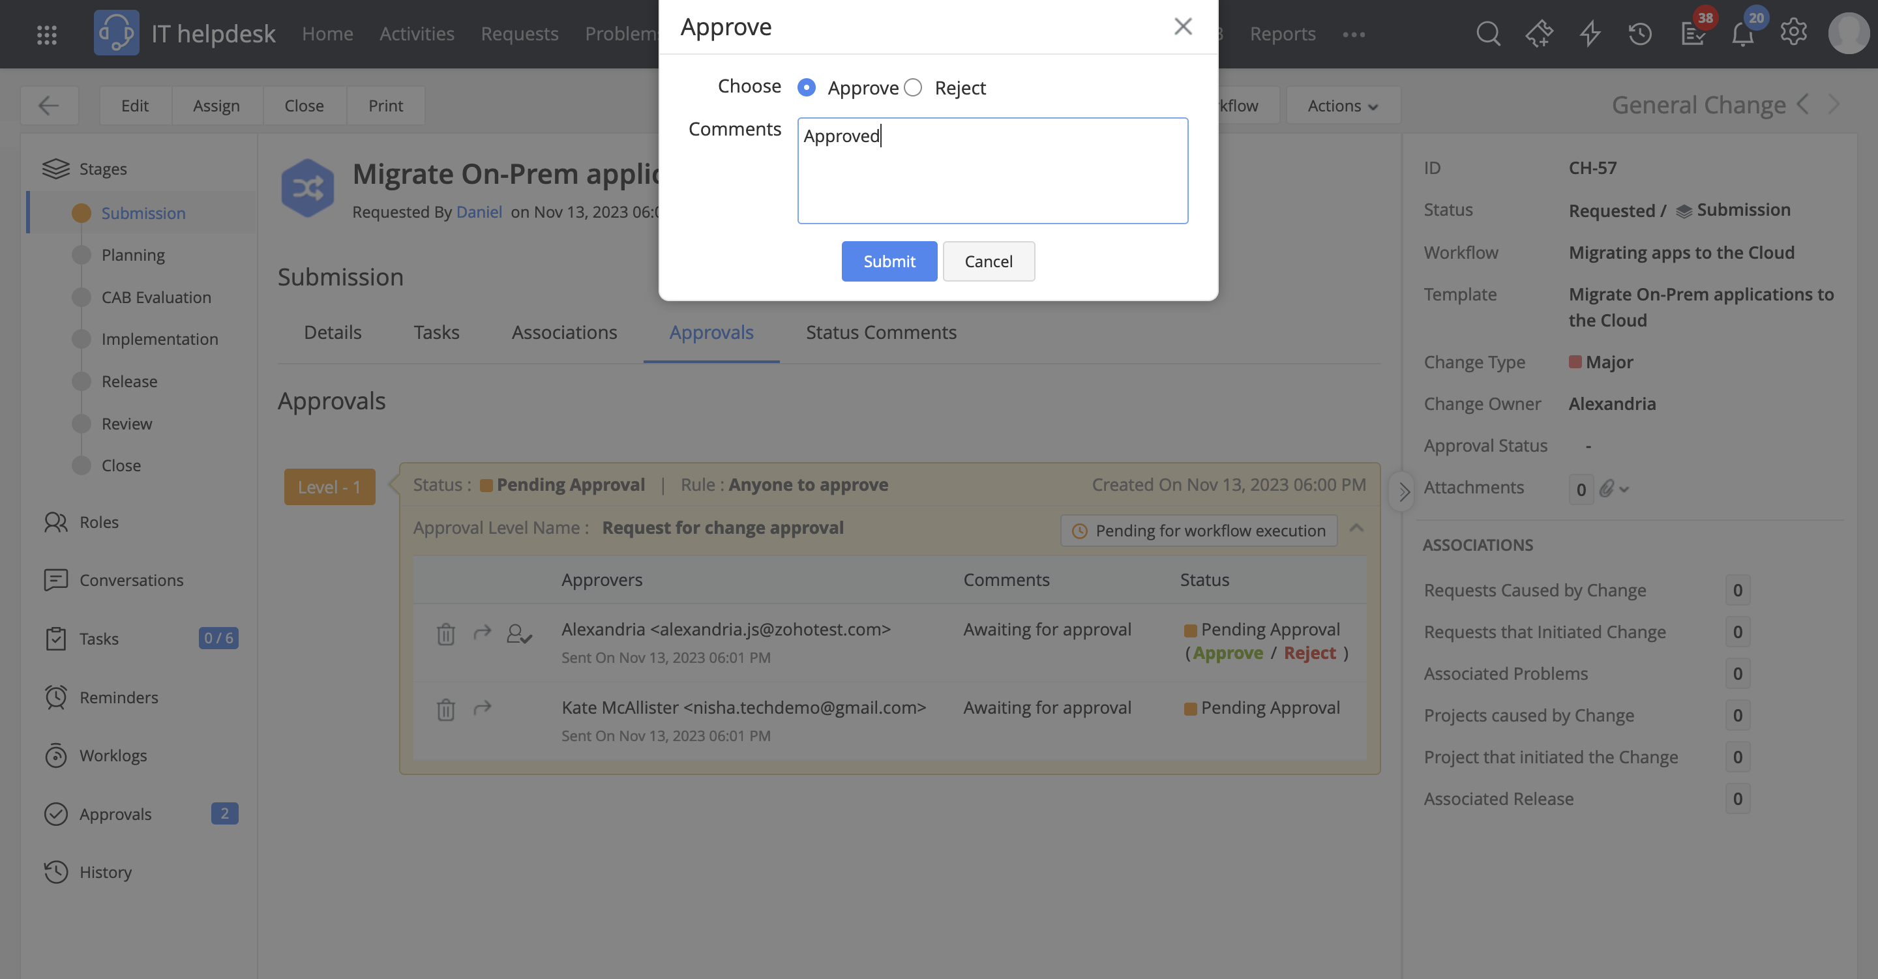
The change manager reviews the RFC and approves it

Slide 11
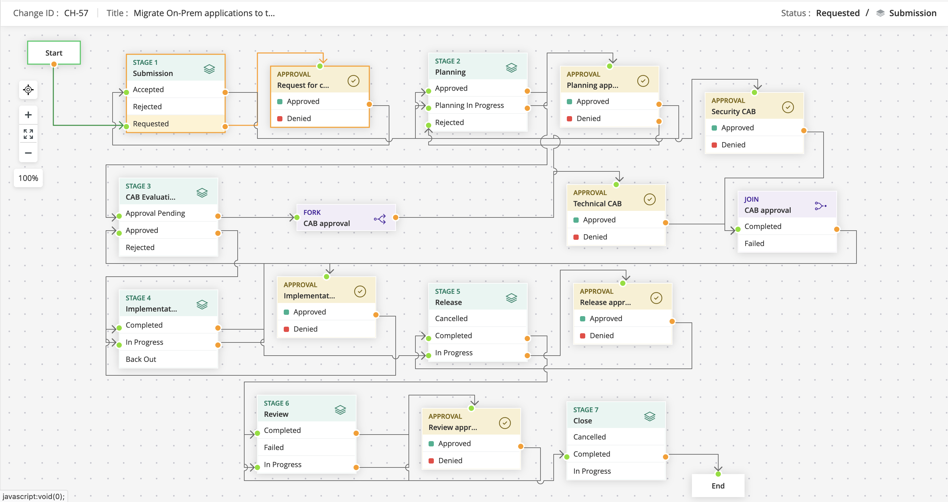
The change gets assigned a relevant workflow that it follows throughout its lifecycle

Slide 12
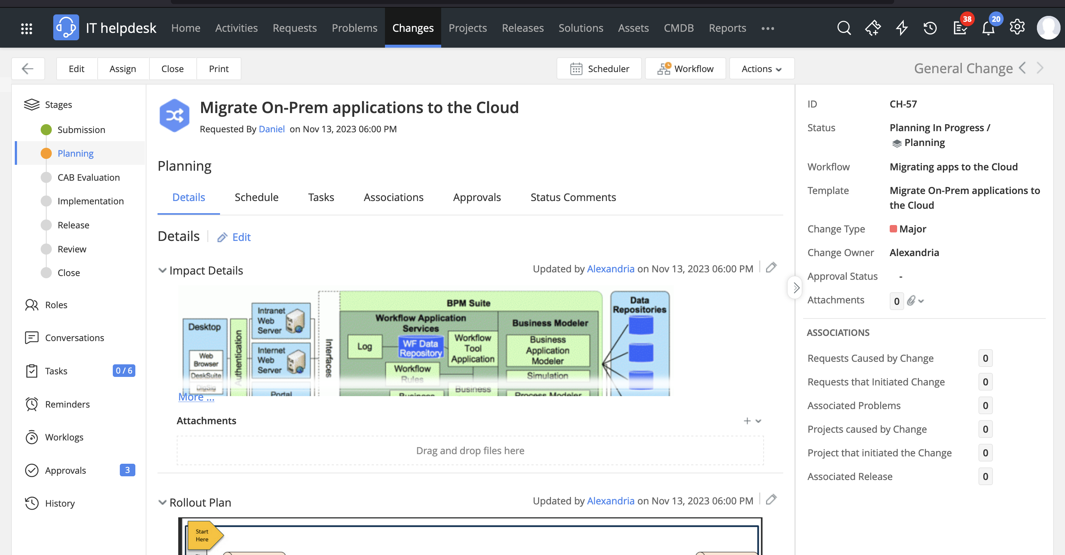
Once the RFC is approved, the change owner records the impact details, rollout plans, back-out plans and checklists

Slide 13
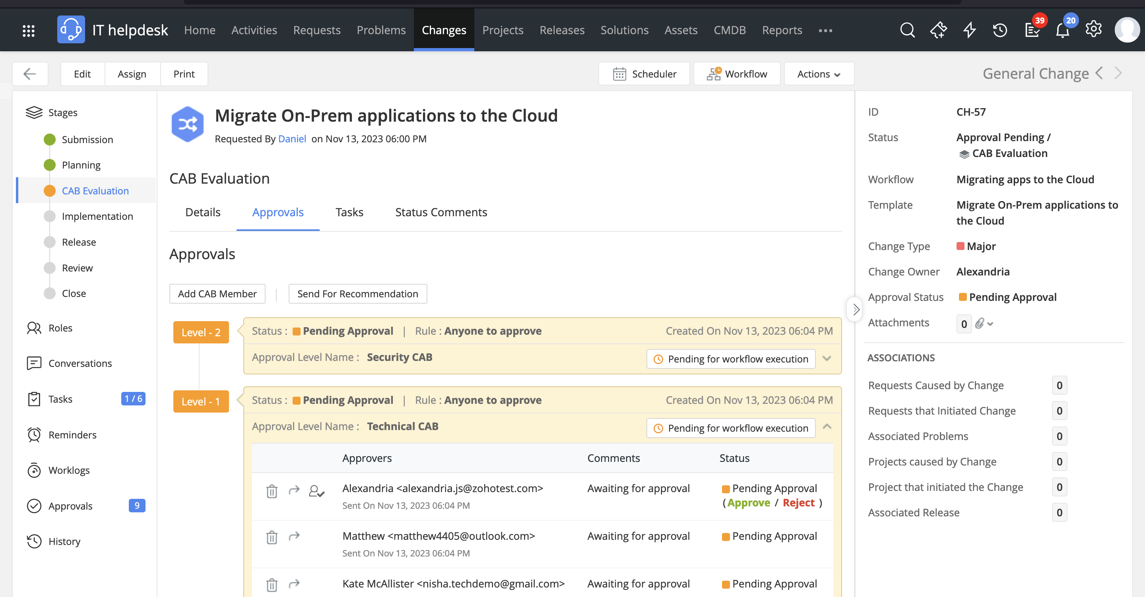
After the plans are drafted, the change is submitted to the appropriate CABs for approval

Slide 14
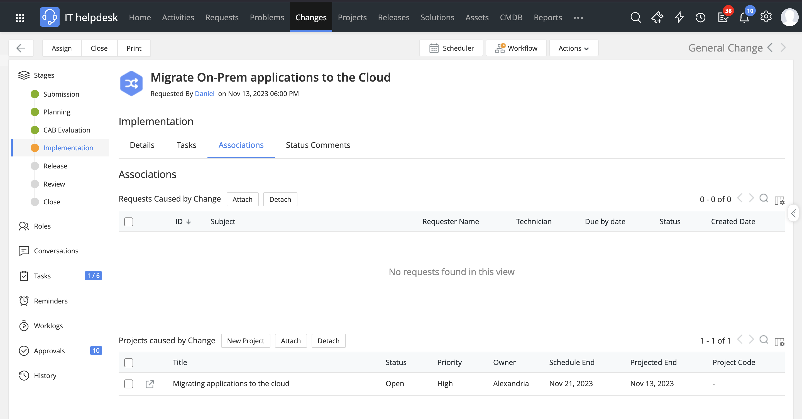
Since this is a large-scale change, a project is associated to handle its broader scope of implementation and manage a higher number of tasks and milestones

Slide 15
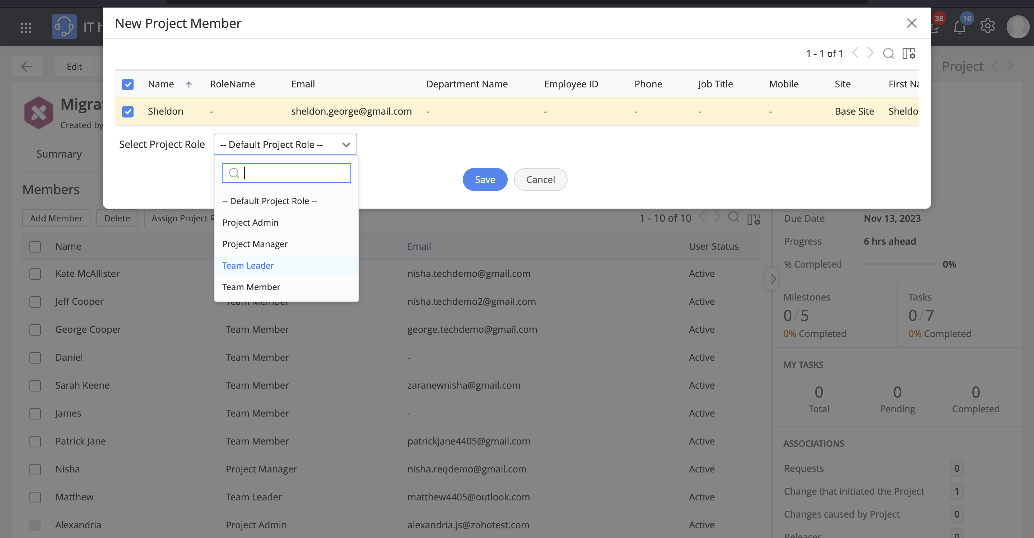
The implementation team is created for the project

Slide 16
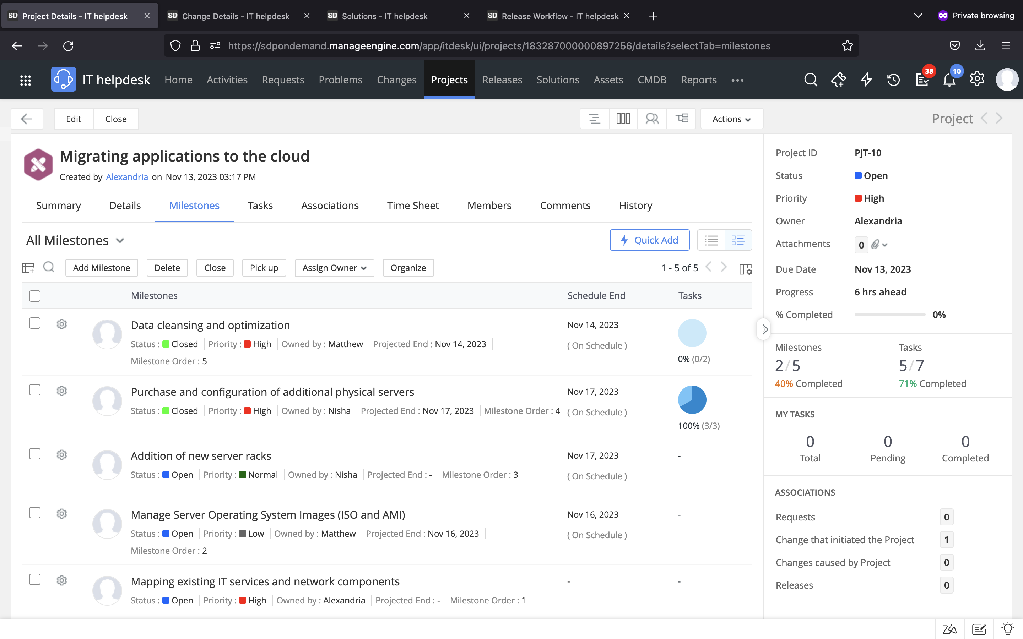
The work is divided into milestones and tasks and delegated to the project members

Slide 17
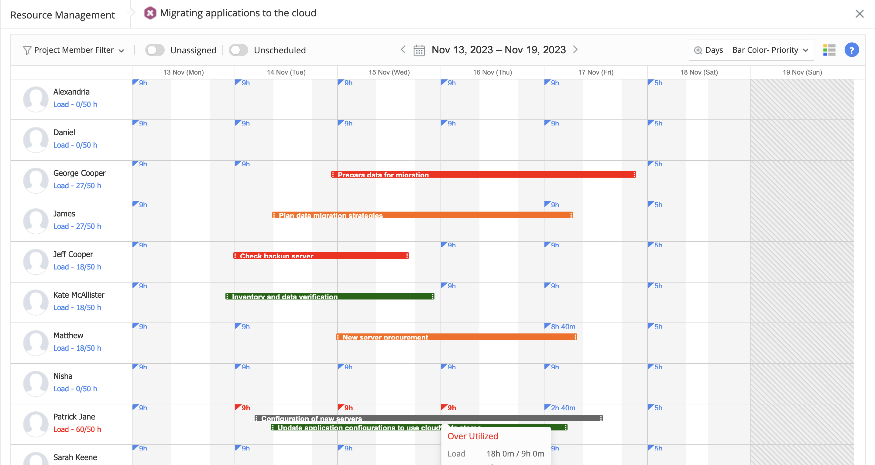
Resource Management is utilized to plan, manage, check resource availability, and assign tasks to technicians

Slide 18
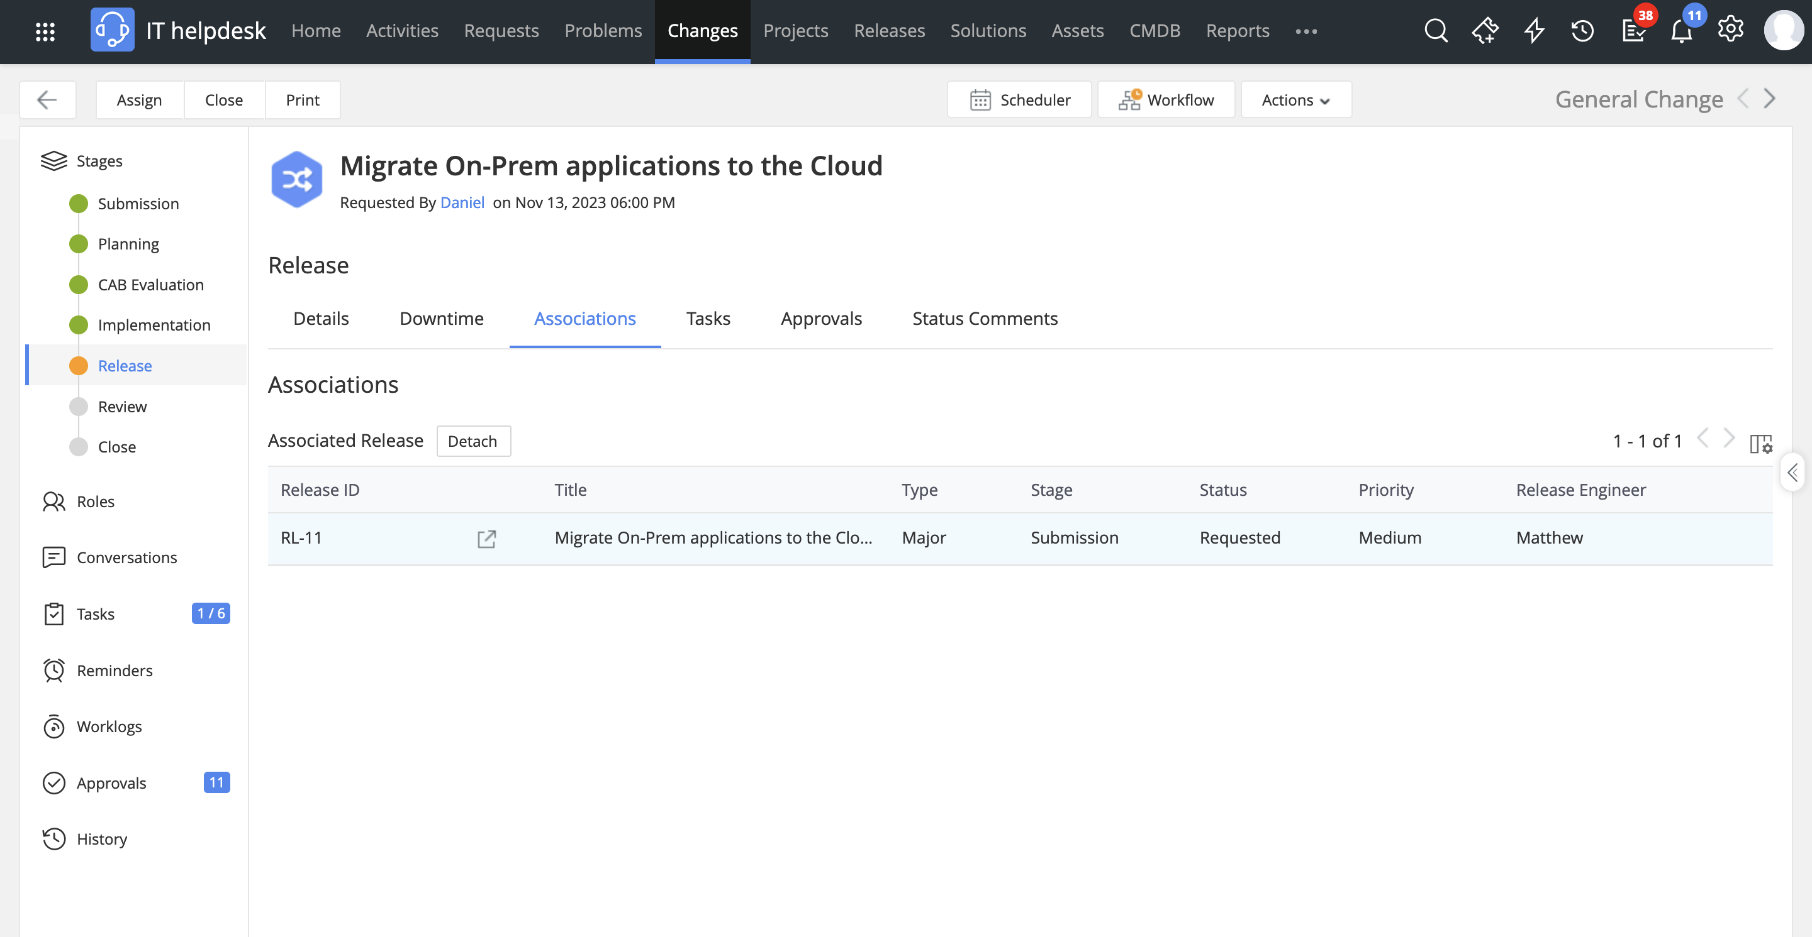
On project completion, to rollout the migration effectively to the production environment, a release is associated to the change

Slide 19
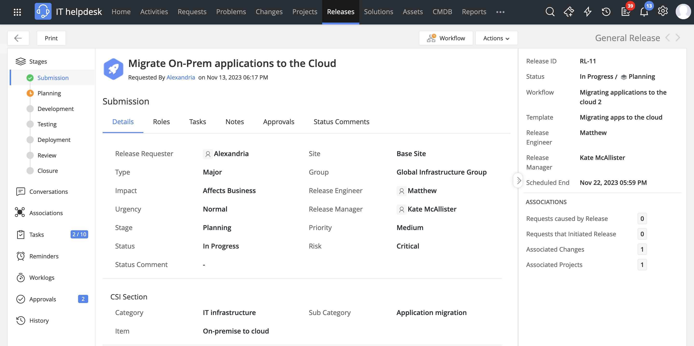
The release ticket pulls in the relevant data from the associated change

Slide 20
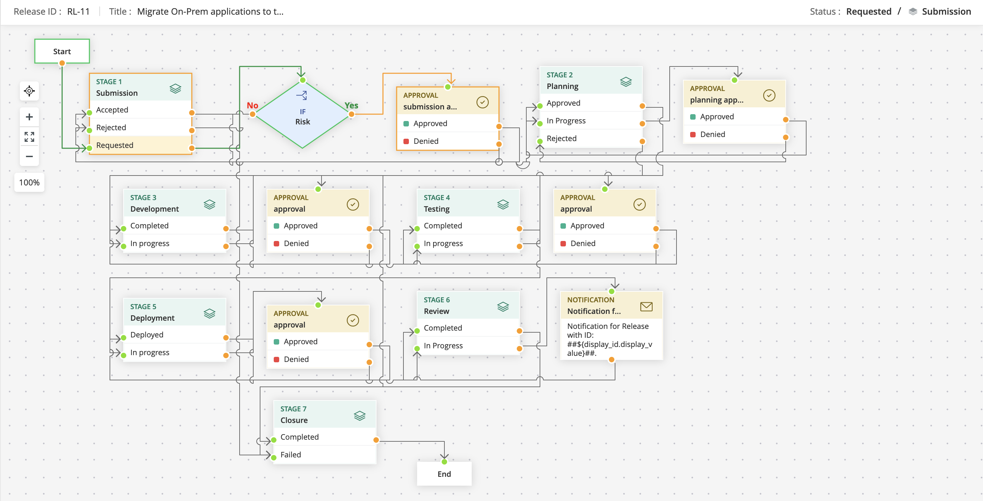
The release is assigned a workflow

Slide 21
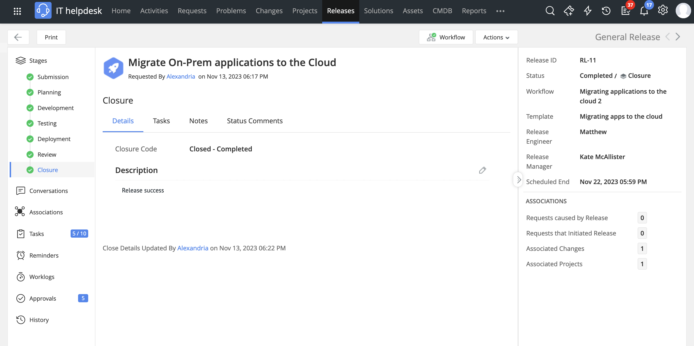
Once the release is deployed, the release coordinator associates a closure code for the release

Slide 22
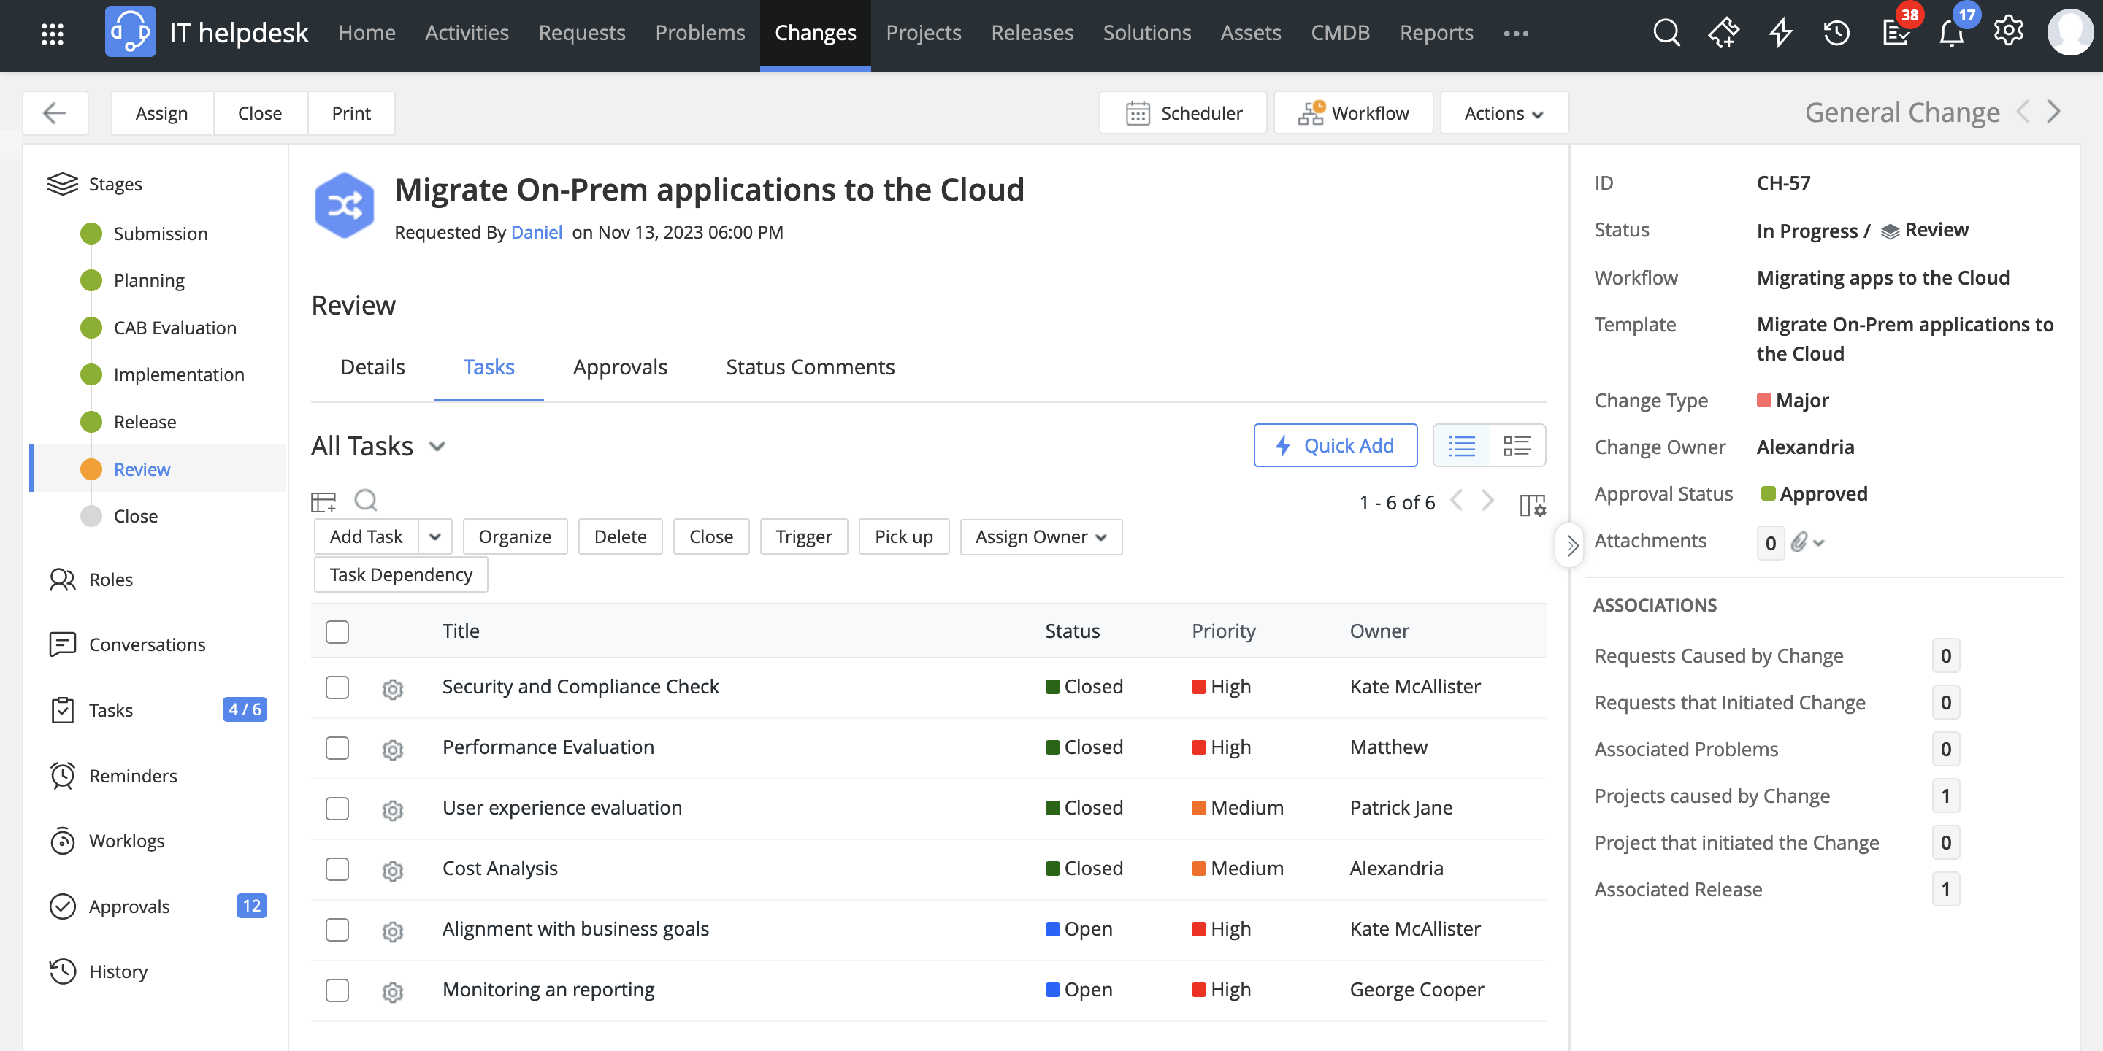
The change review committee assesses the implemented change and the processes involved in each stage

Slide 23
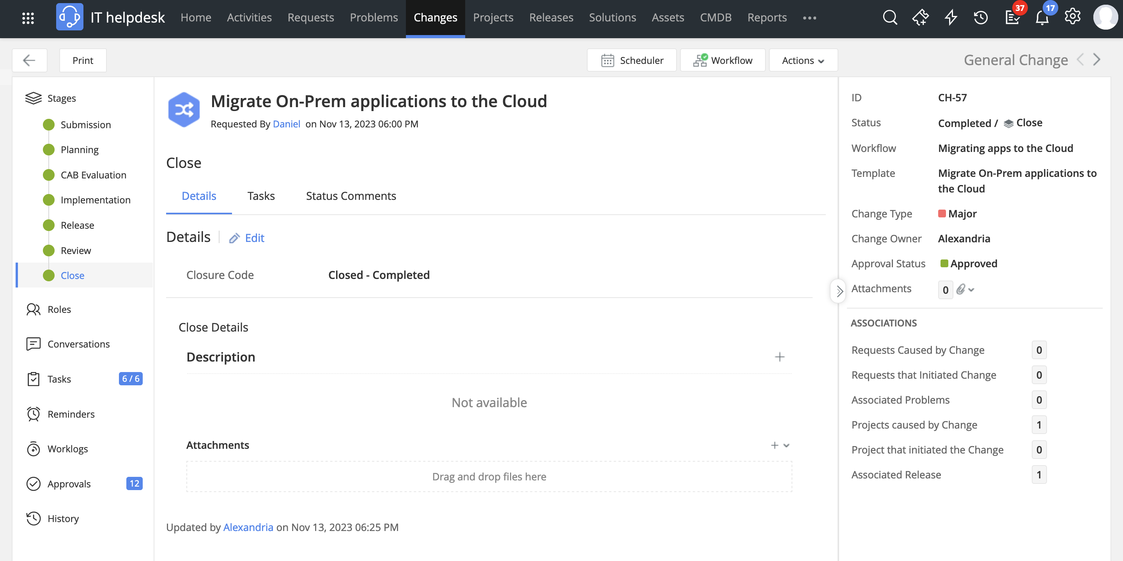
Upon completing the review, the change is closed

Slide 24


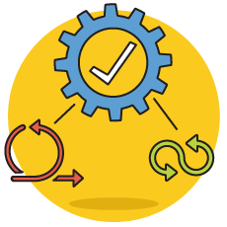
A scalable change management solution that works your way
As a flexible platform, ServiceDesk Plus helps you chart organizational changes the way you want
By associating releases and projects to change management, you can retain high-level oversight of complex development efforts
The full-fledged project management module helps enterprises adopt agile or DevOps frameworks

Slide 25


