Slide 1


Manage inventory, optimize costs,
and minimize risks with ServiceDesk Plus
IT asset management (ITAM)

Slide 2

A foundational challenge and the hybrid workplace
With this greatest shift in working practices, IT asset managers now have to deal with:
Shifting asset boundaries
A need to optimize budgets and ace vendor audits
Major incidents that impact the backbone of their IT infrastructure
But treading around these potholes with a legacy asset management tool and spreadsheets may be quite difficult.
Managing a corporate IT landscape was challenging for enterprises of all sizes, even before the pandemic.

Slide 3

How do you create an ITAM strategy that scales with a hybrid IT estate?

Slide 4



ITAM lessons from a data analytics firm
Managing an IT landscape consisting of remote and on-premises assets
Mitigating risks during IT software audits and ensuring compliance
Gaining a comprehensive overview of the IT infrastructure to thwart major incidents

Slide 5

Build and manage an IT asset inventory for a hybrid future

Slide 6

The remote work model: Scattered assets
The data analytics firm pivoted to remote work, enabling its core workforce of about 400 to work from home. It was also on the cusp of a business expansion, with plans to double its workforce
While the move was welcomed by most of the workforce, it struck a different chord with one department:
    A weary IT team facing the prospect of managing a hybrid inventory with legacy tools and spreadsheets

Slide 7



The ITAM blind spots
Ineffective legacy tools that make it difficult to discover and manage IT assets in one place
An inability to track IT workstations provisioned to remote employees
A depleted asset inventory, leading to delayed onboarding for new employees

Slide 8
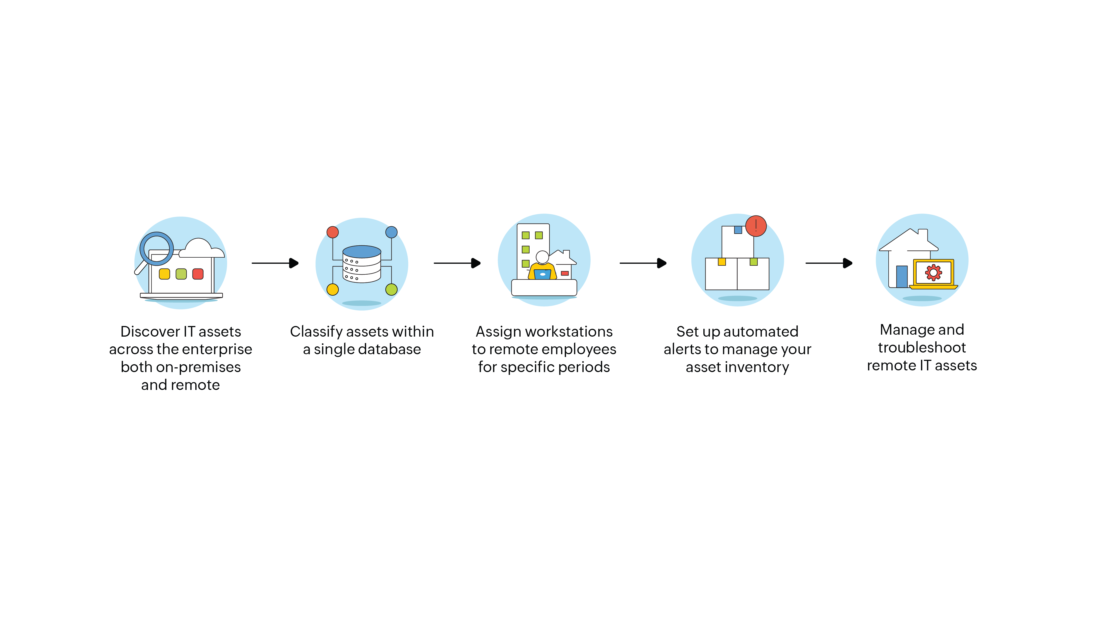
Modeling an ITAM framework that follows best practices

Slide 9

Implementing an ITAM toolchain with ServiceDesk Plus

Slide 10
The ServiceDesk Plus framework for hybrid ITAM
Asset classification
Asset groups
Automatically assign assets based on login info
Asset relationships
Asset loan
Asset replenishment
Financials and contracts
Remote access plus
A unified agent for asset discovery
Barcode scan
Distributed asset scan
Probe scan

Slide 11
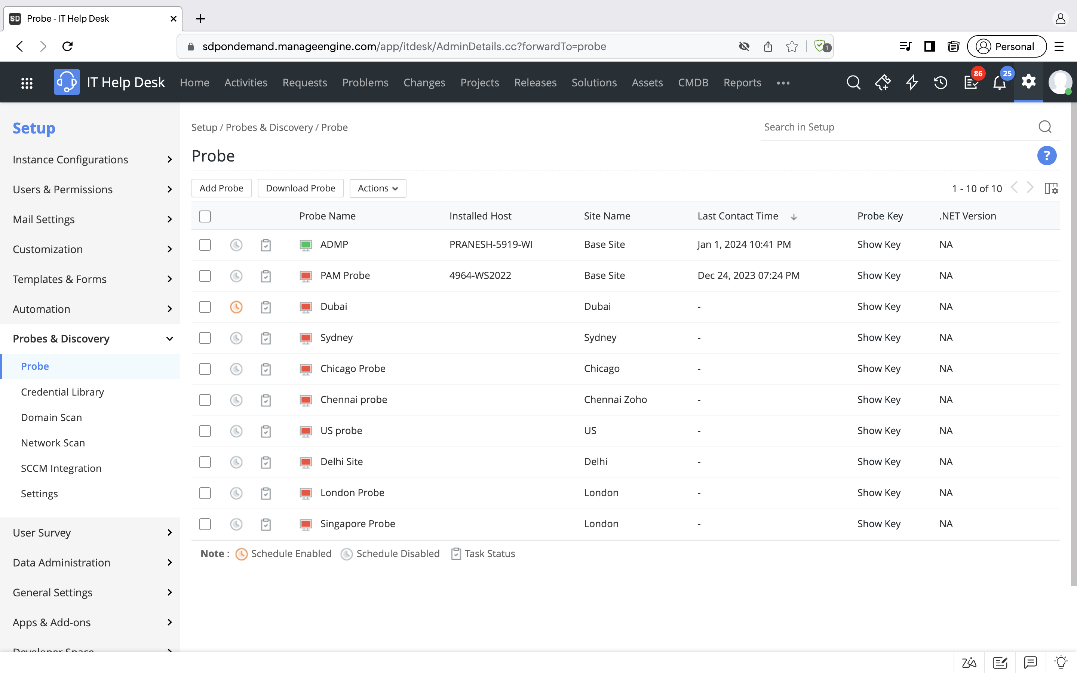
Leverage multi-modal discovery techniques for effective asset discovery and tracking

Slide 12
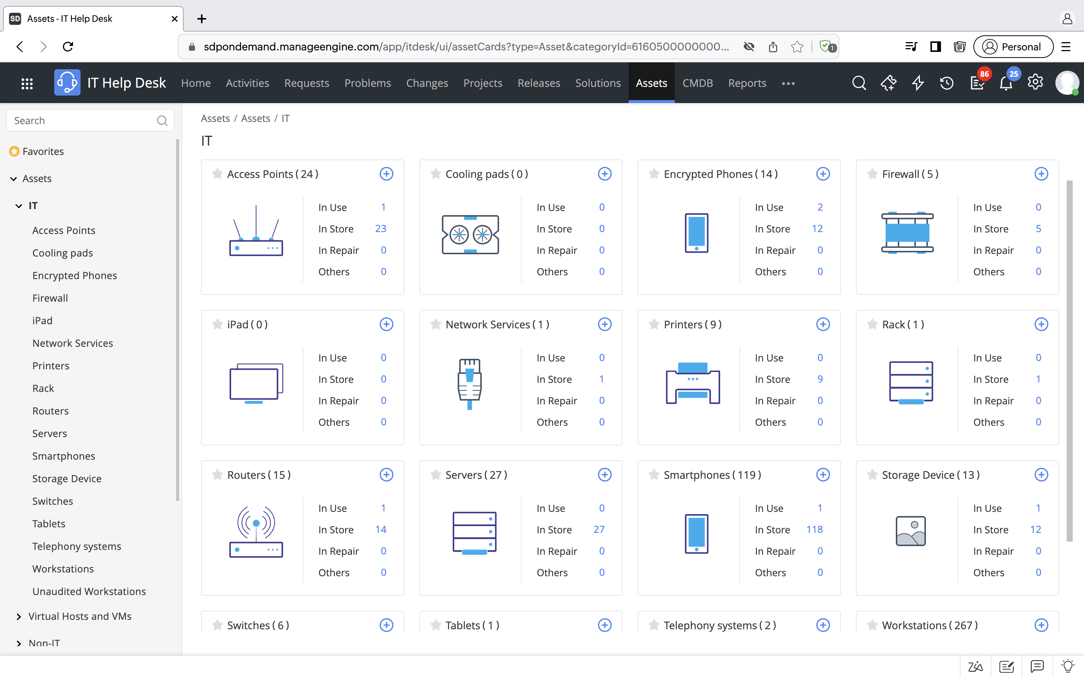
Gain complete visibility into your IT asset estate by having a unified repository of assets

Slide 13
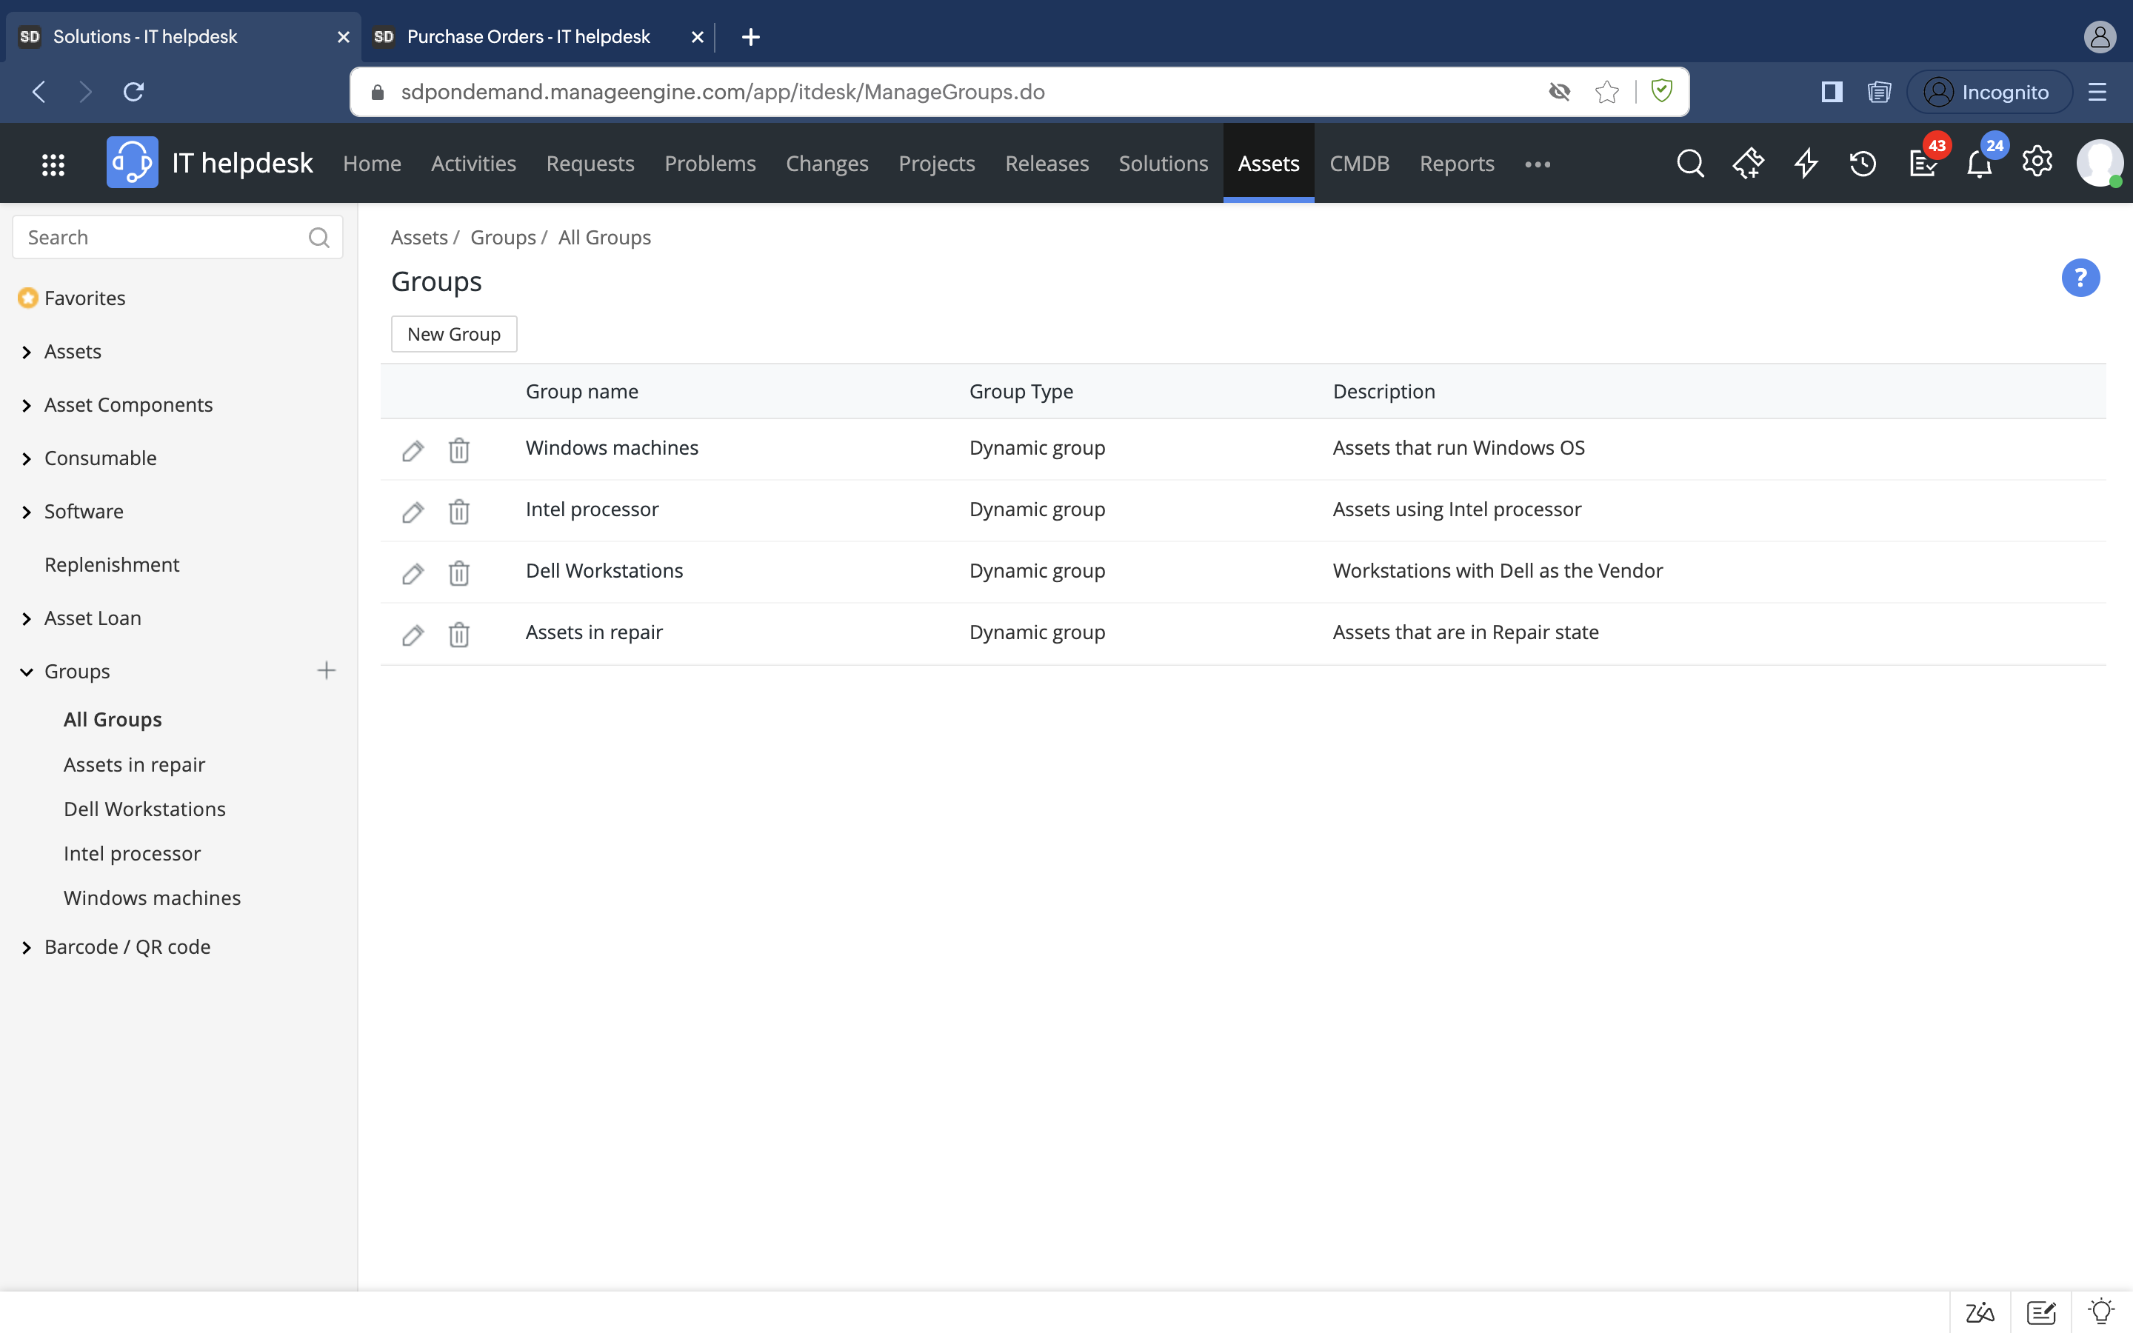
Create groups and classify assets across product types, OS, departments, asset state, vendors, and more

Slide 14
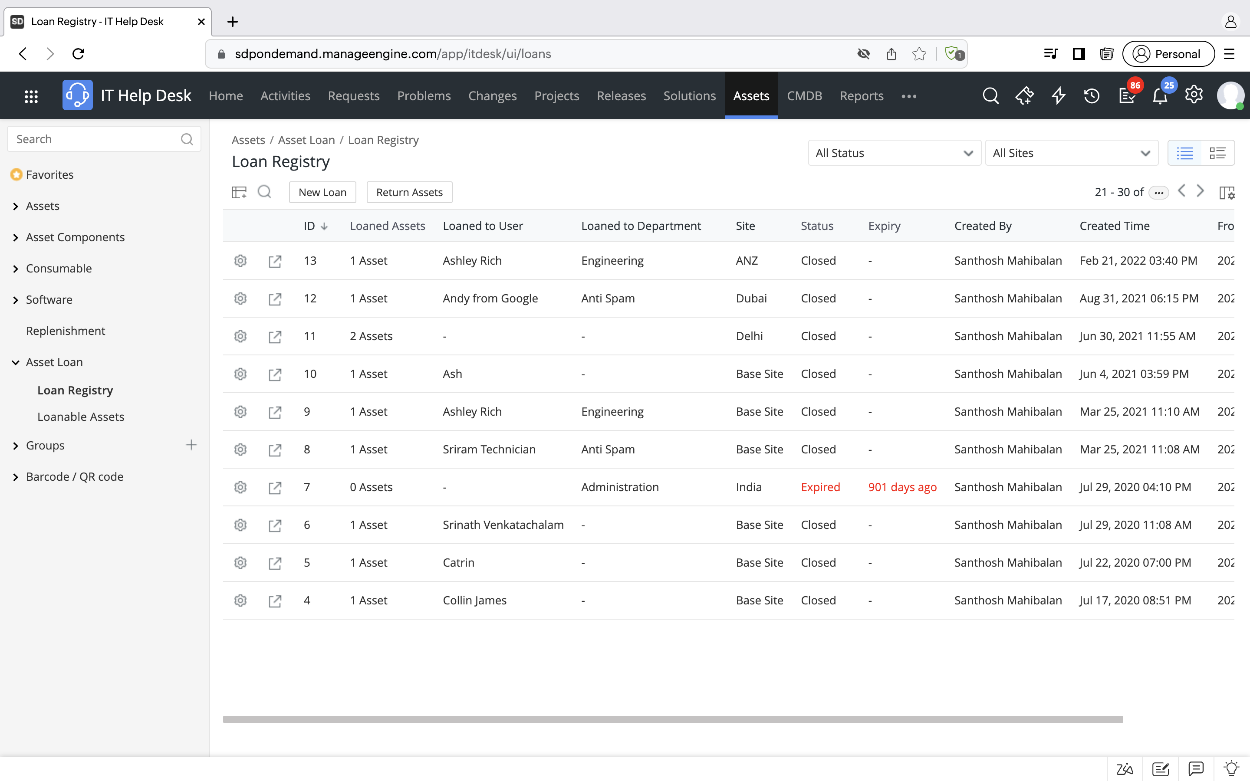
Easily provide temporary assets and track all loaned assets

Slide 15
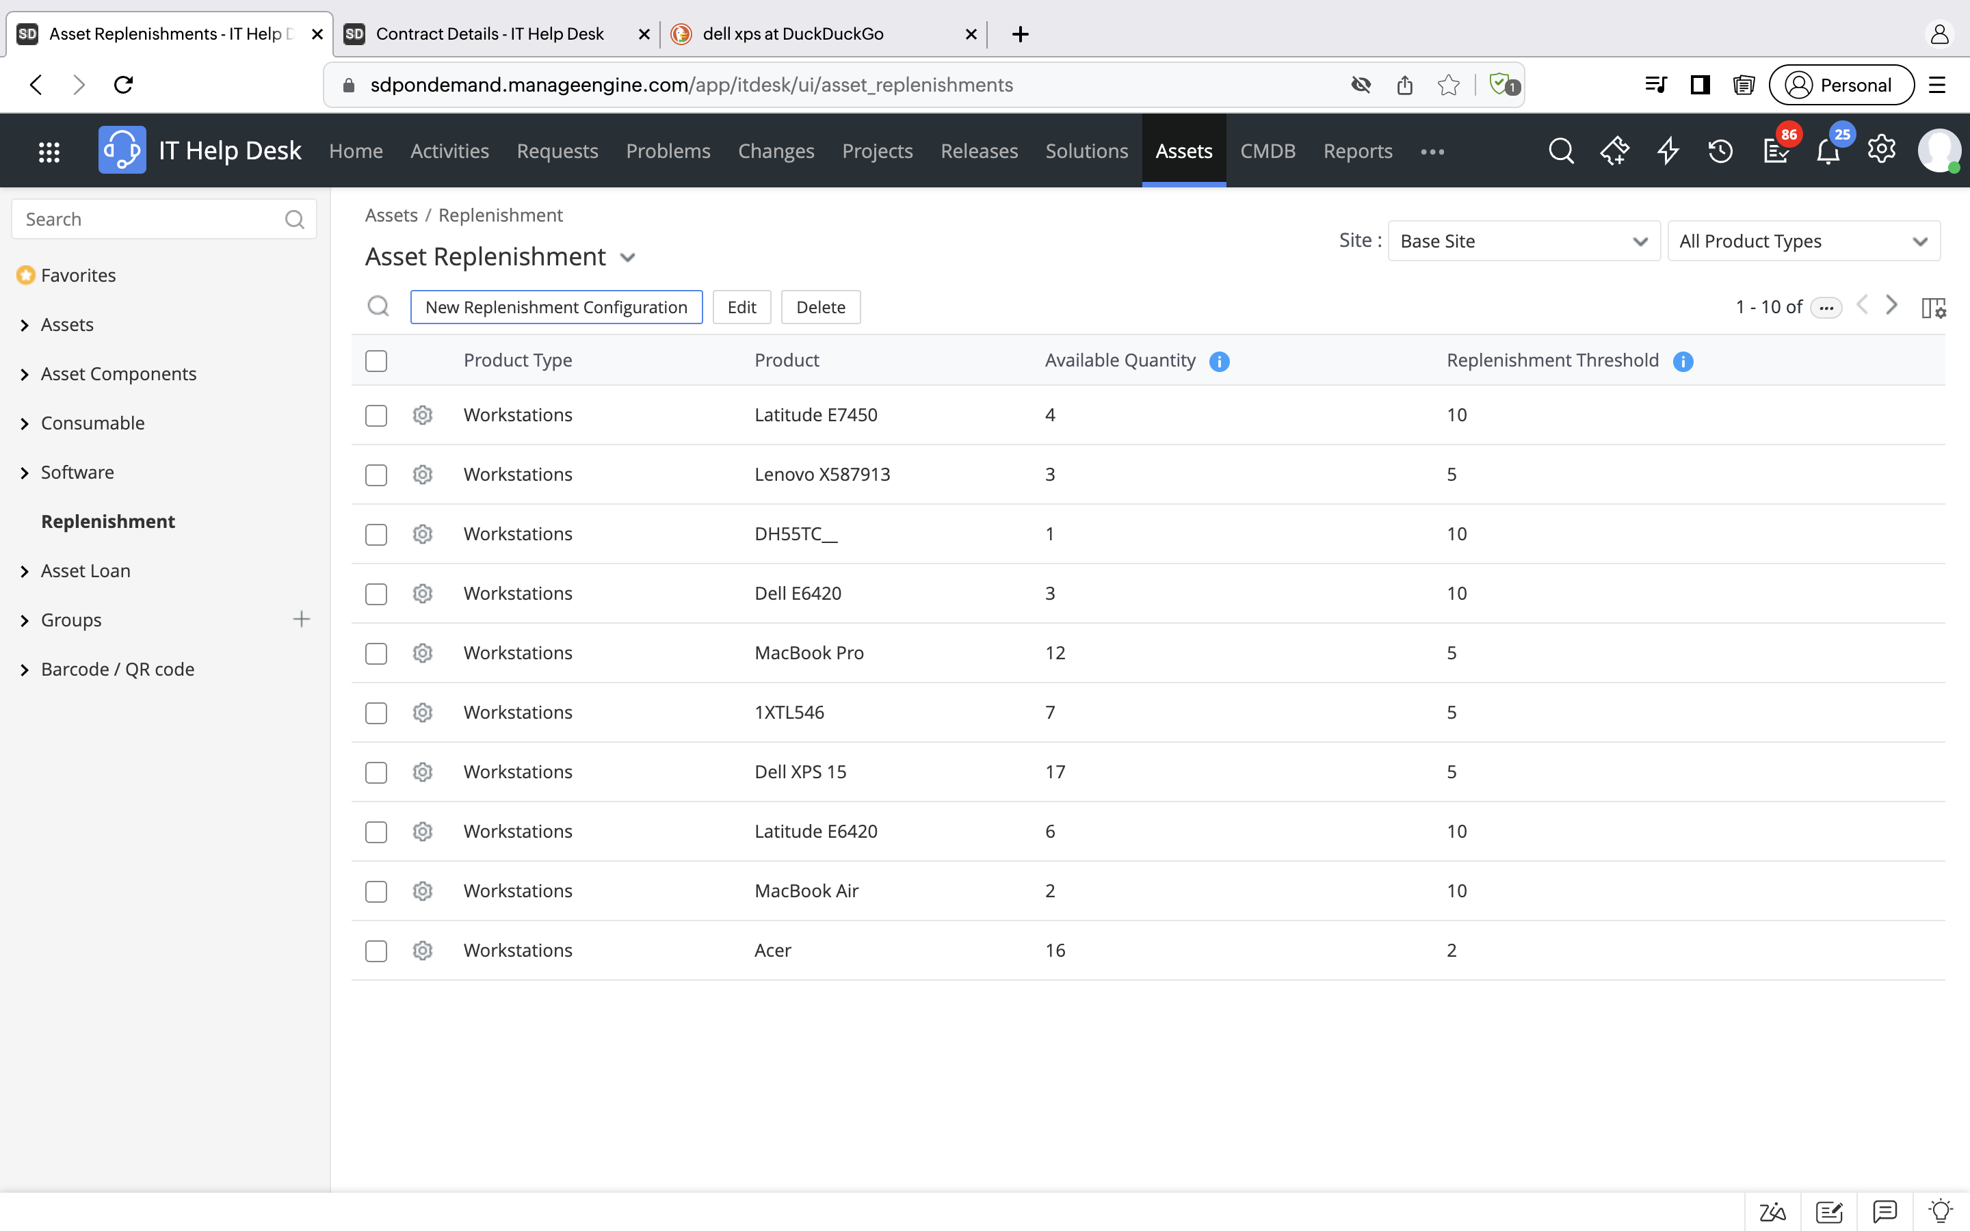
Track asset inventory in store and notify technicians on the expected asset inventory exhaustion

Slide 16
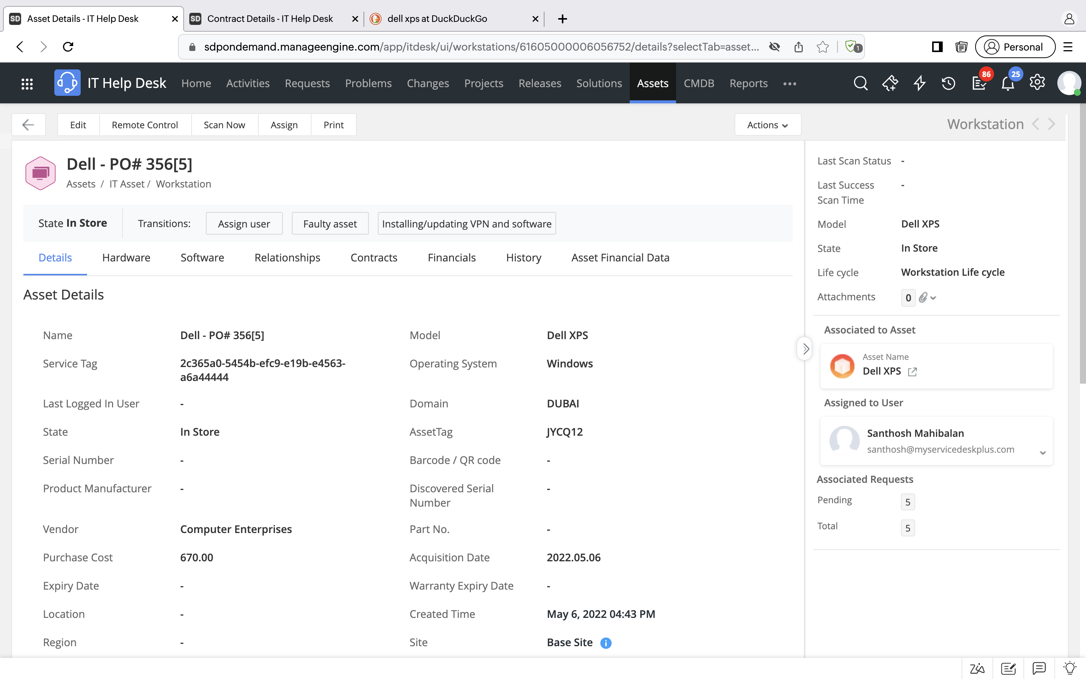
Drill down into asset details on all of your assets at any given time

Slide 17
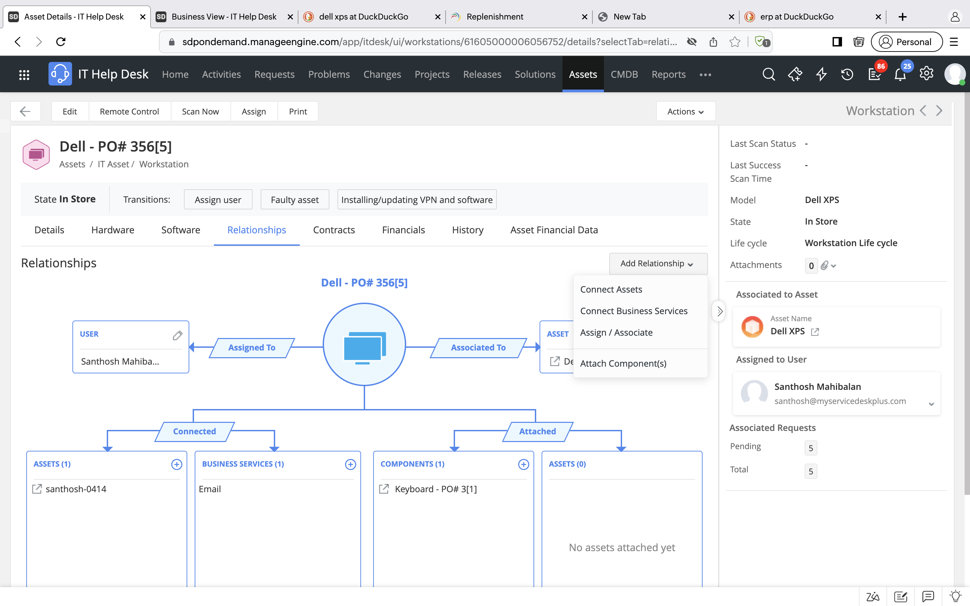
Track asset relationships and gain visibility into how your assets are webbed with one another

Slide 18
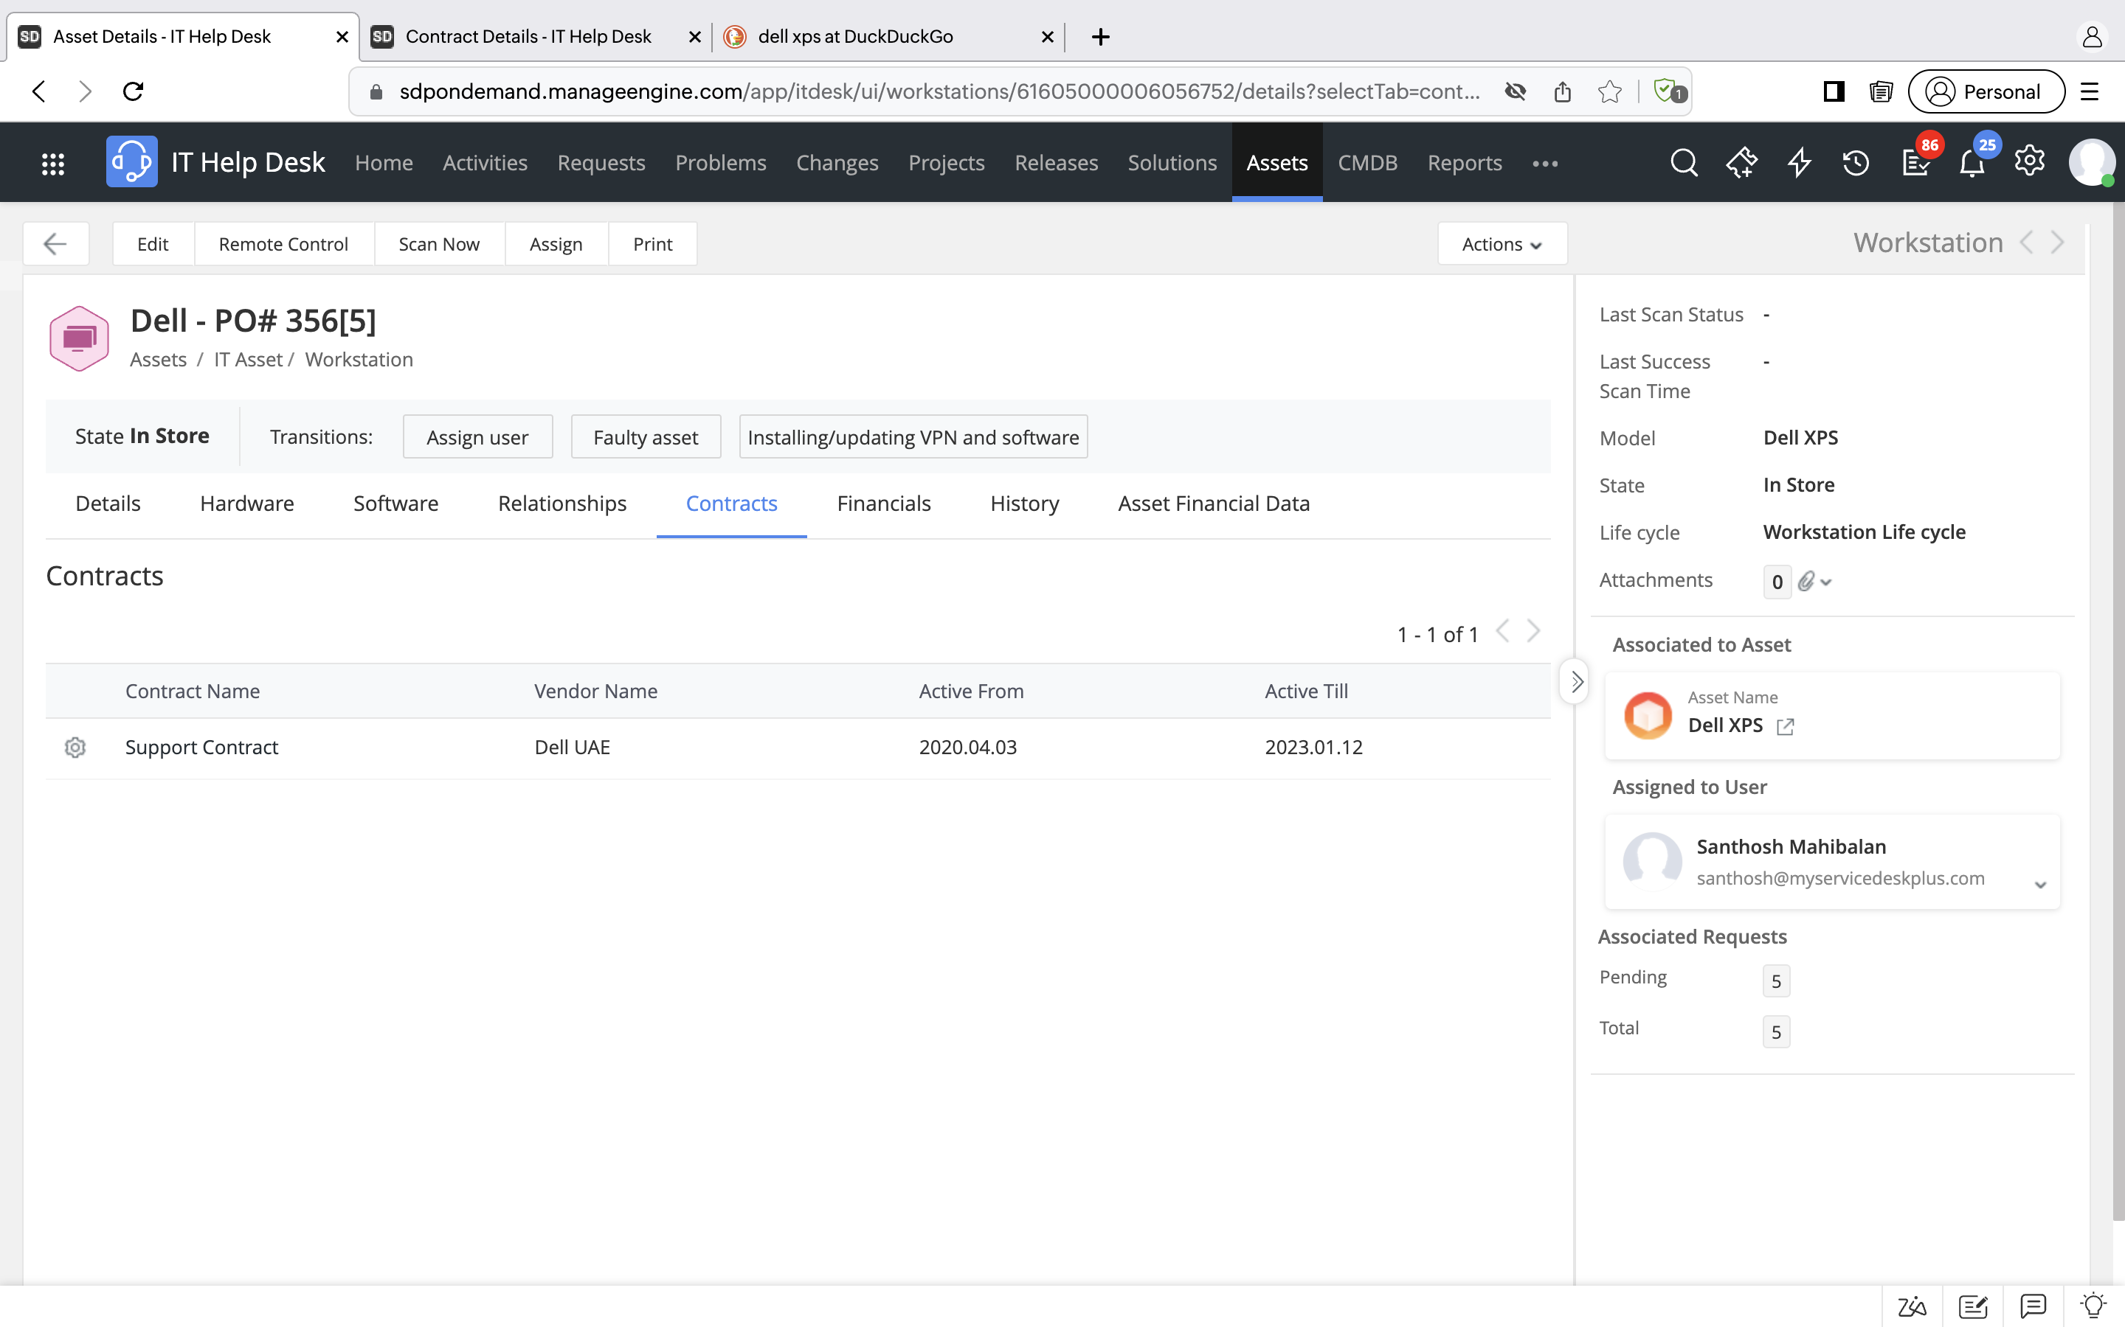
Associate corresponding contracts and and get notified about their expiry in advance

Slide 19
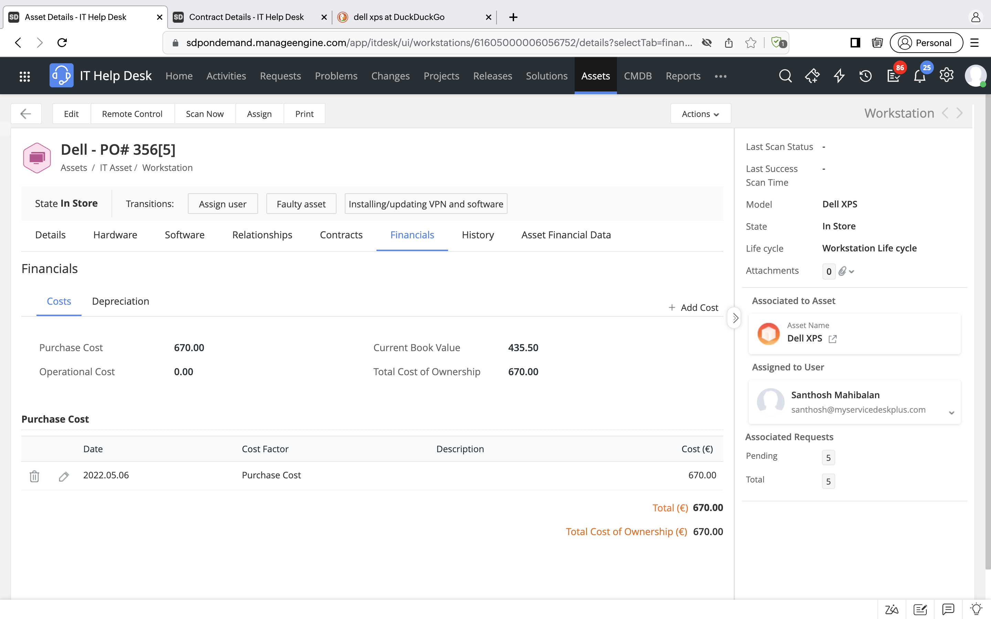
Record and track asset financials to optimize costs and plan procurement

Slide 20
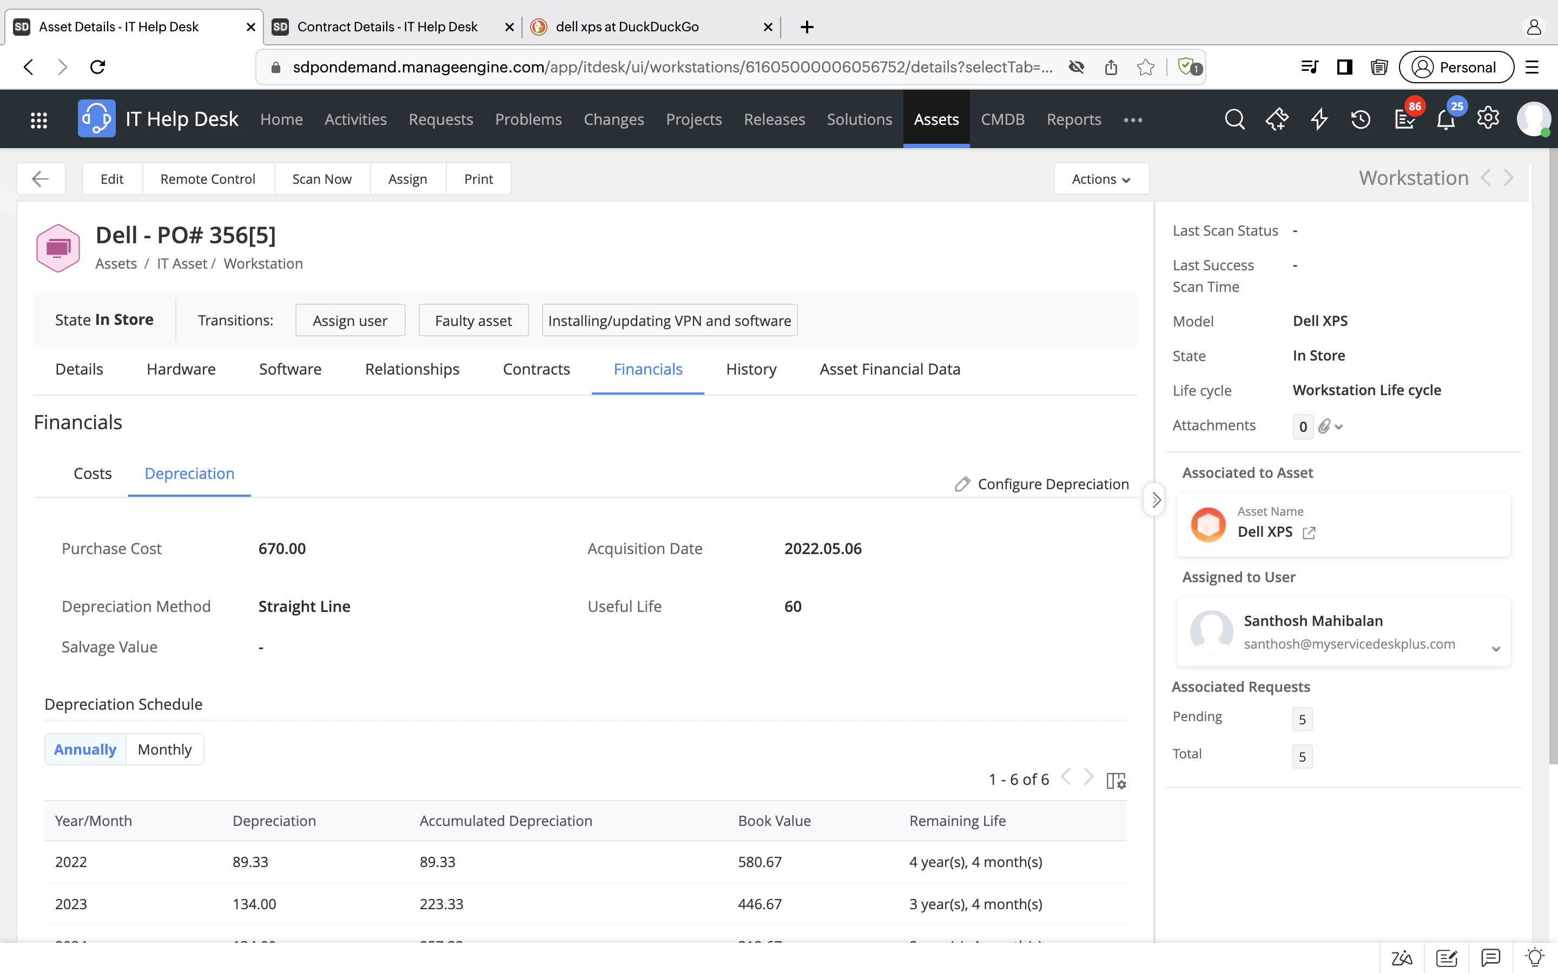
Evaluate the wear and tear of your assets by calculating their depreciation value and tracking their depreciation schedule

Slide 21




A relaxed IT asset manager, courtesy of ServiceDesk Plus!
A single frame of reference for both on-premises and remote assets ensures that IT teams don't waste time chasing missing assets
The unified agent for asset discovery helps IT teams leverage Desktop Central's ITAM capabilities, such as enhanced asset discovery, remote control, and system management
Asset loan and replenishment ensure that the asset inventory stays up-to-date and well-stocked to handle the projected future demand
Finally, the analytics firm has asset depreciation, contracts, and other financials at its fingertips, helping it optimize costs and plan procurement

Slide 22

Stay focused on the business without compliance and risk management worries

Slide 23

Landing in the audit's crosshairs
The data analytics firm relied on the database and analytics platform of one of the largest software vendors in the world
As the consulting firm embarked on new pharmaceutical research projects, it decided to expand its workforce and also acquire a smaller company engaged in healthcare consulting
Both of these events triggered a license audit from the database software vendor

Slide 24



The liabilities threatening the bottom line
Noncompliance with license agreements, which may result in the vendor imposing hefty penalties
Other underused software licenses, meaning the IT team misses the opportunity to rationalize IT budgets
Obscurity in software purchase and spending patterns

Slide 25
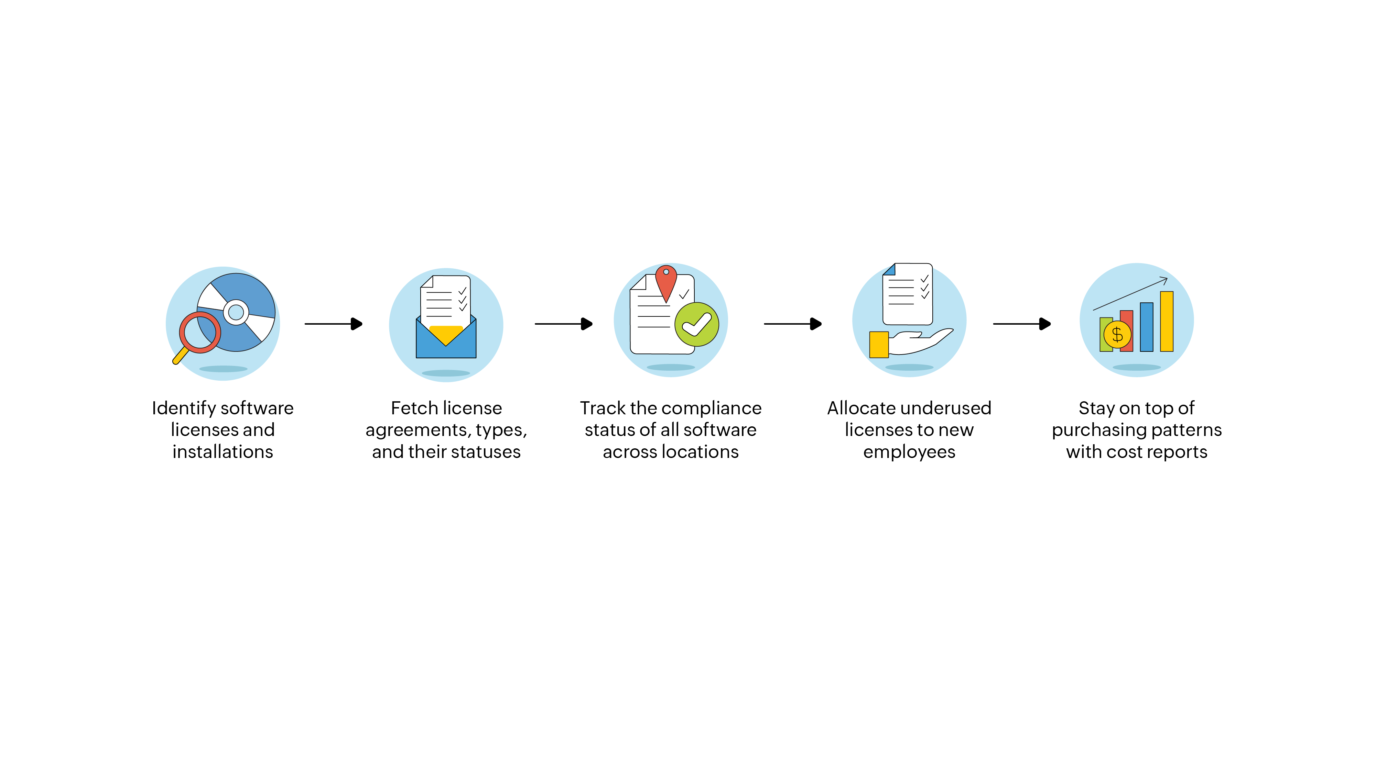
Devising a risk-free software asset and compliance management workflow

Slide 26

Digitize your software governance and risk management with ServiceDesk Plus

Slide 27
Acing audits the ServiceDesk Plus way
Asset scan
Software summaries, license agreements, and service packs
A compliance dashboard
License allocation, renewals, and expiration alerts
Software metering, reports, and dashboards

Slide 28

Demo

Slide 29
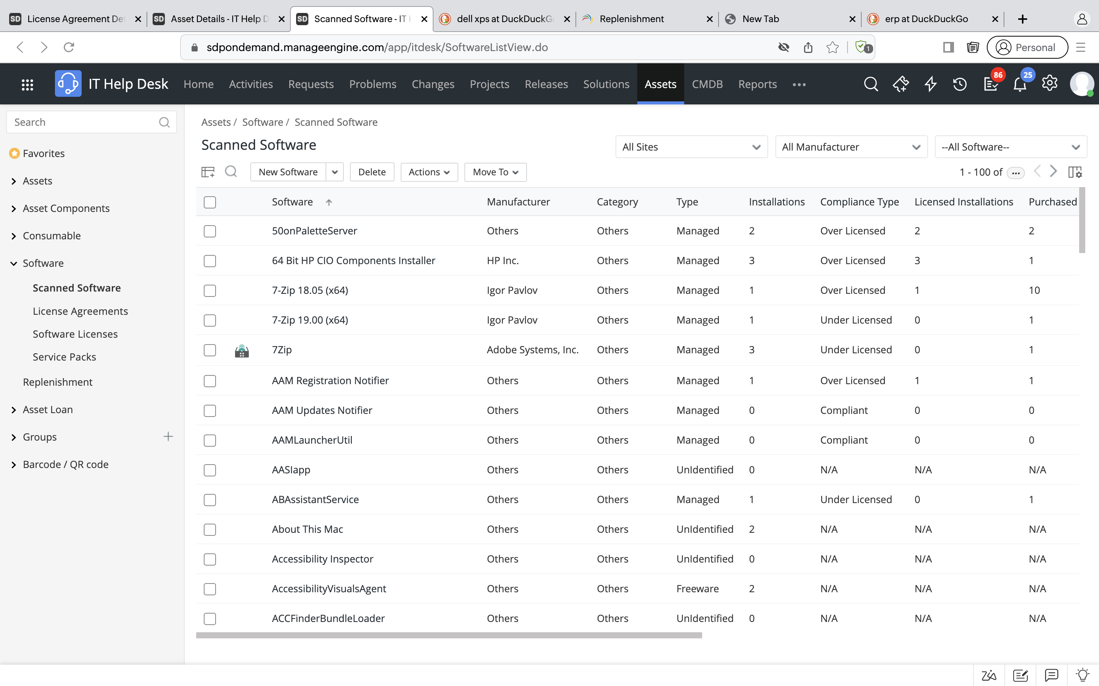
Gain complete visibility of your software estate by capturing crucial details like the license type, compliance type, number of purchases vs. installations, and more

Slide 30
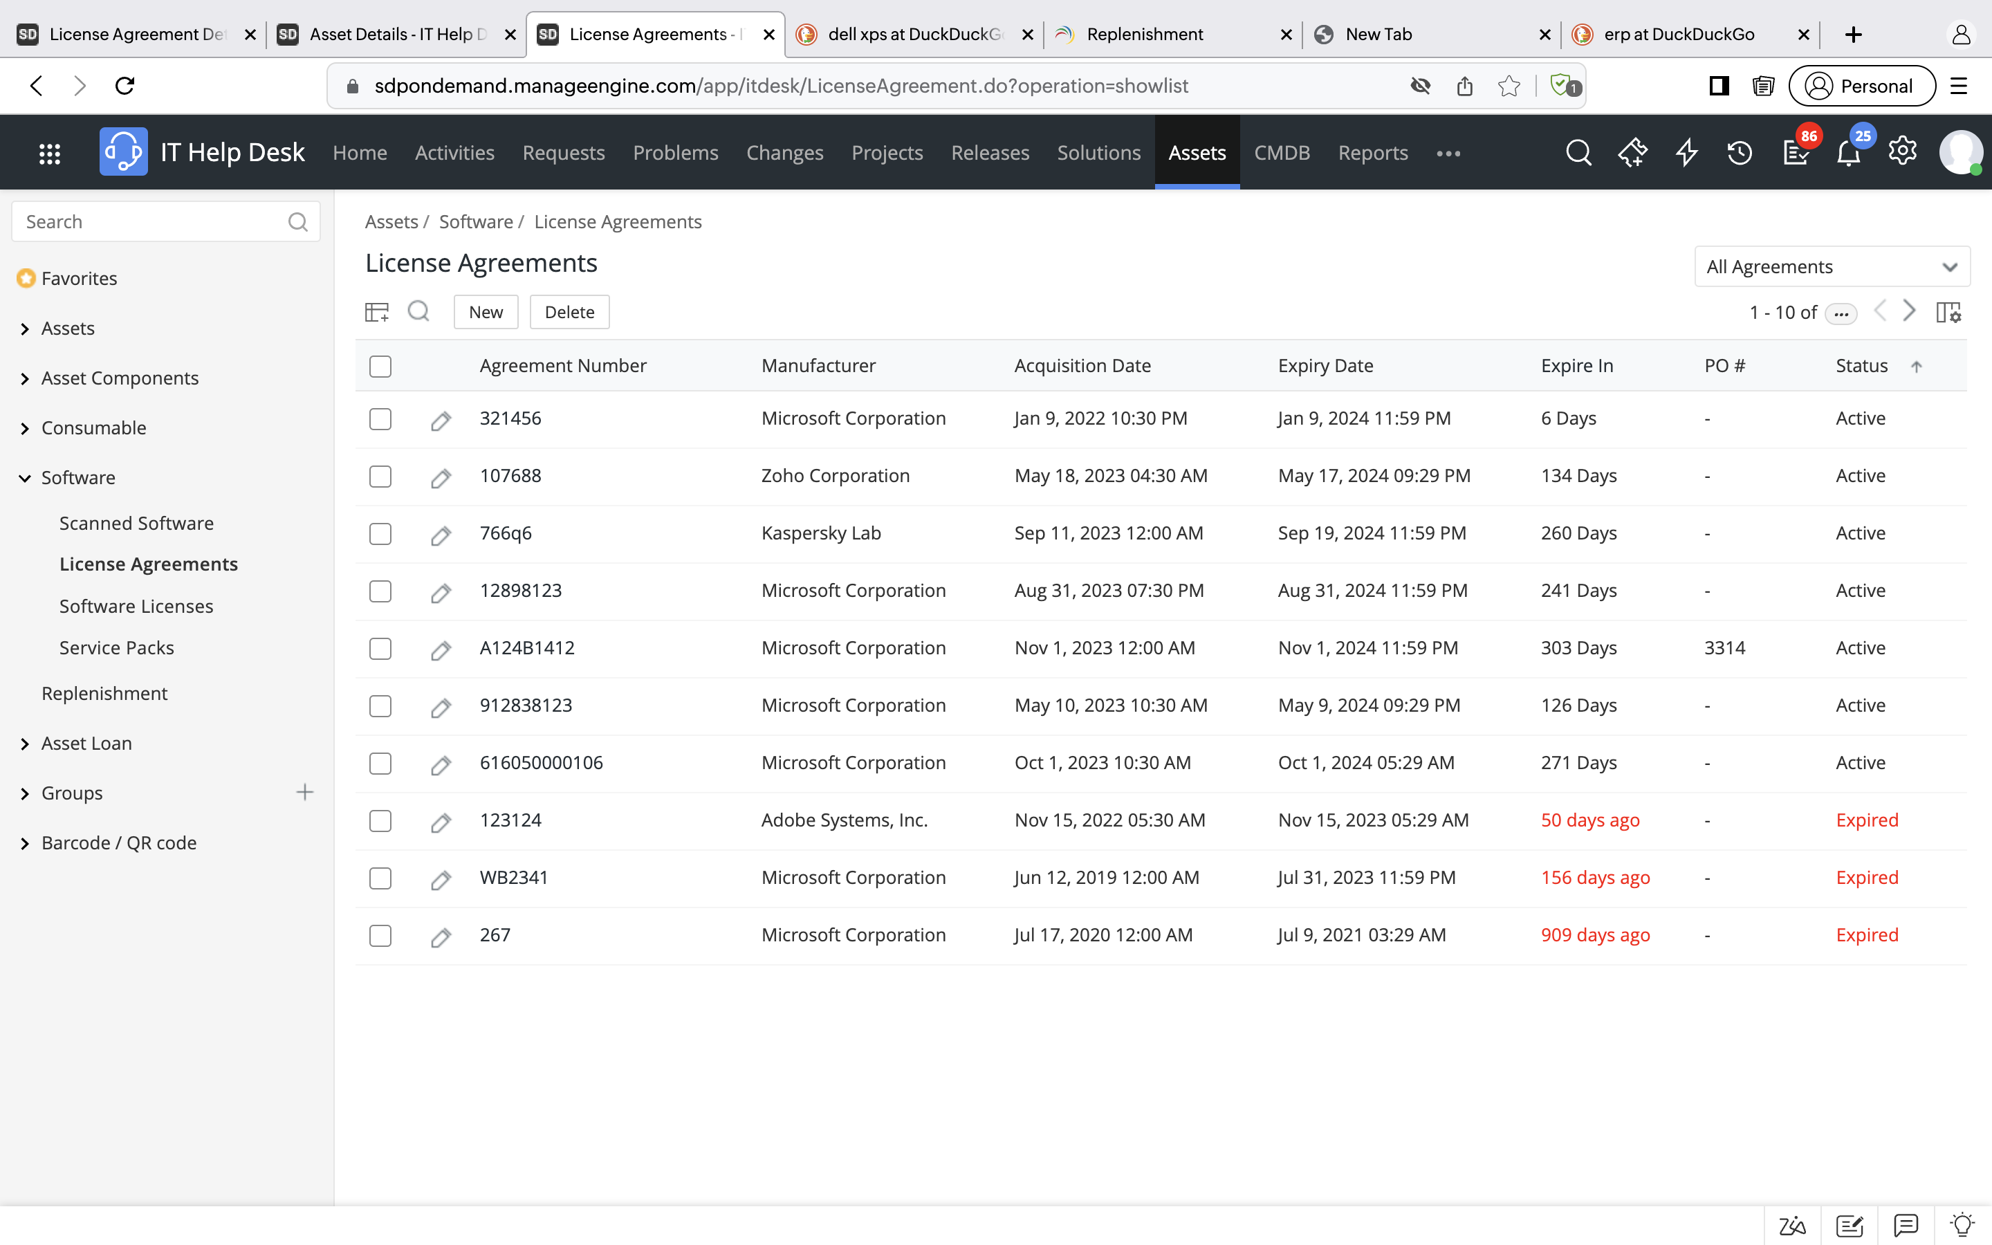
Create license agreements with various vendors and maintain them from a central console

Slide 31
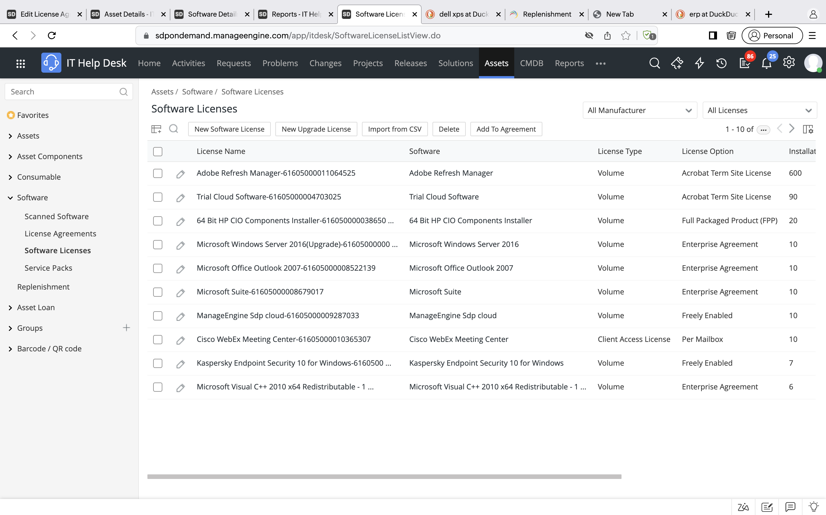
Have a single source of truth for your license portfolio by consolidating and managing all your software licenses from one place

Slide 32
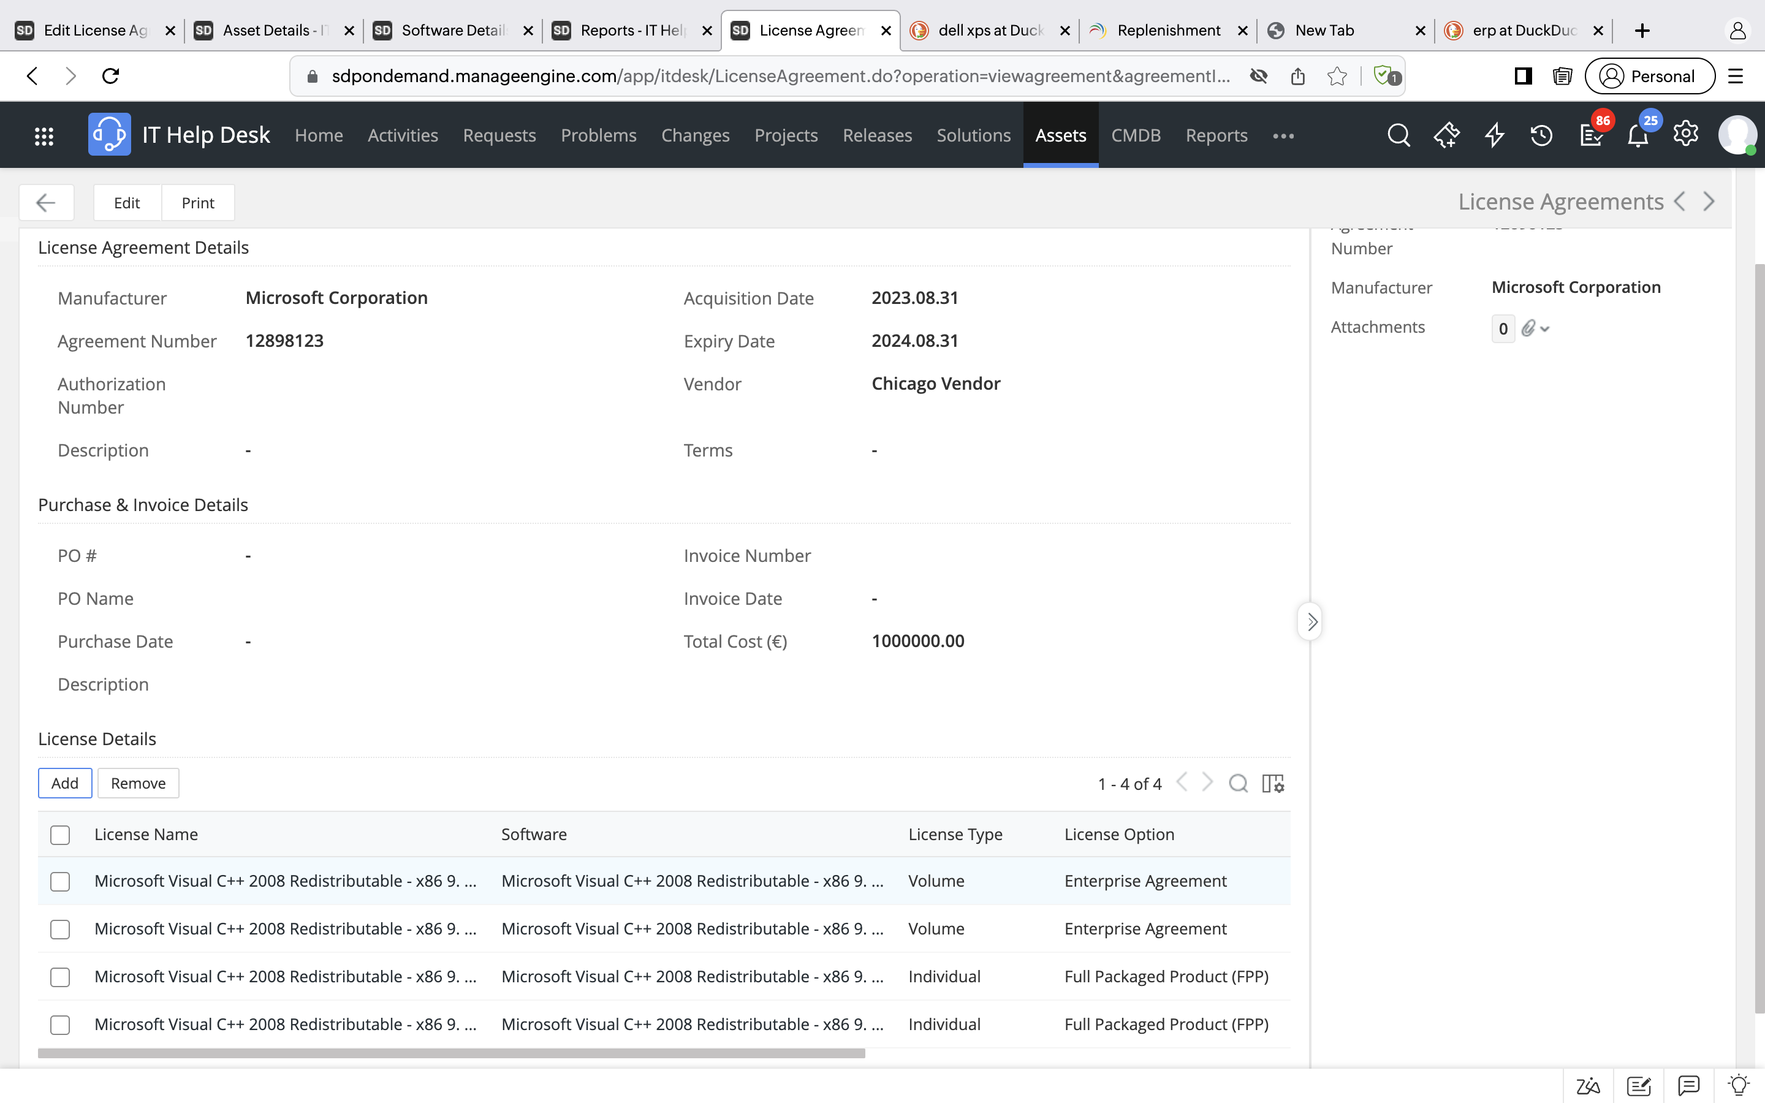
Use software only in accordance with licensing terms by associating license agreements to their corresponding licenses

Slide 33
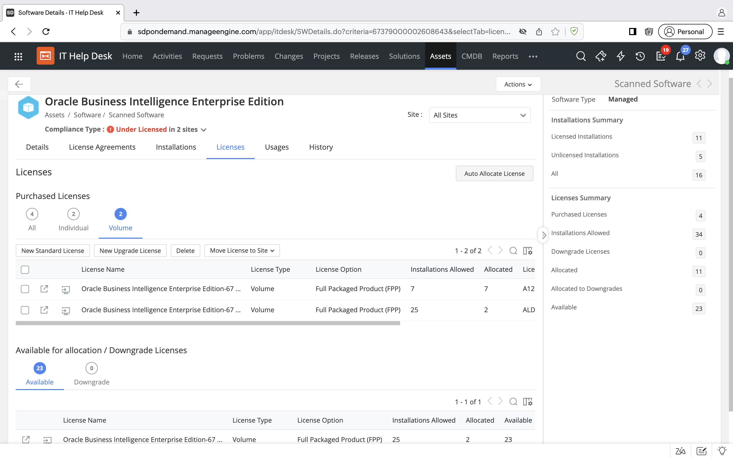
Track software compliance, and optimize license usage by allocating available licenses to the unlicensed software installations

Slide 34
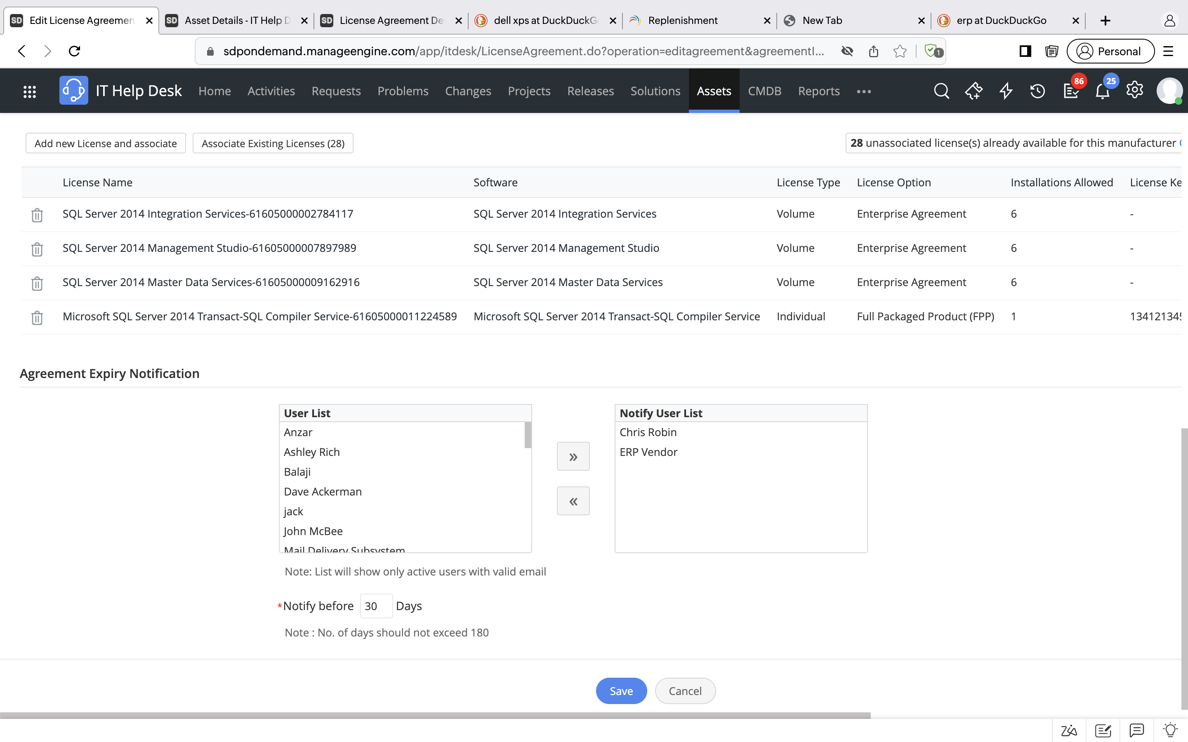
Set expiration alerts for license agreements and get notified on expiration dates before-hand

Slide 35
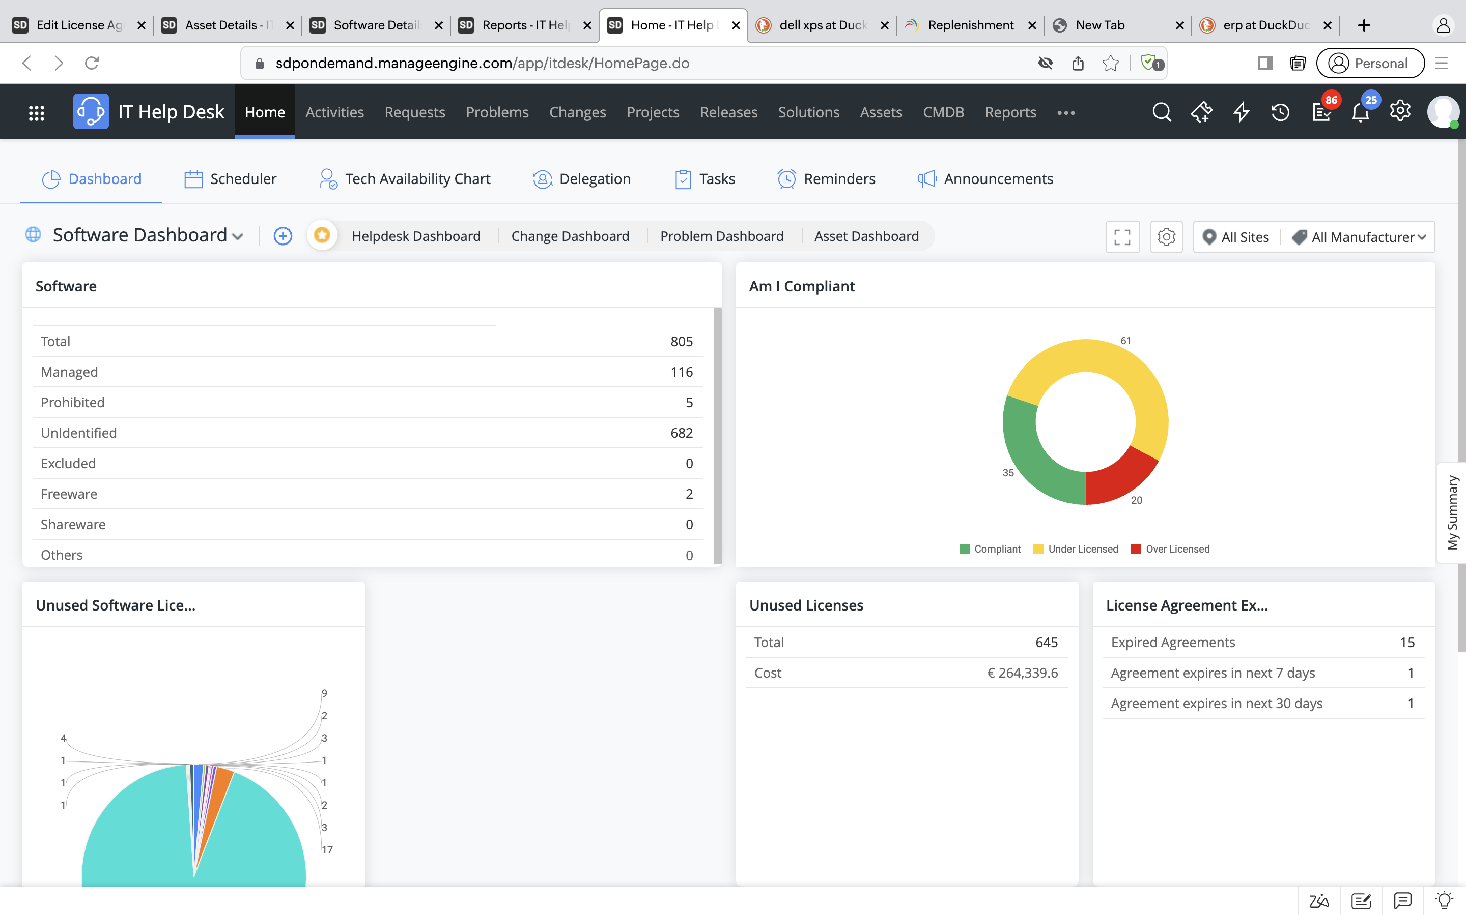
Make informed decisions by keeping proper tabs on your software estate data with interactive dashboards

Slide 36



Saying goodbye to audit red flags
Unauthorized installations and prohibited software are removed from the IT topography
Optimal allocation of software licenses helps IT teams stay on track with their cost control plans
Reports and dashboards help IT teams gain a real-time view of compliance and analyze purchasing decisions

Slide 37

Blunt the impact of major incidents with a bird's-eye view of the IT infrastructure

Slide 38


Revisiting a major availability incident
The healthcare data analytics company hosts several critical survey tools used by its business analysts on a central backbone network
A routine maintenance job to upgrade the backbone servers took down the entire network, stalling business operations

Slide 39

However, there was zero visibility into where the point of failure was, leading to delays in restoring services.

Slide 40

The need of the hour:
Visualizing a complex IT environment within an integrated ITSM console

Slide 41
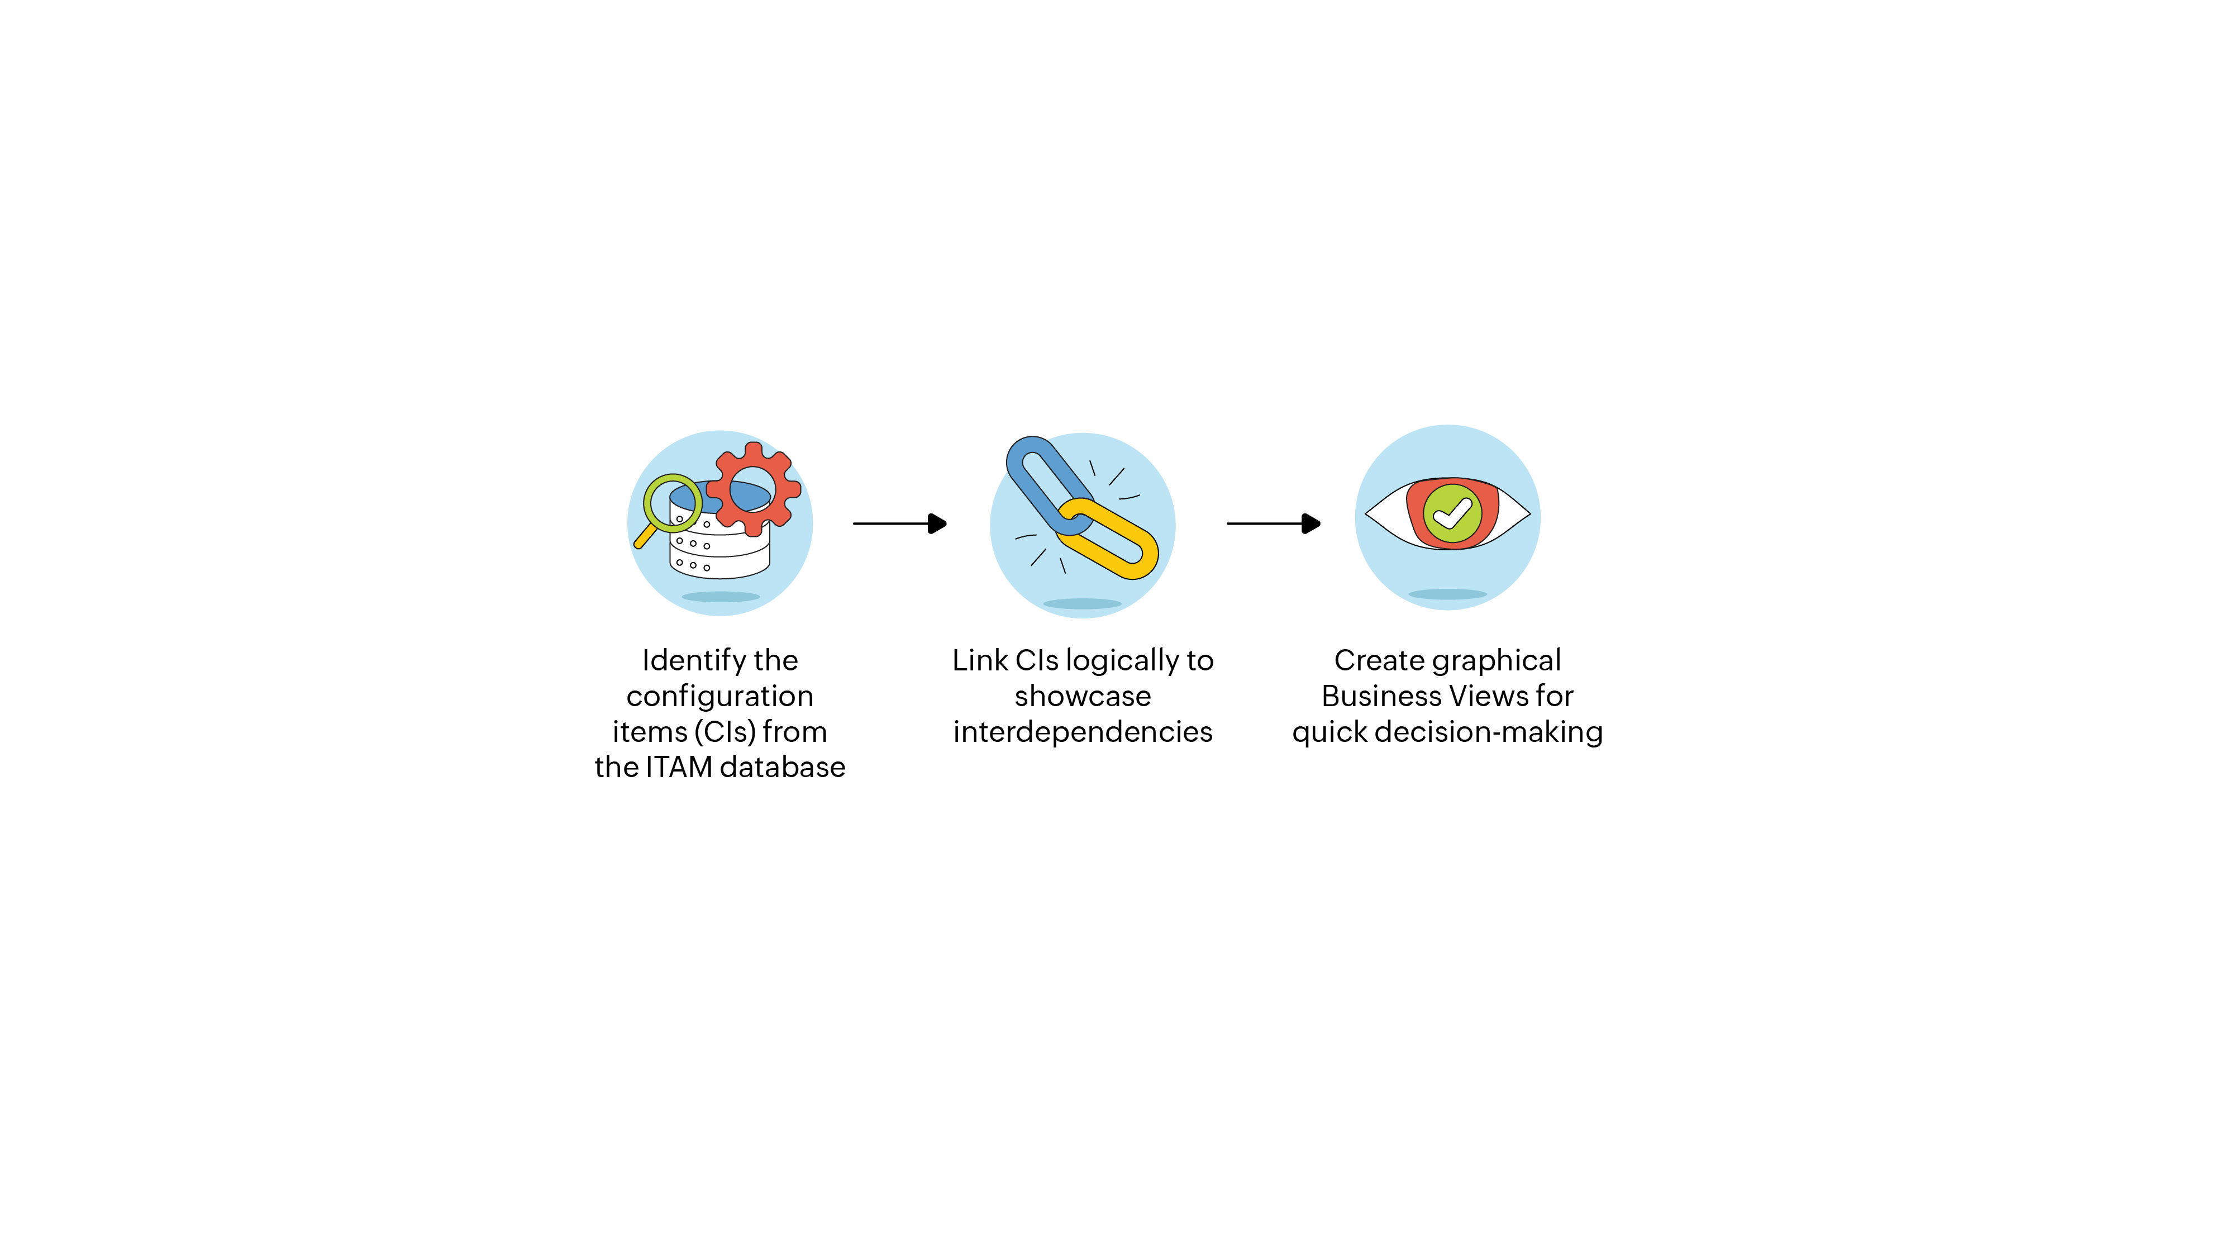
Constructing the IT crystal ball, aka the CMDB

Slide 42
Getting the big picture with ServiceDesk Plus
CI types
CI relationships
Business views

Slide 43
Demo

Slide 44
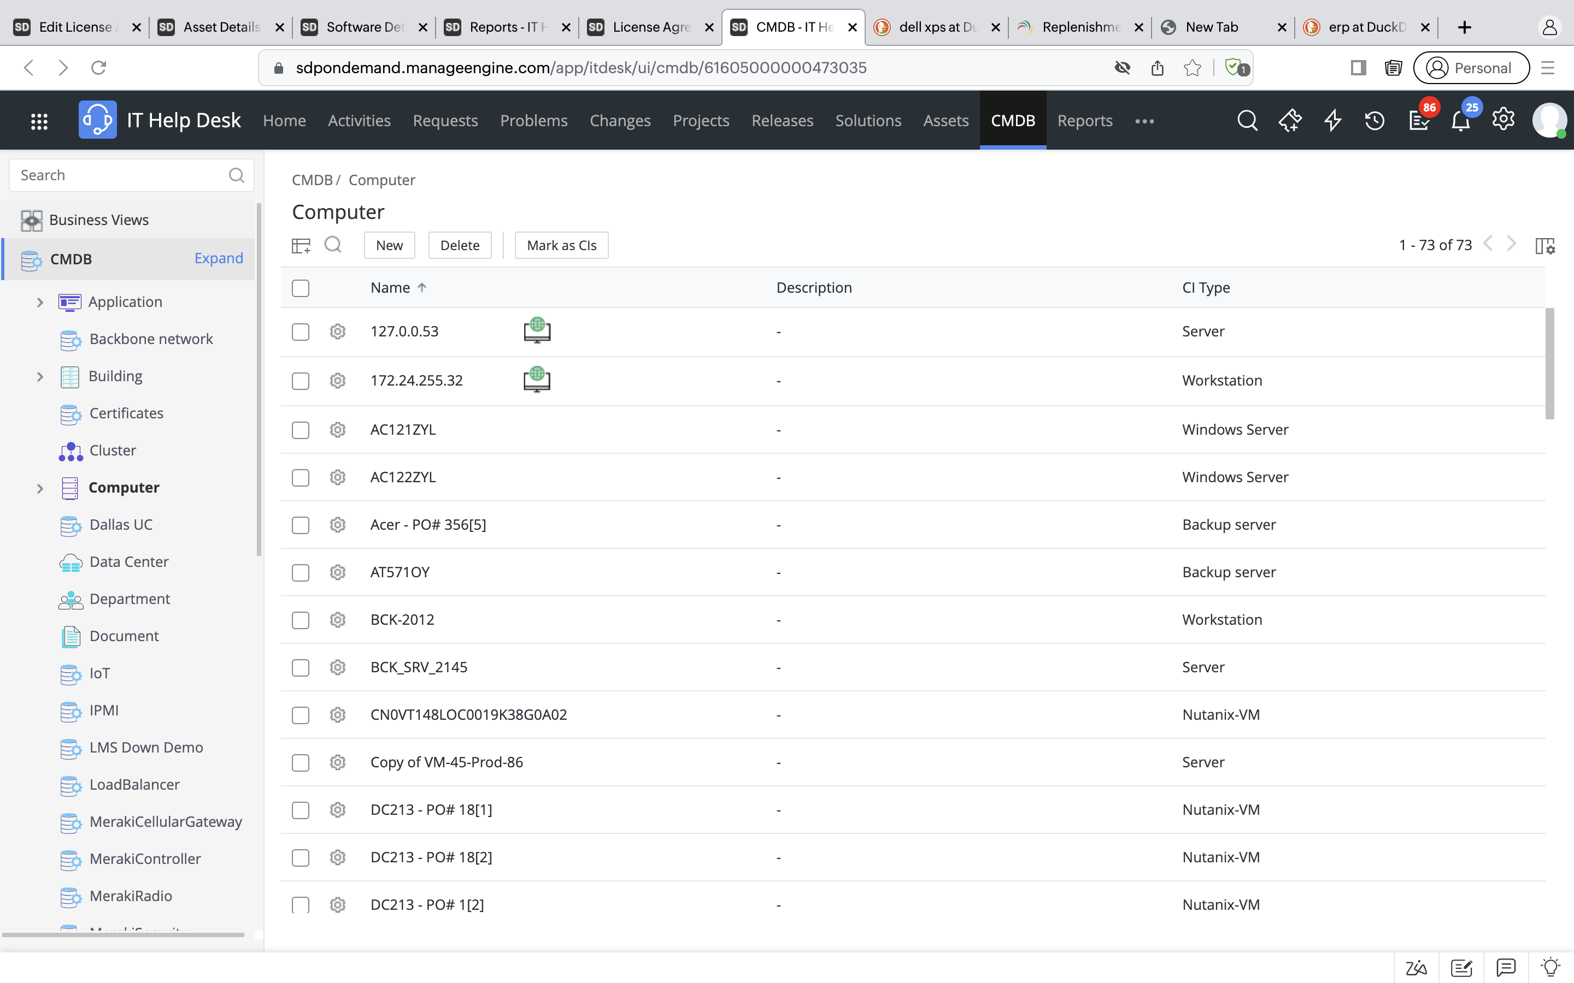
Maintain a central repository for all your business critical configuration items

Slide 45
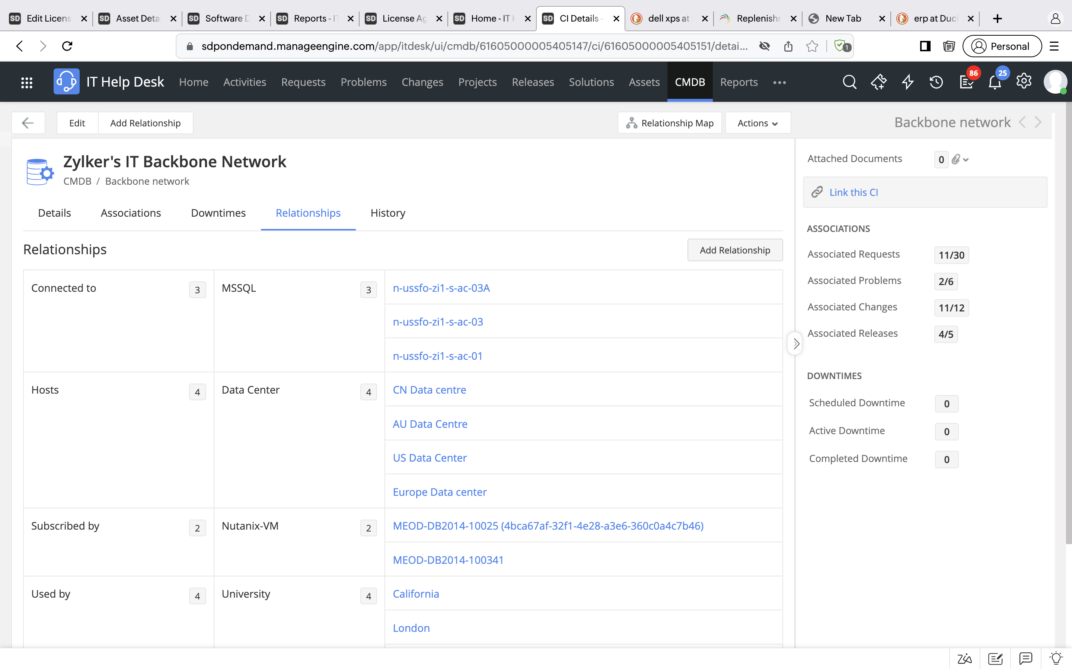
Define CI relationships and link different CIs logically to understand the inter-dependencies between them

Slide 46
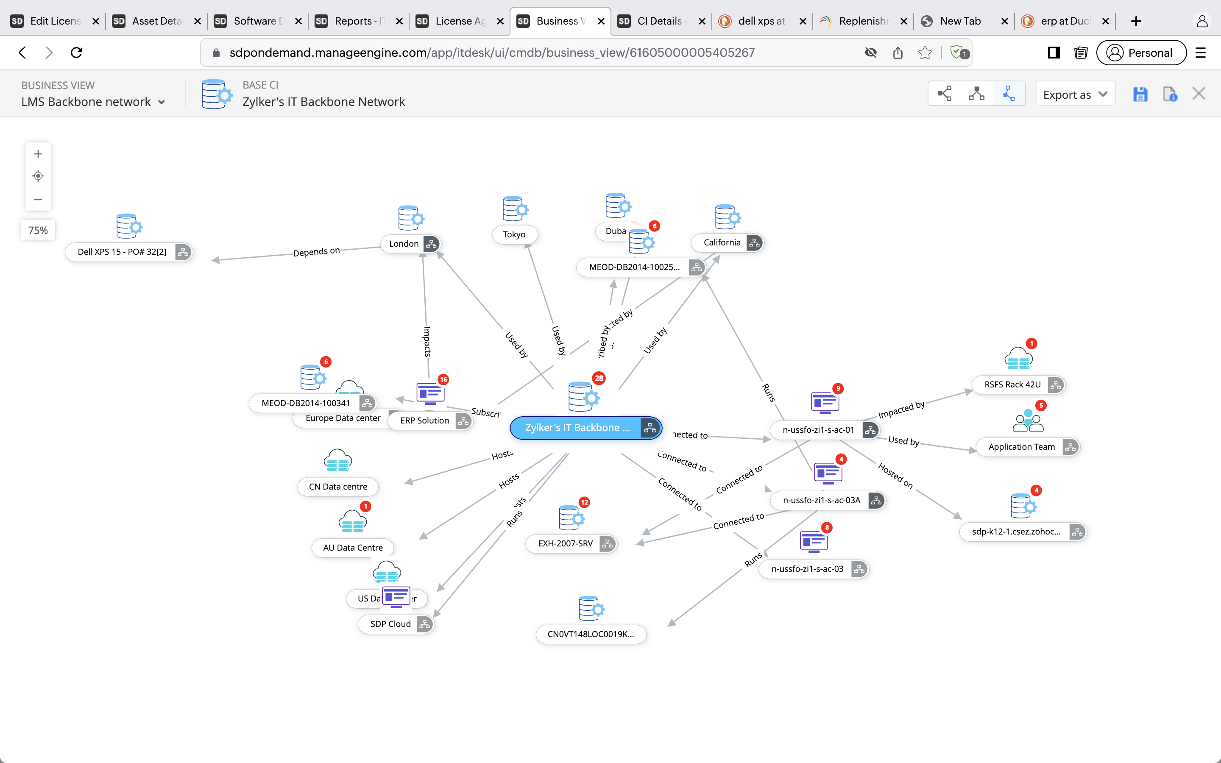
Create business views to understand how your CIs are webbed with one another and gain proper visibility into your IT infrastructure

Slide 47
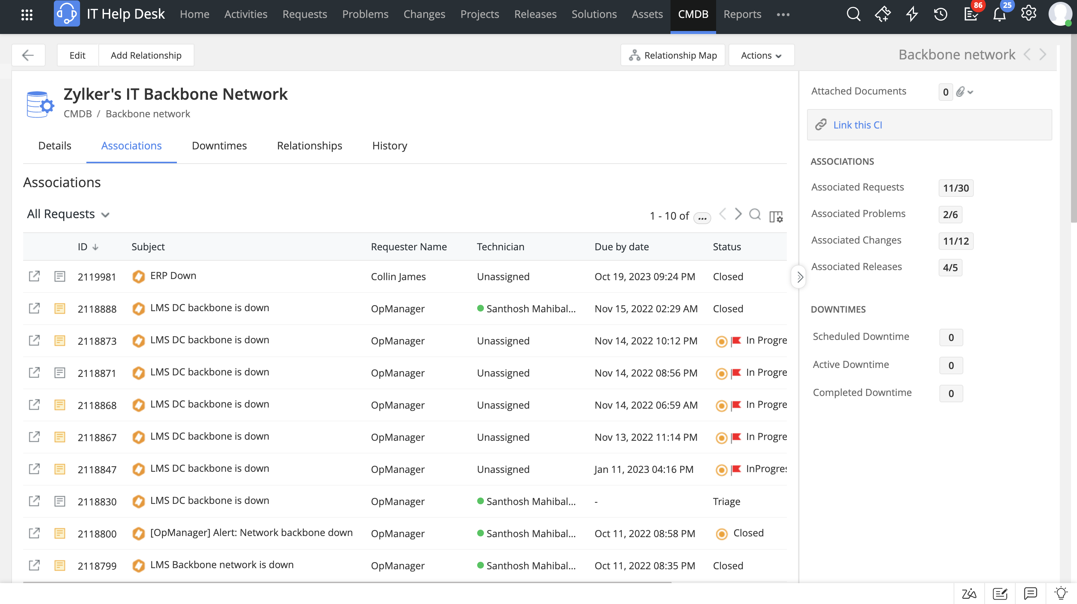
Integrate with other ITSM processes and enrich context around incidents and changes

Slide 48



A holistic console for managing everything IT
As organizations prepare themselves for a hybrid future, infrastructure complexities are at an all-time high
With ServiceDesk Plus, every CI, from printers and IP phones to server racks and data centers, is mapped logically
‌IT service desks can now shorten their response times for major incidents, minimizing the business impact and revenue losses

Slide 49


