Slide 1



Kywi Commercial SA automates
Patch Management using Desktop Central

Slide 2

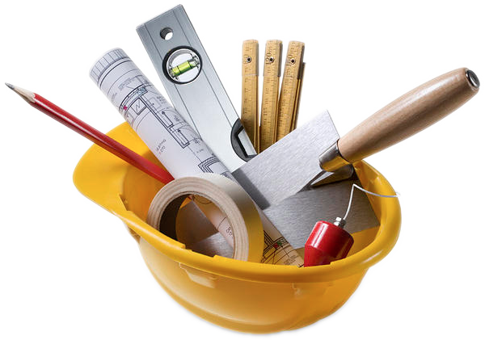
Leaders in Marketing of
Hardware & Building Materials
Now part of Corpracion Favorita, first retail chain in the country
Located in cities such as Quito, Guayaquil, Cuenca, etc.
Manages 250 desktops distributed across 15 locations

Slide 3
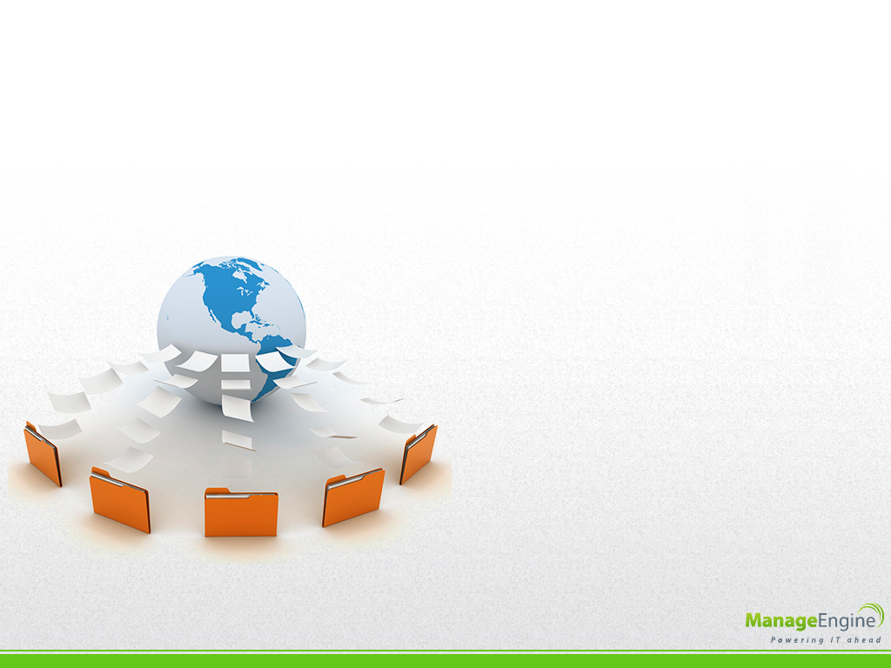
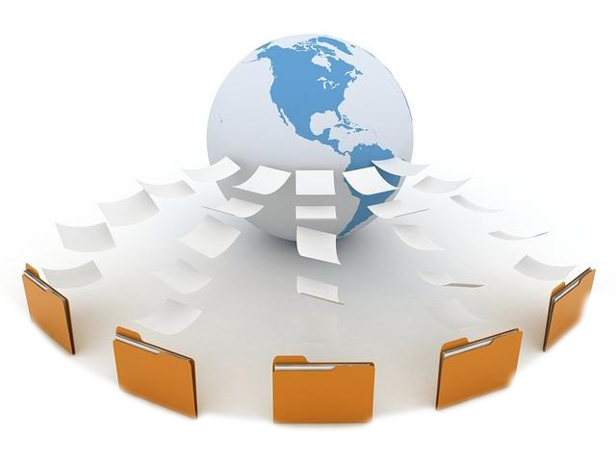
Customer Requirements
An application that:
Distributes patches from central location
Offers Hassle free window updates
Cost Effective

Slide 4
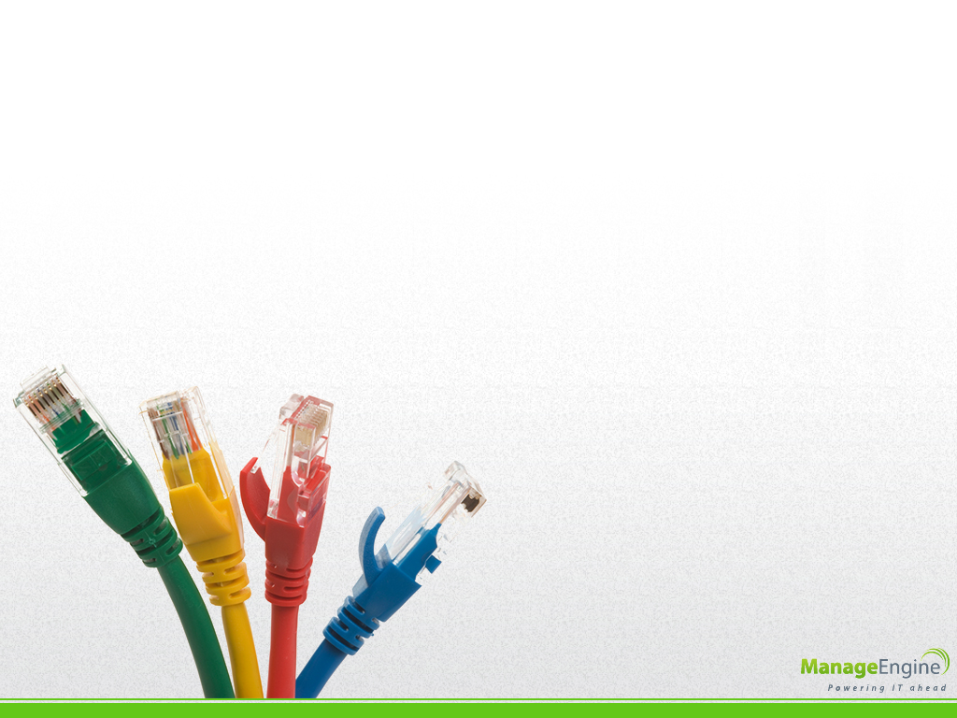
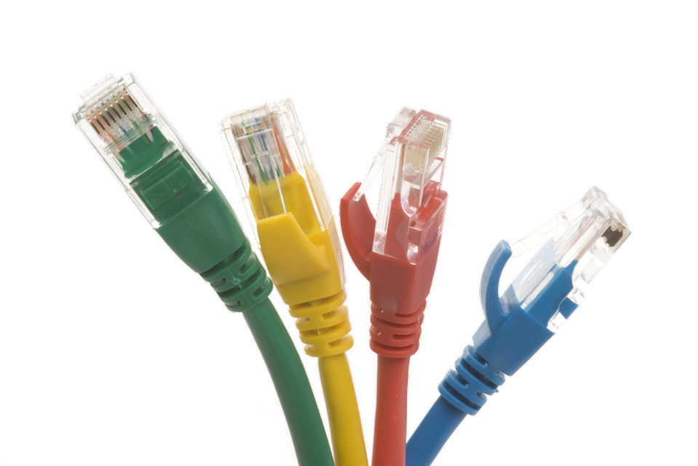
Challenges faced with
Windows Updates
Bandwidth consumption is high as every system downloads patch
Every system should be connected to Internet
Complicated procedure
Time consuming

Slide 5
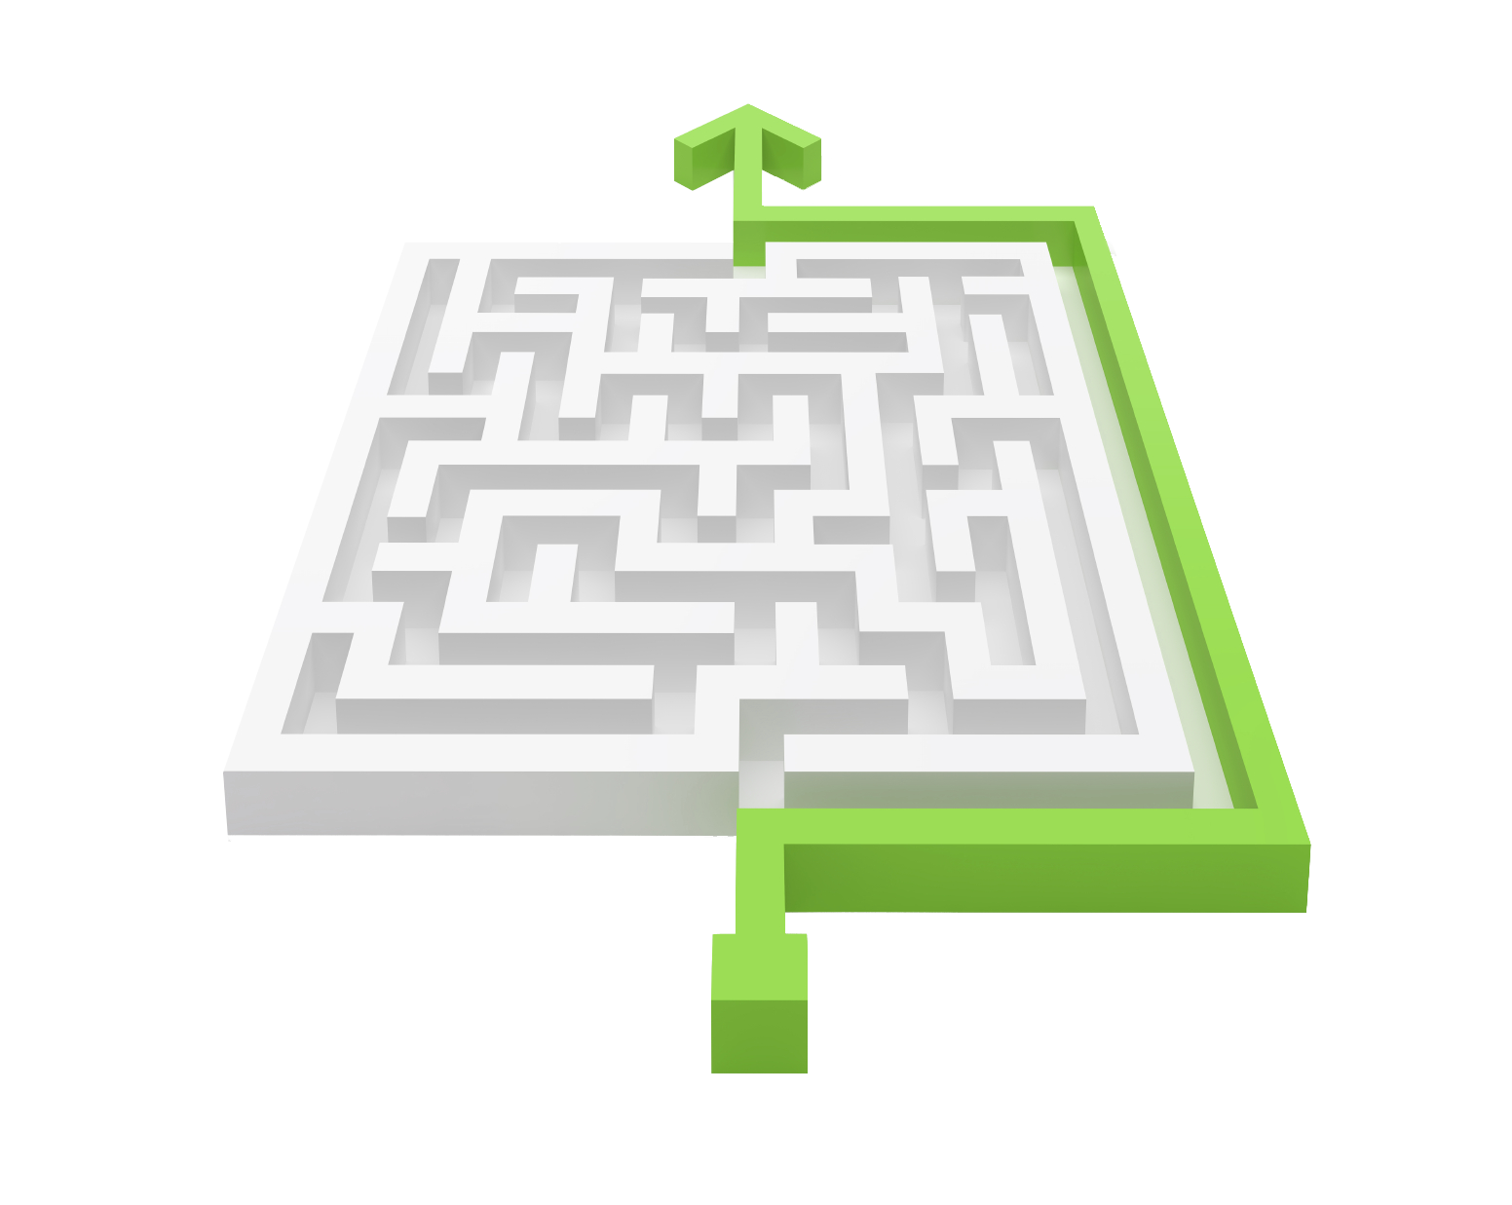
How did Desktop Central simplify Patch Management?
Centralized patch repository
Patch Installation via Distribution Server for remote locations
Once downloaded on the server can be used 'n' no of times with out any additional consumption of Bandwidth
Insightful Reports on H/W & S/W for asset management

Slide 6



Testimonial
I decided for Desktop Central because it was the only one that offered me a fully functional trial with the correct support that helped me with all the problems and doubts
- Santiago Avila
IT Manager

Slide 7

Additional Features
Remote Desktop Sharing
Service Pack Deployment
Power Management
USB device management
Tools & Reports

Slide 8

Contact Us
Email address
desktopcentral-support@manageengine.com
Website
www.ManageEngine.com/desktop-central/

