Slide 1
ManageEngine ®
Applications Manager
Monitoring Custom Applications

Slide 2
Agenda
Problem Statements
Solution for Monitoring Custom Applications
Benefits
Sample Usage Scenario

Slide 3
Problem Statements
Monitor Home Grown Systems?
Legacy Systems that need Monitoring?
Monitor a Web Application?

Slide 4
Applications Manager - The Solution
Integrated Monitoring Console for your whole IT Infrastructure
Monitors your Critical Business Applications:
Servers
Application Servers
Databases
Middleware/Portal
Web Applications
Custom Applications (focus of this presentation)‏

Slide 5
Primary Functions
Monitoring
Alerting
Reporting
SLA Management

Slide 6
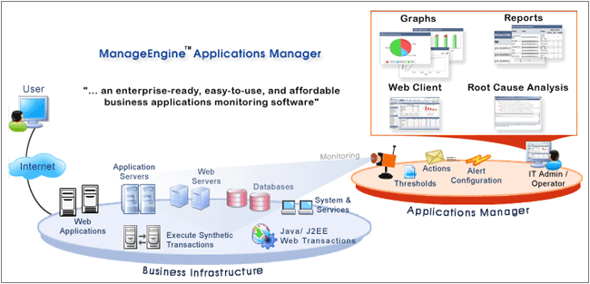
Agentless Monitoring of a heterogeneous infrastructure

Slide 7
Custom Application Monitoring

Slide 8
Integrate In-House Scripts
Pull data out of applications, databases
Execute command line tool within scripts & read output file & report on data
Monitor specific statistics in legacy applications
Configure alarms, view reports, graphs
Support for Scripts in Local and Remote Hosts
Technical Detail: Flexibility to execute any Linux shell scripts or Windows batch files and parse the output data. Support for key=value format data and tabular data

Slide 9
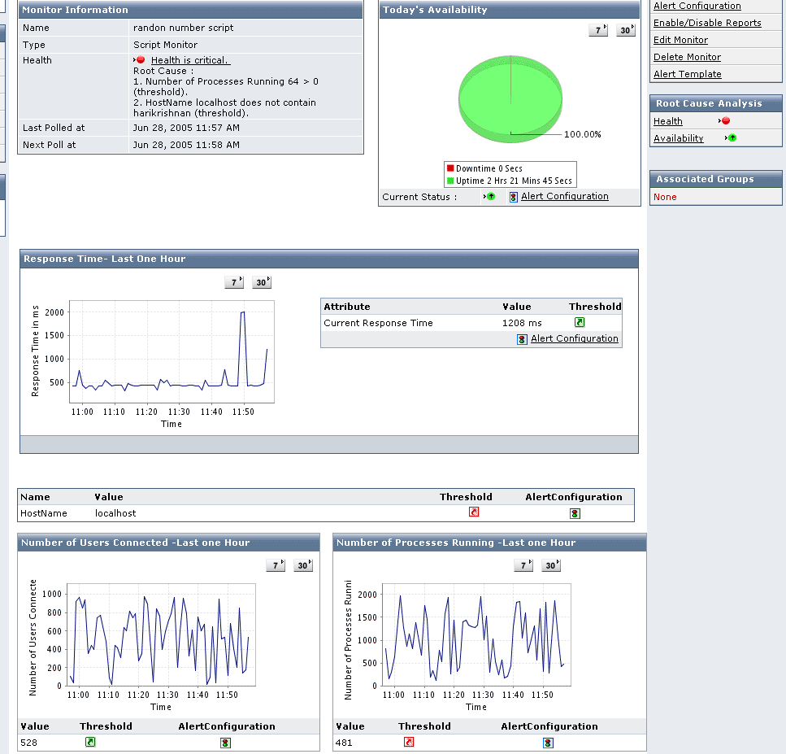
Sample Screenshot

Slide 10
Record & Playback Web Transactions
Monitor a dynamic Web Application hosted on the Internet
Support for html, ASP, JSP, PHP etc. Web Sites or Web Applications
Eg: Login to an online store and check if it generates price quotes appropriately
Response Times, Availability, Content Check etc.
Technical Detail : Record HTTP requests and it replayed at regular intervals to ensure that Web Application is functioning properly

Slide 11
Java Applications using JMX
Monitor Custom Application Metrics
Sample Metrics : Monitor number of new user sign ups, number of application errors, number of failed transactions
Build Custom Dashboards
Graphing, Alerts & Reports
Technical Detail: Needs your Java Application to be using JMX 1.2 / JRE 1.5 and expose information using Java Management Extensions

Slide 12
Java Runtime Monitoring
In-depth JVM Statistics
Availability and general health of JVM
Track memory, usage
Thread Details
Technical Detail: Needs your Java Application to be running on JRE 1.5

Slide 13
J2EE Web Transaction Statistics
Get Java method level statistics
Break up of response times between various tiers (EJB, Web, Java, SQL)‏
Enable or disable at runtime
Identify bottlenecks easily
Minimal Configuration needed to support this
Technical Detail: Needs your Application Server to be running on JRE 1.5

Slide 14
WMI Performance Counters
Monitor any Windows Application that supports WMI
Monitor Custom Application Metrics
Sample Metrics : Monitor number of new user sign ups, Peak Active Clients etc.
Build Custom Dashboards
Graphing, Alarms & Reports
Technical Detail: Application should expose metrics via Windows Management Interface (WMI)

Slide 15
SNMP Enabled Devices / Resources
Build Dashboard with graphs and tables
Configure alerts, view reports
Load MIBs
Create flexible Views
Track application specific metrics
Technical Detail: Supports monitoring an device that exposes info via SNMP V1, V2c

Slide 16
Usage Scenario - 1
Customer has Ad Servers
Currently executes some command line executable to retrieve performance metrics
Solution: Applications Manager (APM) triggers these Custom Script Monitors
Windows batch file runs the specific executable and writes the metrics to an output file
APM reads the data in these output files and moves it to monitoring system
Generates graphs, reports, alarms

Slide 17
Usage Scenario - 2
Monitored Application opens TCP Ports
Solution: Applications Manager (APM) triggers “Service Monitors”
Checks opening ports work or not
Escalates if unavailable or if response time is high
Generates graphs, reports, alarms

Slide 18
Usage Scenario - 3
Server Application runs on Windows
Solution: Applications Manager (APM) triggers “Service Monitors”, WMI Perf Counters
Monitors Windows EventLogs for Errors
Checks if there is Log File Change to monitor application activity
Checks opening TCP Ports work
Monitors Process CPU Usage and Memory
Escalates if unavailable or if response time is high
Generates graphs, reports, alarms

Slide 19
Technical Benefits
Support for heterogeneous applications and servers
Standards based approach to managing IT resources
Agentless Monitoring ensures low cost of maintenance
Distributed architecture for High Scalability
Web Client ensures high usability

Slide 20
Business Benefits
Holistic view to your business applications
Support for industry best practices
Improved employee productivity
Complement Existing Investments in 3rd Party NSM
Low TCO & High ROI

Slide 21
Key Differentiators
In-depth Application Monitoring
Software that is easy to evaluate, use and deploy
Setup and Ready to Go in hours not days or months
Intuitive Web Client
Agentless Monitoring
Agile Support and Upgrade Services

Slide 22
More Info
Live Demo: http://demo.appmanager.com
Website: http://www.appmanager.com
Download: http://www.appmanager.com/download.html
Forums: http://forums.manageengine.com/appmanager
Product Editions:
Free Edition : 5 Monitors: Applications, Servers etc. Never Expires
Professional Trial Edition : 30 day evaluation. No restrictions on Monitor Instances
Enterprise Edition : Distributed set up for scalability
Chinese, Japanese, Spanish, Hungarian, Korean, German, French & Vietnamese Versions are available
Contact: appmanager-support@manageengine.com

