Slide 1


Applications Manager Overview

Slide 2
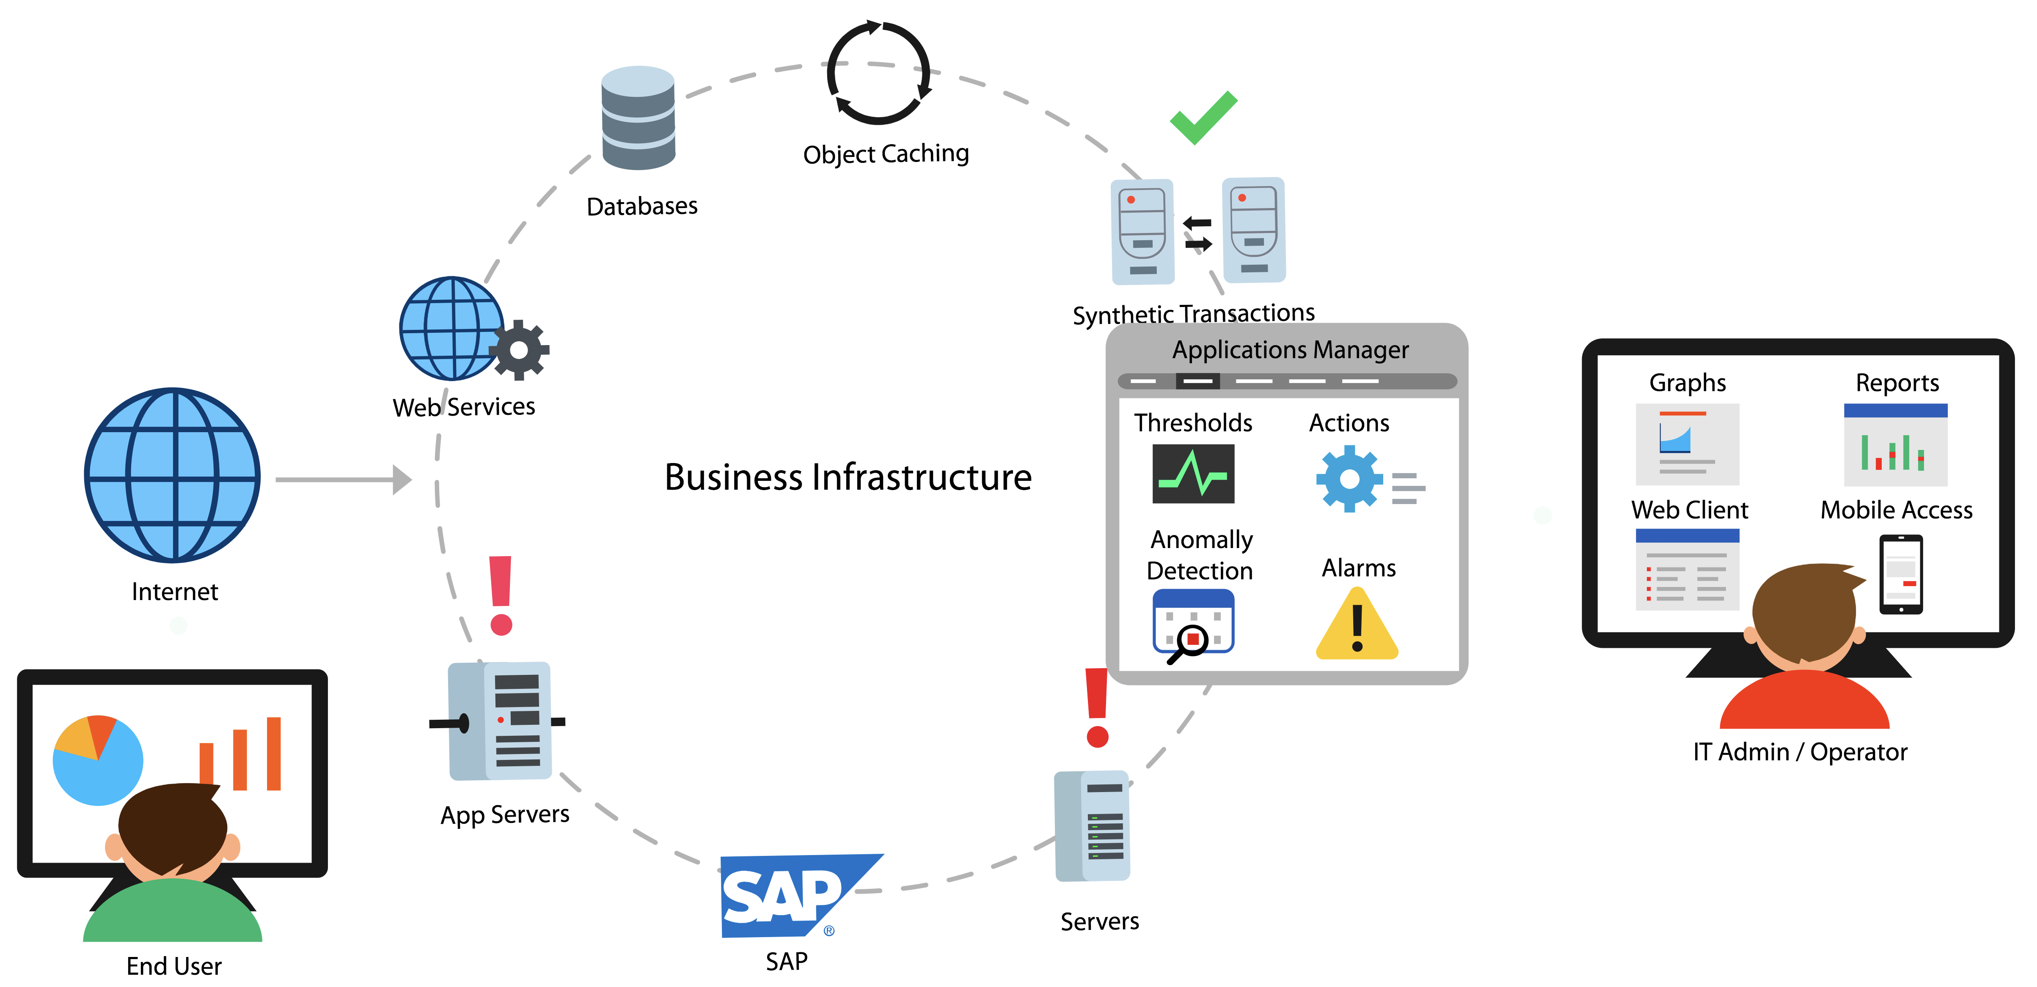
Applications Manager
Apps + infrastructure + user experience monitoring: all from a single console
Notes:
Agentless, Editions, Supported database backend.

Slide 3
Who uses Applications Manager
IT Operations
DevOps Engineers
Site Reliability Engineers
DBAs
Production Support
CloudOps
Architects
Anyone who is responsible for application performance
Notes:
It is a minute after midnight and the site goes live. Soon after, users complain of several problems. The site is not reachable due to increased traffic. Even if the site is reachable for some people, the landing page appears to be slow. Customers who click on Mobiles and Tablets category leads to HTTP 500 internal server error. Some pages lead to a HTTP 502 bad gateway error. Whatever happened to the Electronics page!! This was nothing short of a disaster..

Slide 4






Application Performance
Monitoring
Find and fix performance issues across your entire application stack
APM
Notes:
GroupsRule EngineCommon configuration

Slide 5






Transactions
Traces
Get complete insight into
Database Calls
Exceptions
Exceptions

Slide 6





APDEX
Transaction details and code level diagnostics
Track KPIs of
applications
Response time
Throughput
Notes:
GroupsRule EngineCommon configuration

Slide 7

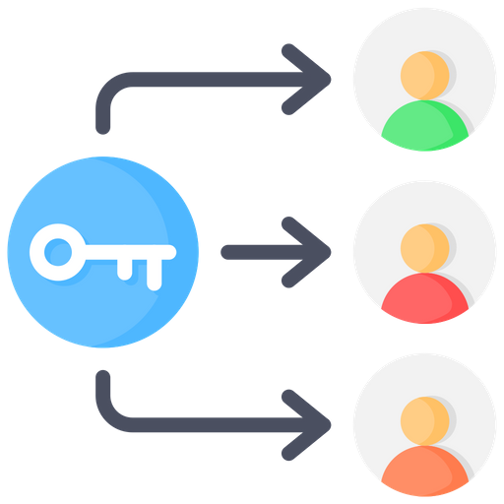


Identify problems such as
USER SESSION
BLOCKED QUERIES
WAITS
LOCKS

Slide 8
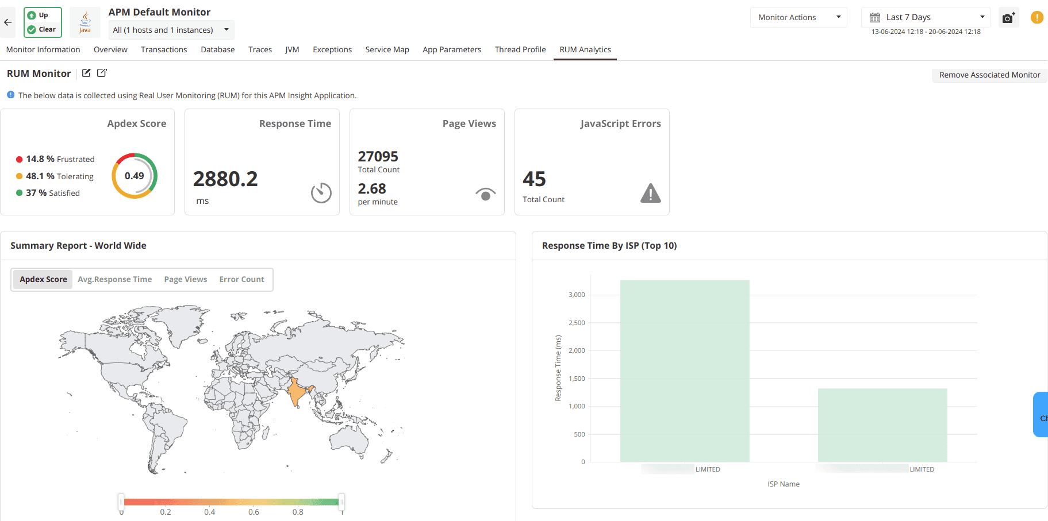
RUM Analytics Dashboard

Slide 9
Infrastructure monitoring
Monitor the IT infrastructure that powers your applications
Notes:
GroupsRule EngineCommon configuration

Slide 10
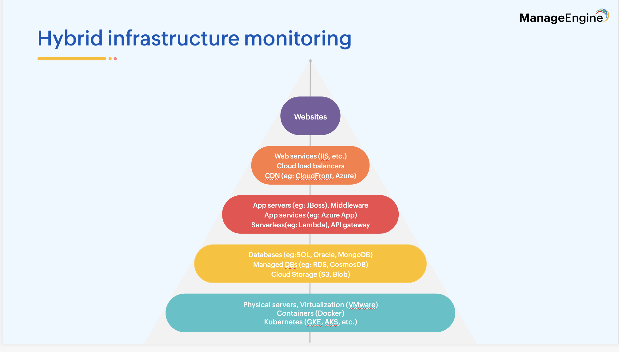

Slide 11
More on infrastructure monitoring
Monitor IT infrastructure metrics alongside APM and distributed traces in a single, integrated platform - without having to switch between multiple tools.
Supports monitoring of both on premise and cloud infrastructure
Agentless monitoring and agent-based monitoring.
Supports both modern apps such as Kubernetes and legacy servers such as AS/400
Vendor agnostic: Supports popular commercial vendors such as Microsoft, Oracle, SAP, IBM, AWS, and VMware as well as open source such as Apache and Red Hat.
Notes:
It is a minute after midnight and the site goes live. Soon after, users complain of several problems. The site is not reachable due to increased traffic. Even if the site is reachable for some people, the landing page appears to be slow. Customers who click on Mobiles and Tablets category leads to HTTP 500 internal server error. Some pages lead to a HTTP 502 bad gateway error. Whatever happened to the Electronics page!! This was nothing short of a disaster..

Slide 12
Agent based monitoring
Enhanced visibility: Gain deeper insights into server health and performance using lightweight agents installed on target machines.
Platform support: Now available for both Windows and Linux systems.
Ideal for secure environments: Use agents when SNMP/WMI is restricted, credentials can't be shared, or ports can't be opened.
Flexible deployment: Install agents directly from the UI
(Settings → Discovery & data collection → Manage agent → Deploy agent)
Minimal overhead: Designed to consume minimal resources and work seamlessly in real-time environments.
Complements agentless monitoring: Use in tandem with agentless mode depending on your infrastructure needs.
Notes:
It is a minute after midnight and the site goes live. Soon after, users complain of several problems. The site is not reachable due to increased traffic. Even if the site is reachable for some people, the landing page appears to be slow. Customers who click on Mobiles and Tablets category leads to HTTP 500 internal server error. Some pages lead to a HTTP 502 bad gateway error. Whatever happened to the Electronics page!! This was nothing short of a disaster..

Slide 13
Comprehensive database monitoring
Unified visibility across all major databases
Monitor health and performance of popular databases like Oracle, MySQL, SQL Server, PostgreSQL, DB2, MongoDB, Cassandra, and more.
Track KPIs such as query performance, buffer cache, table locks, sessions, replication status, and memory usage.
Deep-dive performance analysis
Identify slow queries and bottlenecks affecting end-user experience.
Correlated application-DB insights
Understand how backend database performance impacts front-end application experience.
Drill down from application transactions to database calls seamlessly.
Notes:
It is a minute after midnight and the site goes live. Soon after, users complain of several problems. The site is not reachable due to increased traffic. Even if the site is reachable for some people, the landing page appears to be slow. Customers who click on Mobiles and Tablets category leads to HTTP 500 internal server error. Some pages lead to a HTTP 502 bad gateway error. Whatever happened to the Electronics page!! This was nothing short of a disaster..

Slide 14
Cloud monitoring
Out-of-the-box support for major cloud platforms
Monitor performance and availability of AWS, Azure, GCP, Oracle Cloud, OpenStack, and more.
Track metrics for virtual machines, storage, containers, databases, and networking components.
End-to-end visibility across hybrid environments
Unified monitoring for on-prem, private, and public cloud resources from a single console.
Map interdependencies between cloud and non-cloud components.
Cost and resource optimization
Monitor resource utilization trends to right-size infrastructure.
Identify underused or overprovisioned resources to optimize costs.
Notes:
It is a minute after midnight and the site goes live. Soon after, users complain of several problems. The site is not reachable due to increased traffic. Even if the site is reachable for some people, the landing page appears to be slow. Customers who click on Mobiles and Tablets category leads to HTTP 500 internal server error. Some pages lead to a HTTP 502 bad gateway error. Whatever happened to the Electronics page!! This was nothing short of a disaster..

Slide 15
Container and Kubernetes monitoring
Comprehensive monitoring for containerized environments
Monitor performance and availability of AWS, Azure, GCP, Oracle Cloud, OpenStack, and more.
Track metrics for virtual machines, storage, containers, databases, and networking components.
End-to-end visibility across hybrid environments
Auto-discover container components as they scale up or down.
Track resource usage across namespaces, deployments, and services.
Proactive troubleshooting and optimization
Get alerts on CPU, memory, and disk anomalies in containers and clusters.
Identify performance bottlenecks and optimize container resource allocation.
Notes:
It is a minute after midnight and the site goes live. Soon after, users complain of several problems. The site is not reachable due to increased traffic. Even if the site is reachable for some people, the landing page appears to be slow. Customers who click on Mobiles and Tablets category leads to HTTP 500 internal server error. Some pages lead to a HTTP 502 bad gateway error. Whatever happened to the Electronics page!! This was nothing short of a disaster..

Slide 16

End User Monitoring
Notes:
GroupsRule EngineCommon configuration

Slide 17
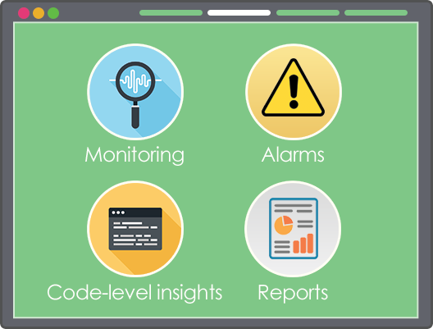

Real Browser Monitoring
Run synthetic transactions to simulate user experience with your site
Test applications/ features before launch
Collect information across geographies
Notes:
It is a minute after midnight and the site goes live. Soon after, users complain of several problems. The site is not reachable due to increased traffic. Even if the site is reachable for some people, the landing page appears to be slow. Customers who click on Mobiles and Tablets category leads to HTTP 500 internal server error. Some pages lead to a HTTP 502 bad gateway error. Whatever happened to the Electronics page!! This was nothing short of a disaster..

Slide 18

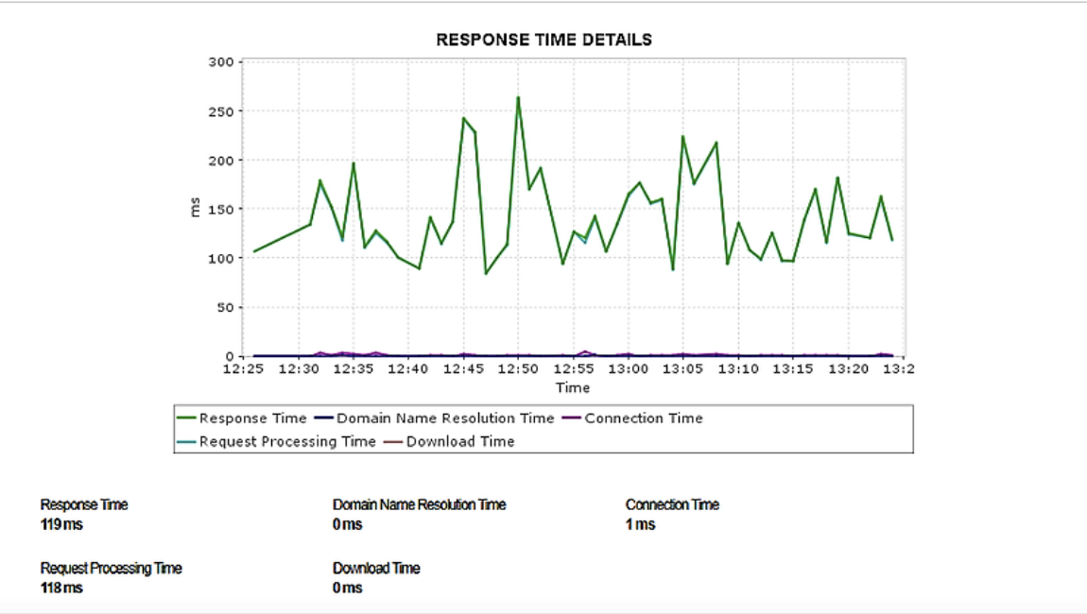


Monitor availability and response time of your REST API endpoints
Notes:
Applications manager enables you to proactively monitor your REST APIS for performance and functional correctness.

Slide 19
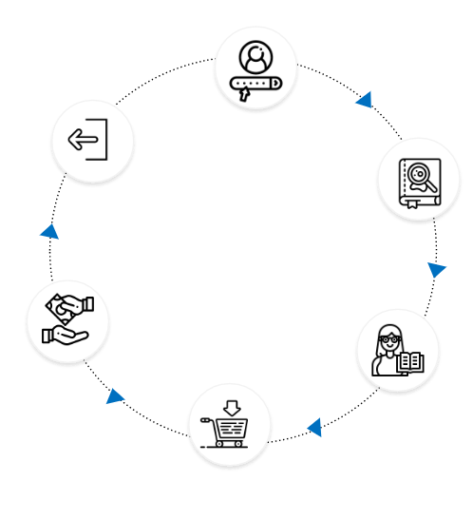
Real User Monitoring
Capture user’s transaction with a website in real time.
Analyze front end performance across geographies.
Manage service quality delivered to clients.

Slide 20
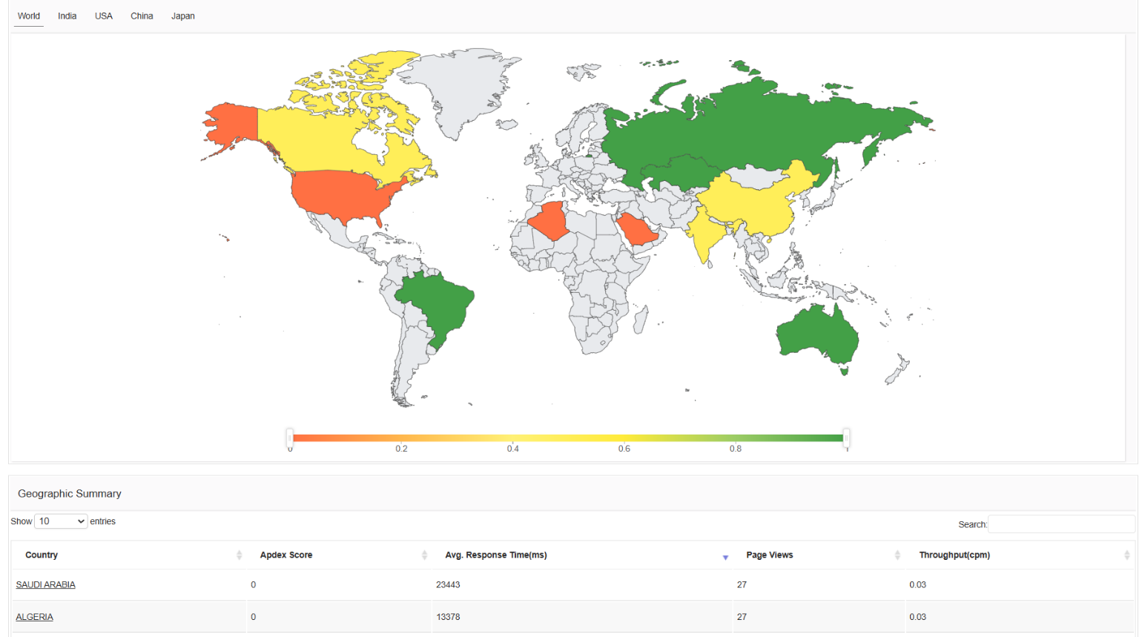
Real User Monitoring

Slide 21
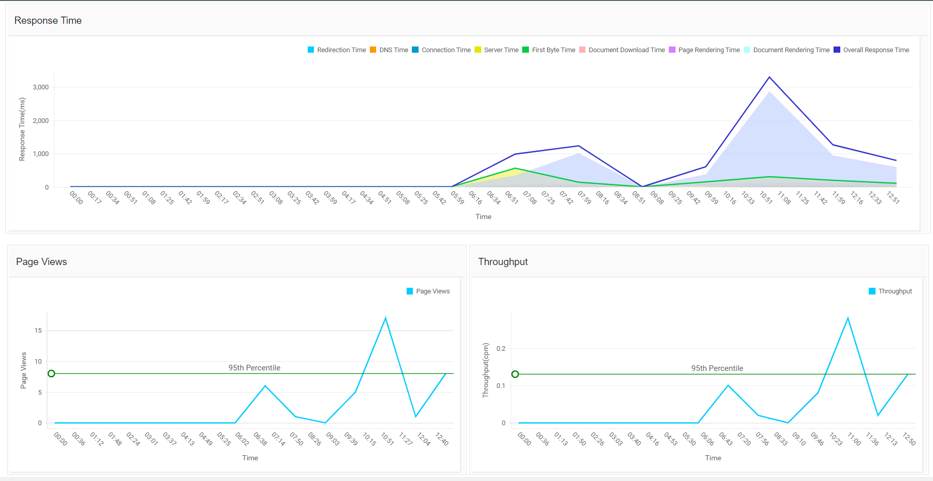
Real User Monitoring

Slide 22







Other features
Notes:
GroupsRule EngineCommon configuration

Slide 23
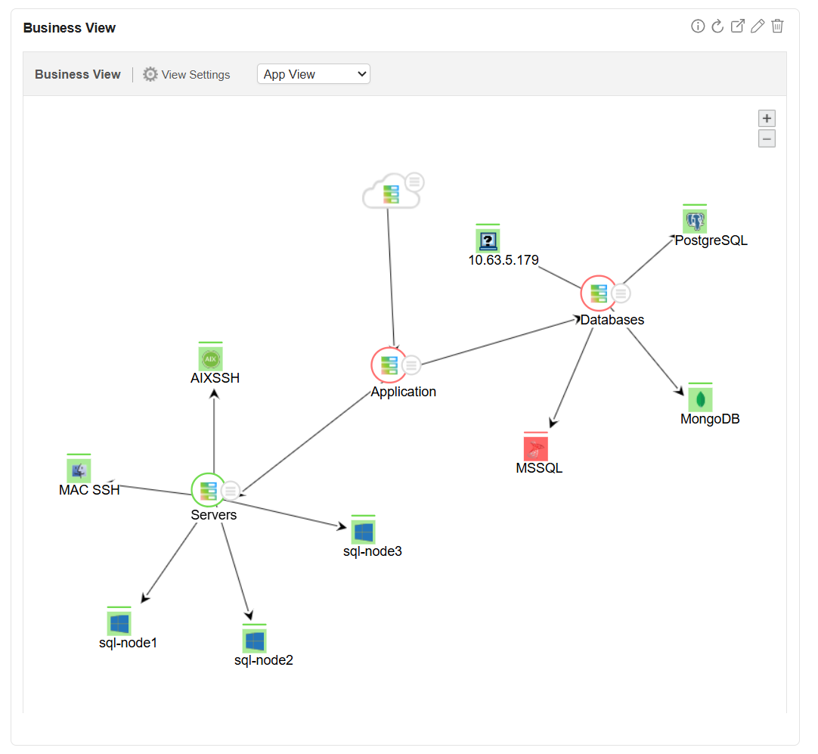
Automatic Discovery and Dependency Mapping

Slide 24
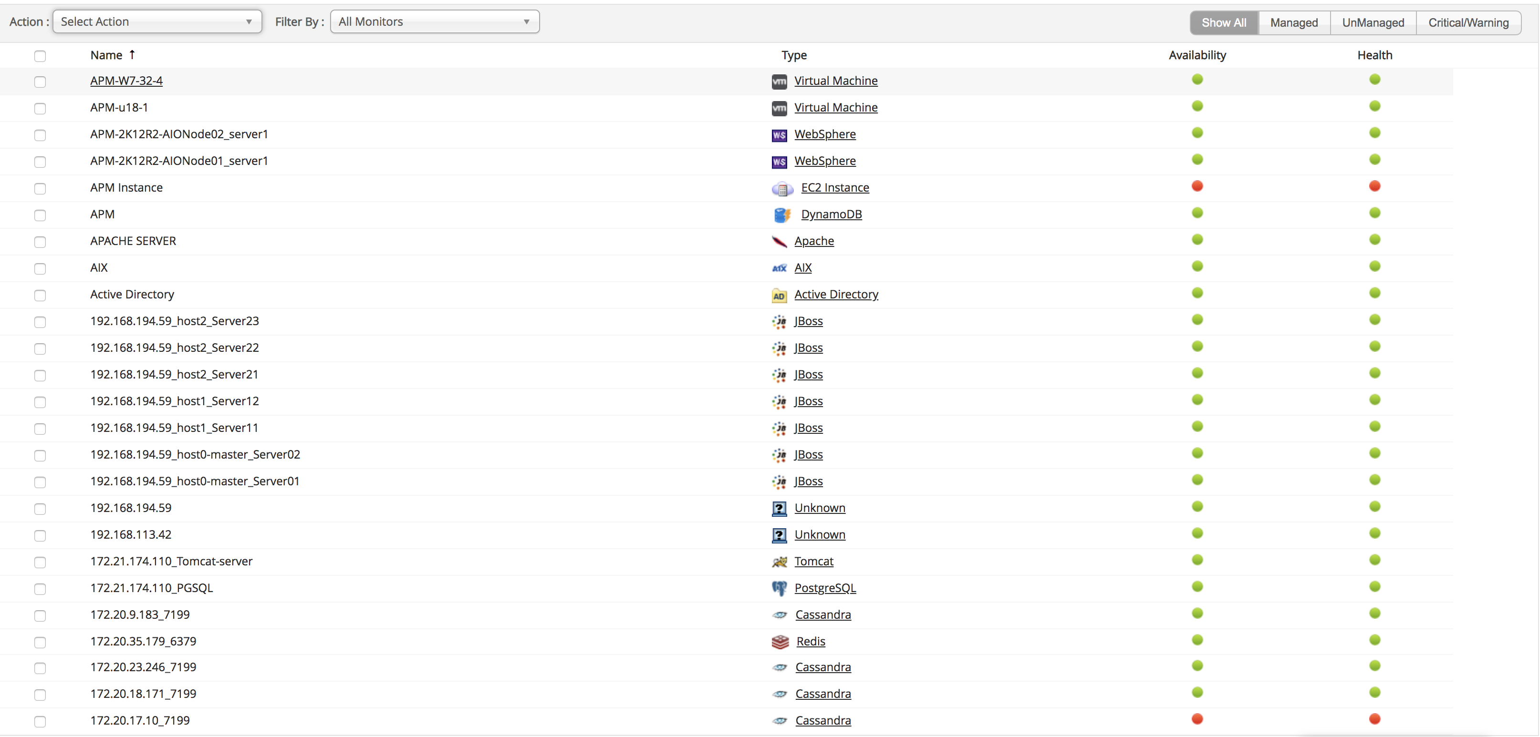
Business Service Management

Slide 25
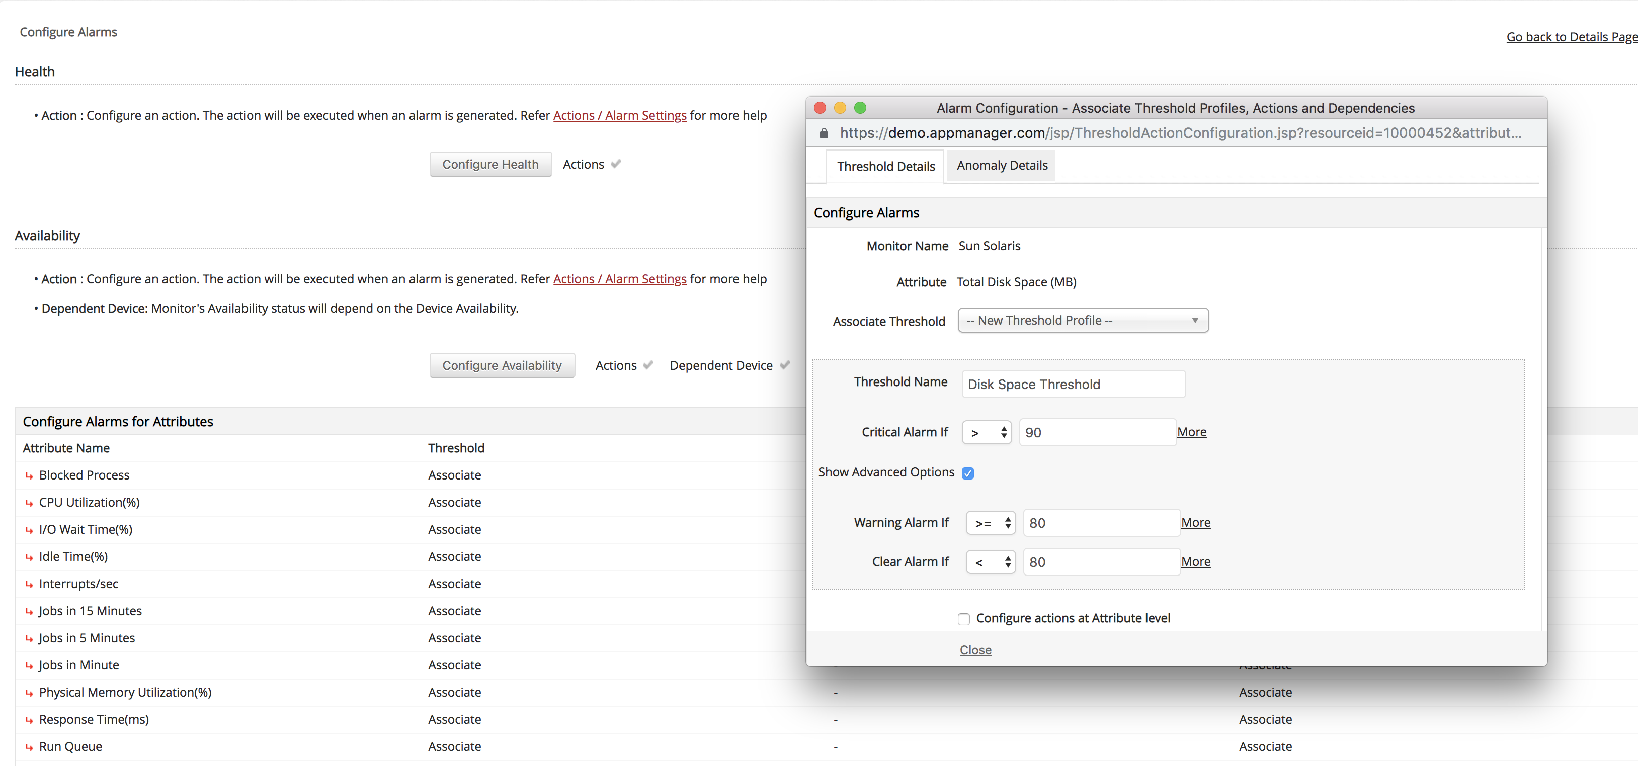
Real-time Notifications

Slide 26
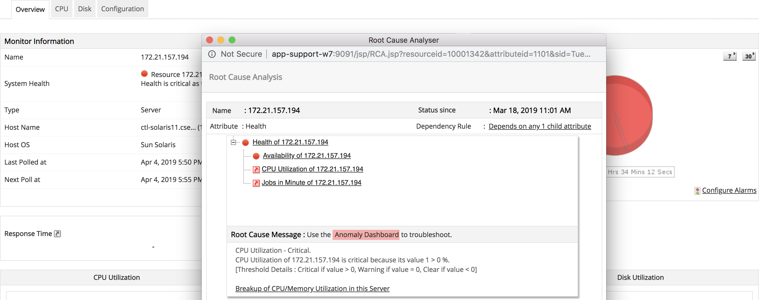
Root Cause Analysis

Slide 27
AI-assisted alerts with dynamic baselines
Smarter anomaly detection with AI
Leverage machine learning to automatically learn performance patterns over time.
Detect deviations from historical trends using dynamic baselines, instead of relying solely on static thresholds.
Reduce false positives
Alerts are triggered only for true anomalies, not typical fluctuations—minimizing alert noise and enhancing accuracy.
Context-rich alerts
Alerts come with contextual data (e.g., which metric, how far it deviated, historical comparison) to aid in faster root cause analysis.
Notes:
It is a minute after midnight and the site goes live. Soon after, users complain of several problems. The site is not reachable due to increased traffic. Even if the site is reachable for some people, the landing page appears to be slow. Customers who click on Mobiles and Tablets category leads to HTTP 500 internal server error. Some pages lead to a HTTP 502 bad gateway error. Whatever happened to the Electronics page!! This was nothing short of a disaster..

Slide 28
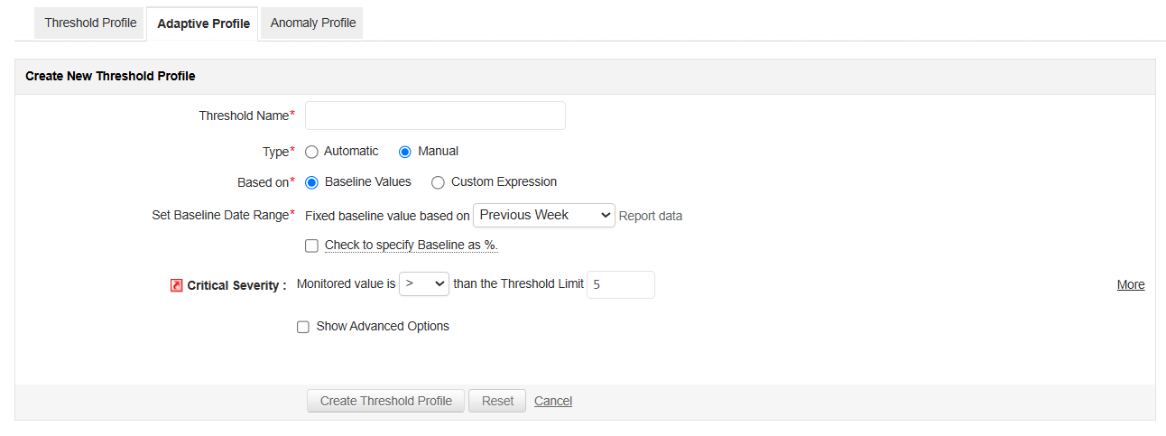
Dynamic baselining

Slide 29
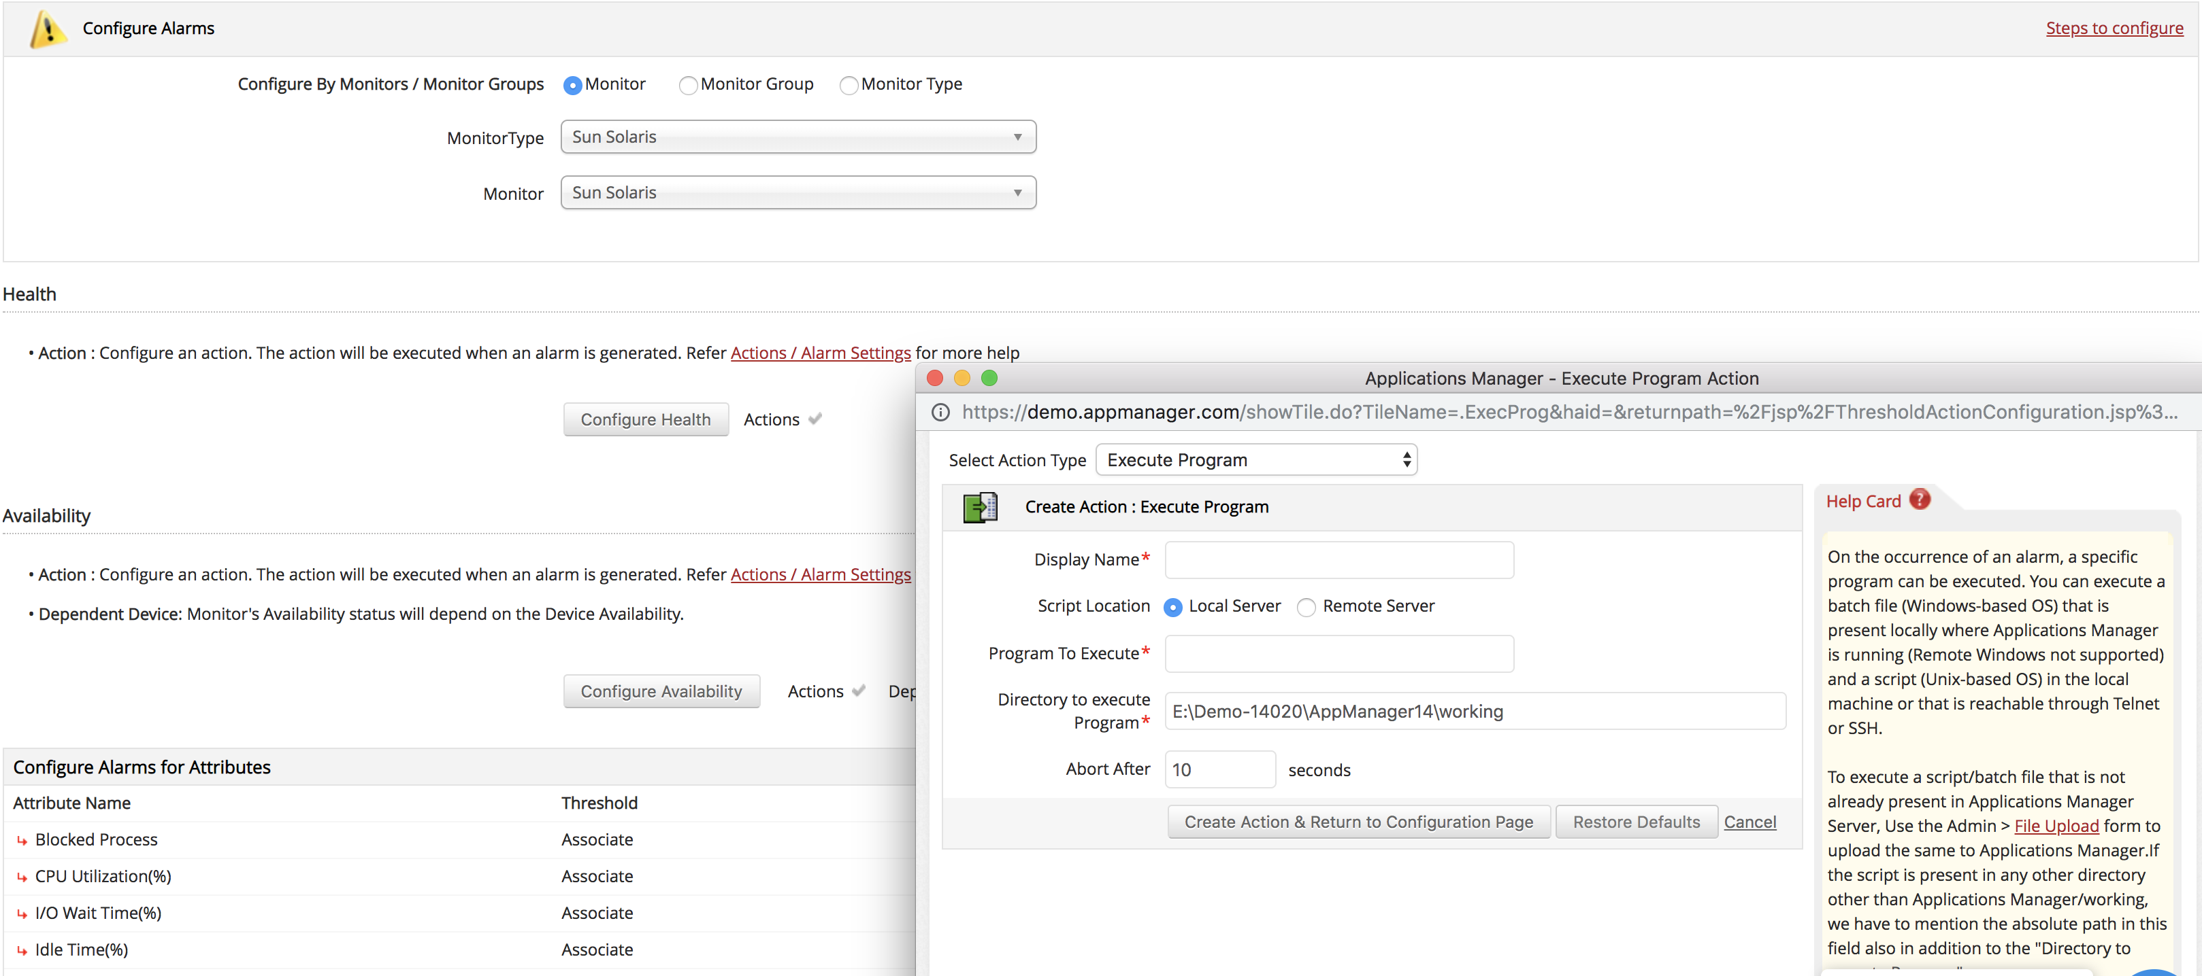
Automate corrective actions

Slide 30
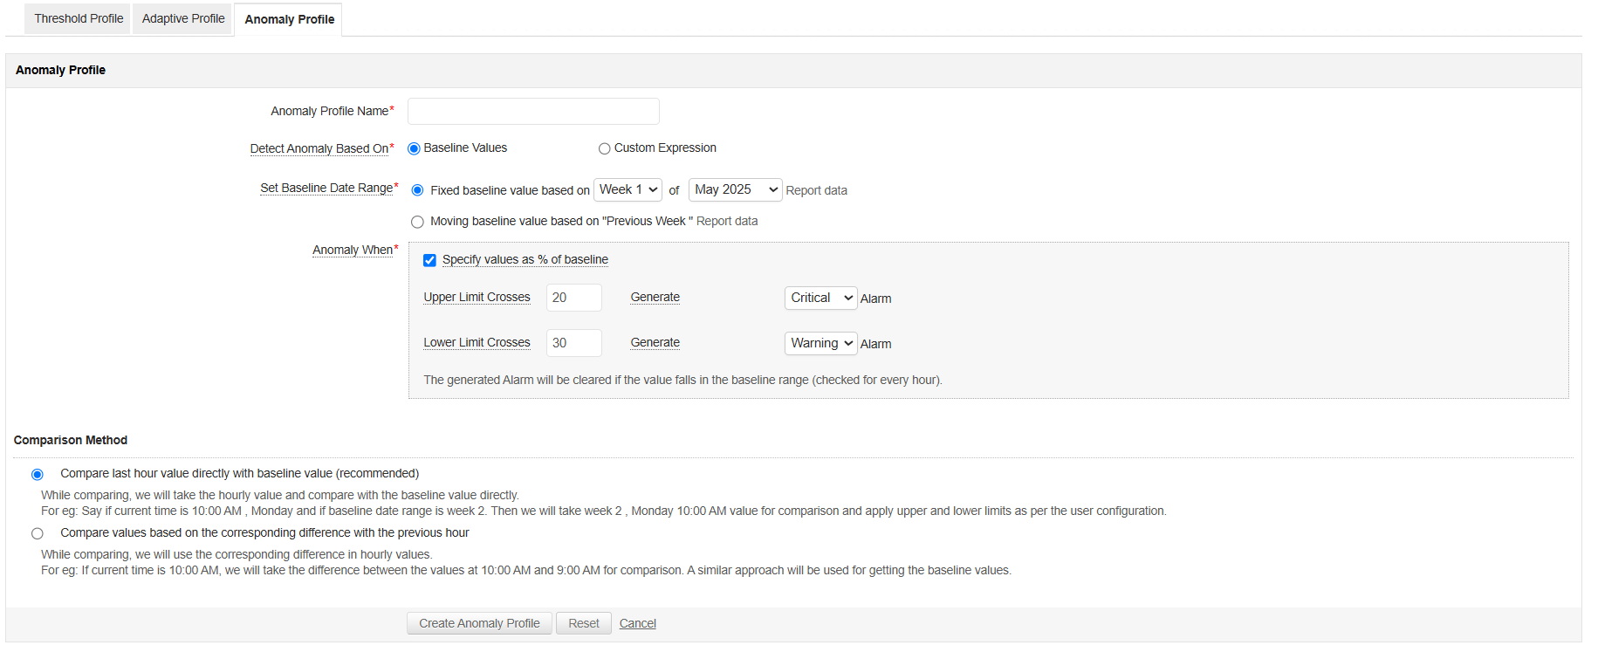
AI powered anomaly detection

Slide 31
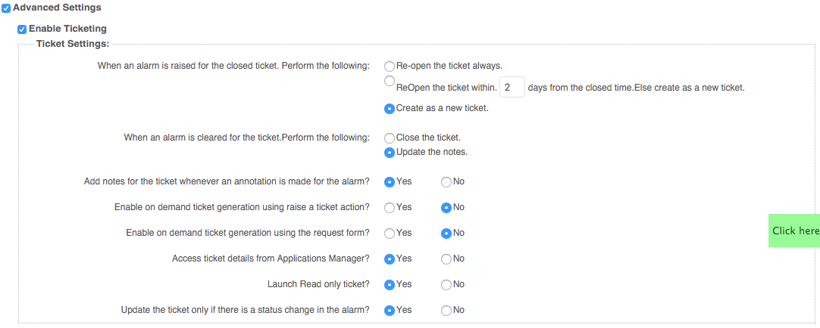
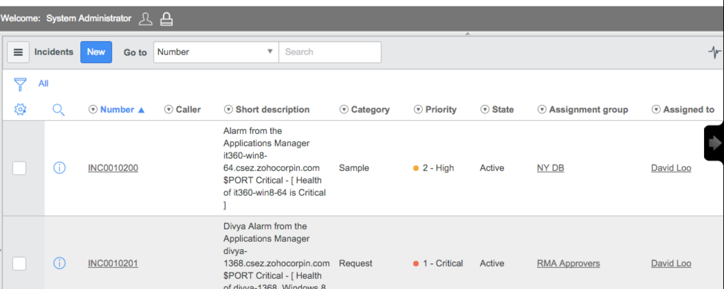
Log a ticket

Slide 32
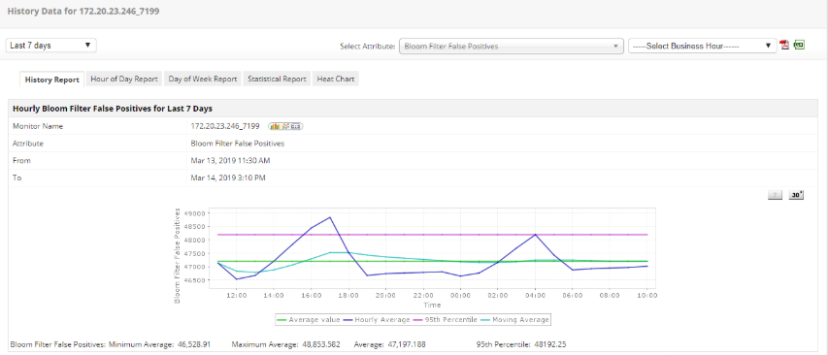
Trend Analysis Report

Slide 33
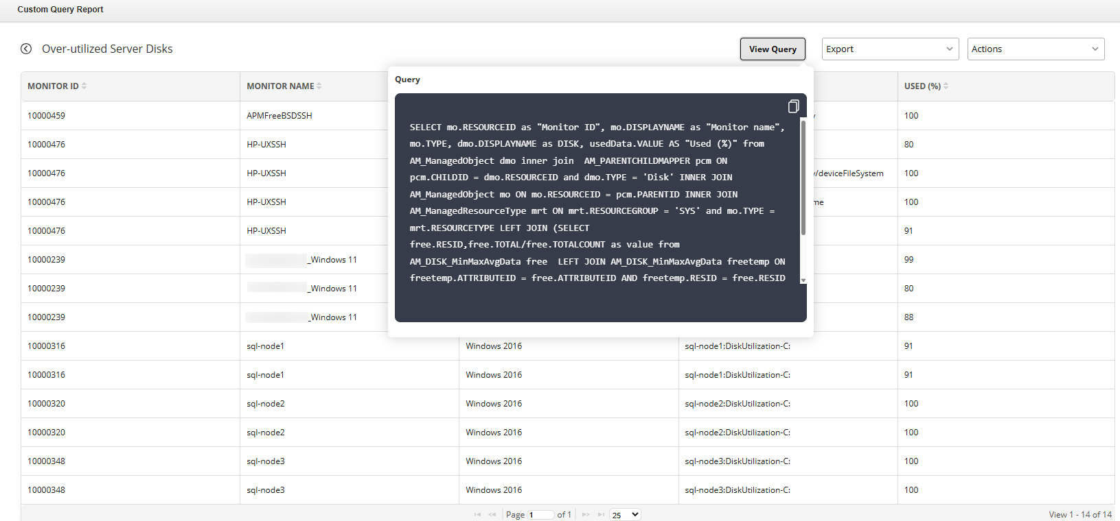
Custom Query Report

Slide 34
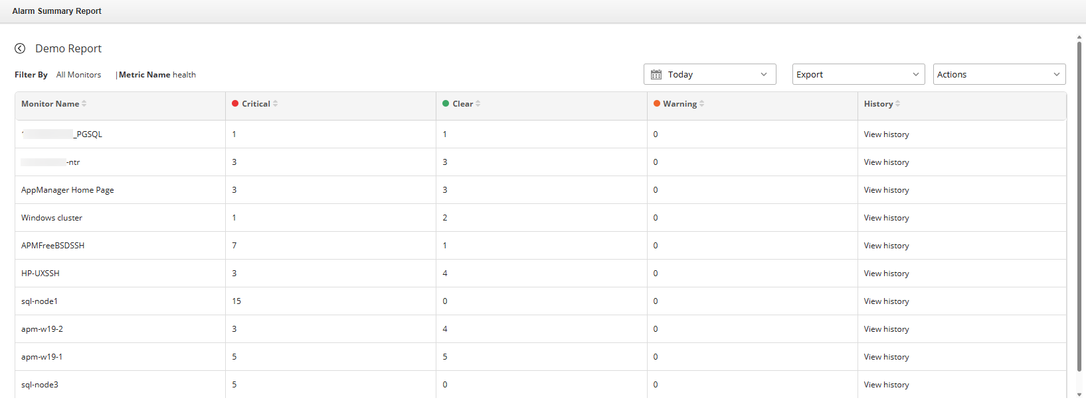
Alarm Summary Report

Slide 35
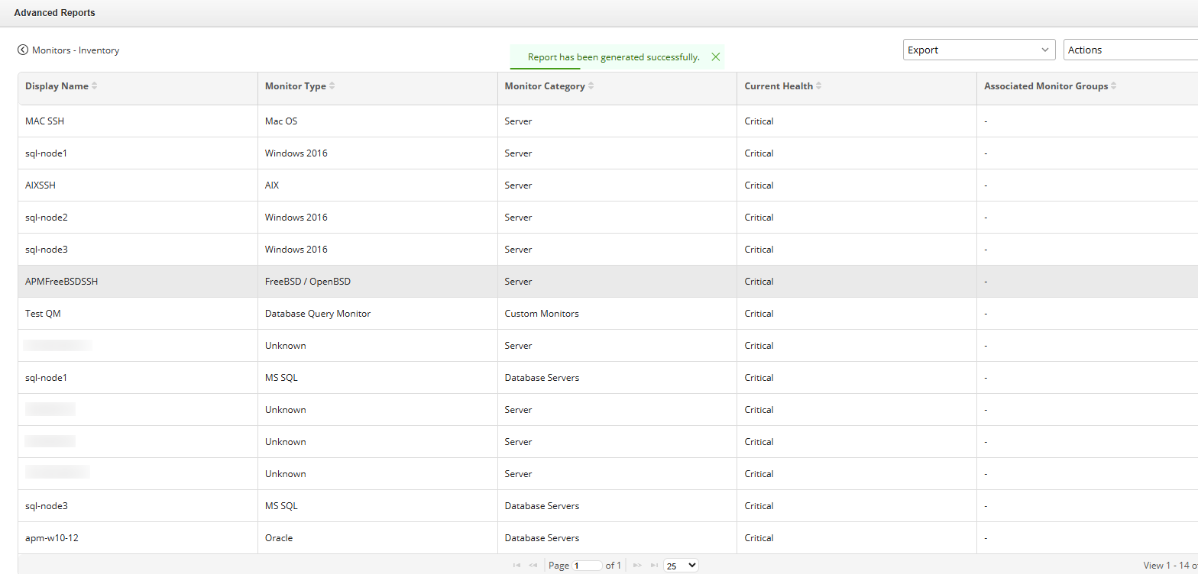
Advanced Report

Slide 36
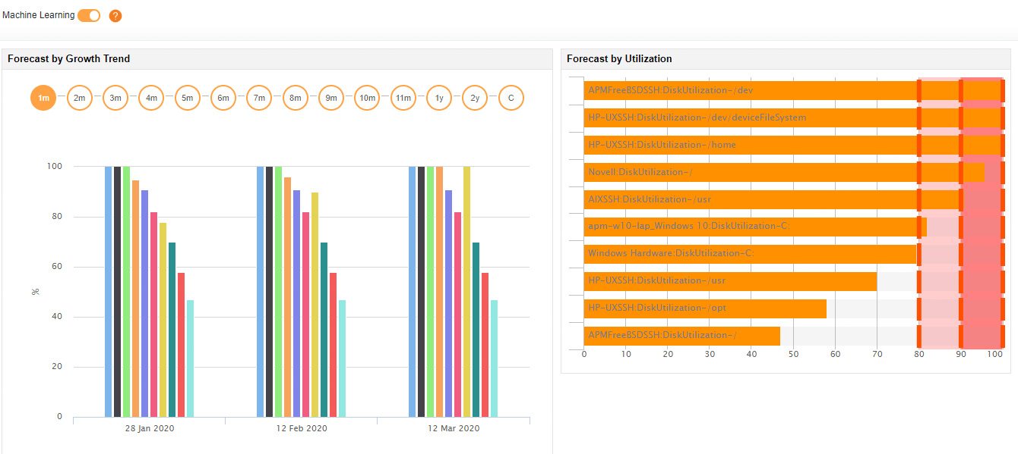
Forecast Report

Slide 37
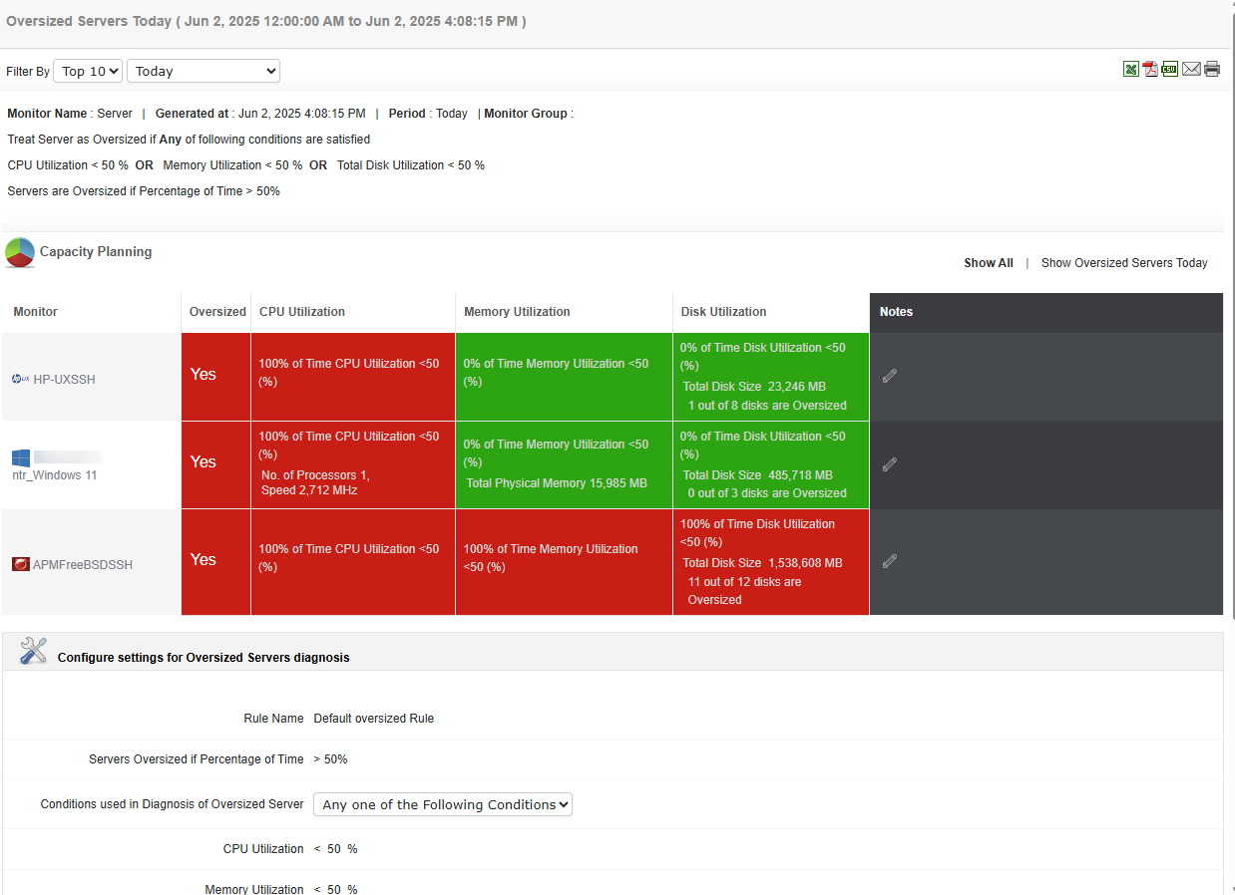
Capacity Planning Report

Slide 38
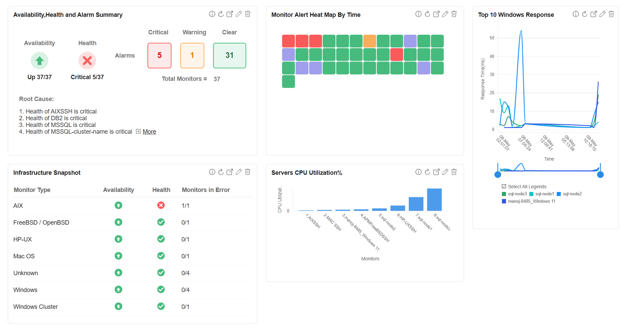
Customizable Dashboards

Slide 39
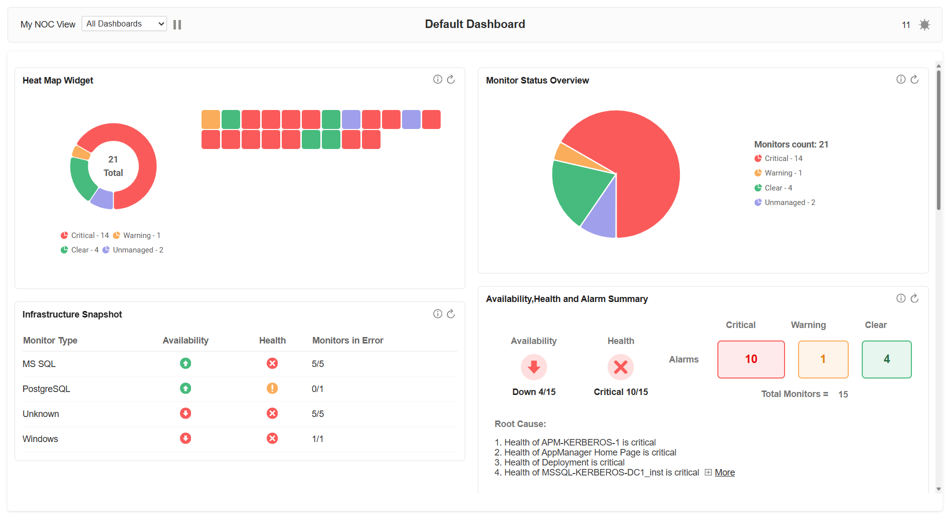
NOC View in Dashboards

Slide 40
OPM Plus for unified IT operations
Combines network, server, application, and cloud monitoring in a single platform
Reduces tool sprawl by eliminating the need for multiple products or scripts
Easy to set up and use with an intuitive interface
Native mobile apps available for iOS and Android
Offers REST APIs for integration with ITSM, CMDB, and DevOps tools
Supports flexible deployment options including on-premise, AWS, and Azure Marketplace
Notes:
It is a minute after midnight and the site goes live. Soon after, users complain of several problems. The site is not reachable due to increased traffic. Even if the site is reachable for some people, the landing page appears to be slow. Customers who click on Mobiles and Tablets category leads to HTTP 500 internal server error. Some pages lead to a HTTP 502 bad gateway error. Whatever happened to the Electronics page!! This was nothing short of a disaster..

Slide 41






Why Applications Manager
Quick time-to-value
High scalability
Enterprise-grade security
Low TCO
Friendly support
Transparent pricing & licensing
Low TCO

Slide 42
Available in 2 editions
Professional
Ideal for small to medium businesses
Monitor up to 750 applications based on load
Enterprise
Ideal for medium to large enterprises
Distributed monitoring architecture
Failover support
Notes:
It is a minute after midnight and the site goes live. Soon after, users complain of several problems. The site is not reachable due to increased traffic. Even if the site is reachable for some people, the landing page appears to be slow. Customers who click on Mobiles and Tablets category leads to HTTP 500 internal server error. Some pages lead to a HTTP 502 bad gateway error. Whatever happened to the Electronics page!! This was nothing short of a disaster..

Slide 43

Over 75 educational institutions
Over 100 government organizations
Leading brands across banking, finance, energy, airline, automobile, software, healthcare, hospitality and tourism industries
trust Applications Manager!

Slide 44


What our customers say
"Applications Manager helped me discover and resolve previously unknown, intricate issues faster"
- Atlantic Health System
"I like Applications Manager because it helps us to detect issues present in our servers and SQL databases"
-Lexmark

Slide 45

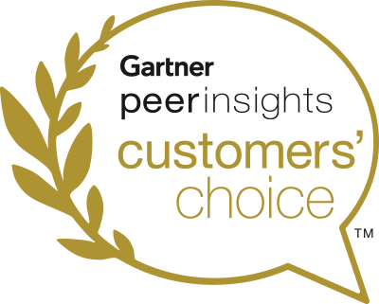
Recognized by Industry Analysts
Recognized in 2024 Magic Quadrant™ for Digital Experience Monitoring
Gartner Peer Insights Customers' Choice 2024 for IT Infrastructure Monitoring Tools
Notes:
It is a minute after midnight and the site goes live. Soon after, users complain of several problems. The site is not reachable due to increased traffic. Even if the site is reachable for some people, the landing page appears to be slow. Customers who click on Mobiles and Tablets category leads to HTTP 500 internal server error. Some pages lead to a HTTP 502 bad gateway error. Whatever happened to the Electronics page!! This was nothing short of a disaster..

Slide 46
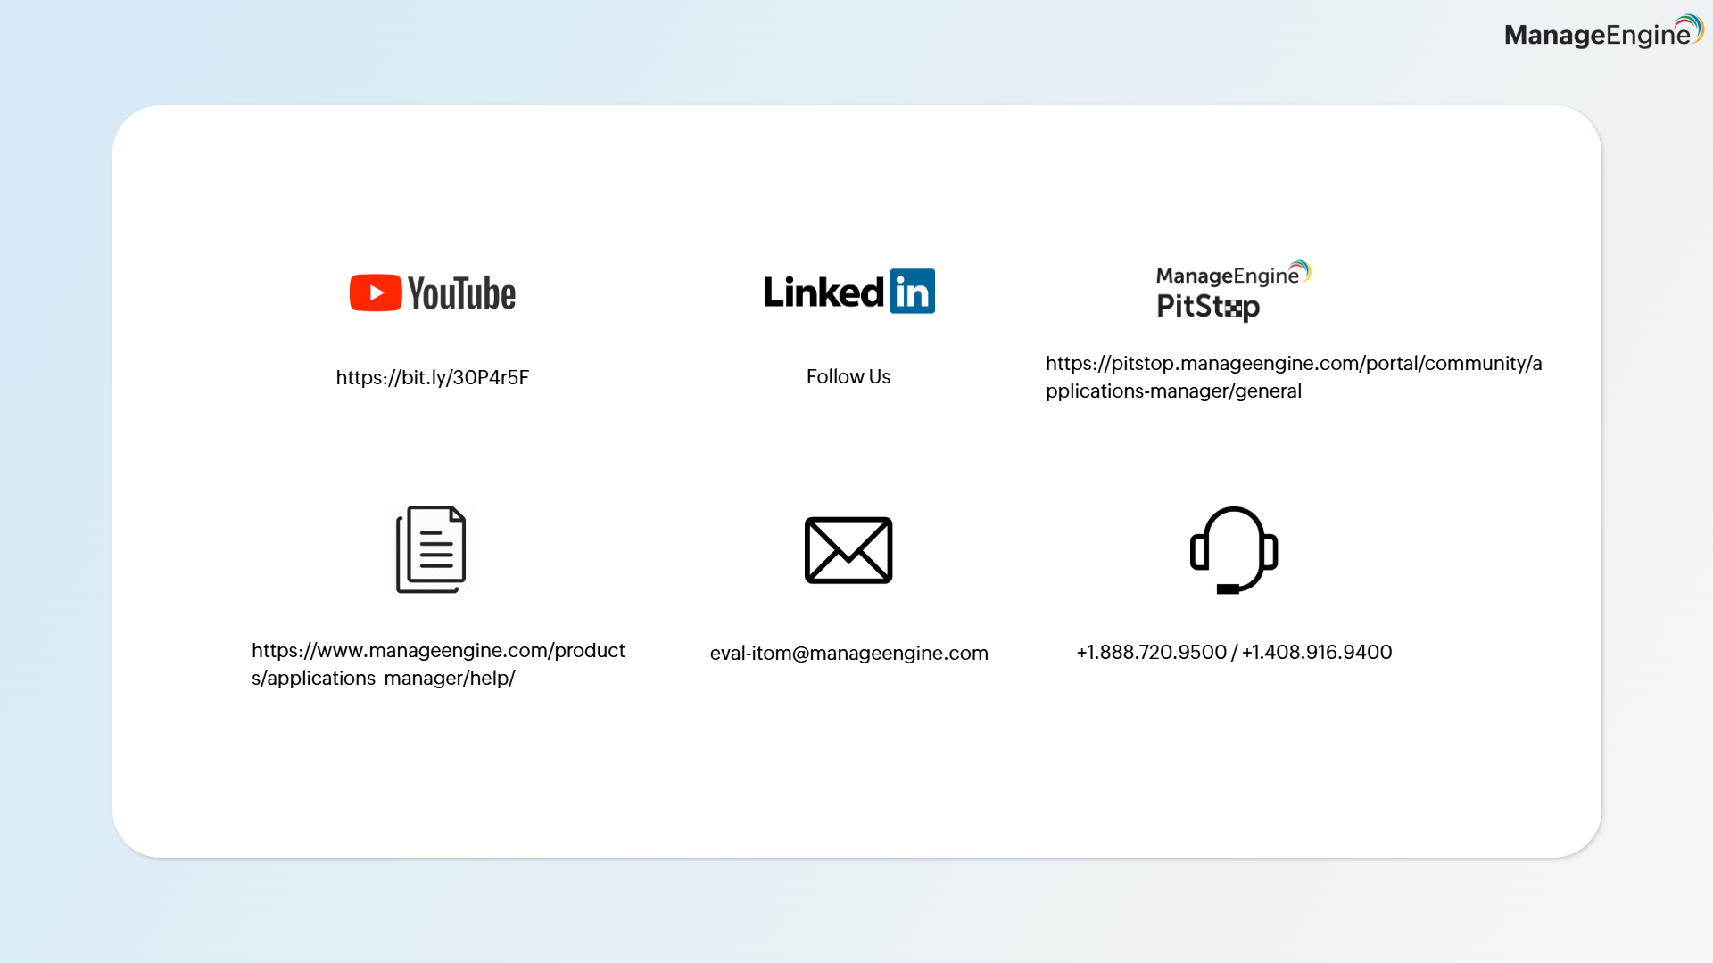

Slide 47
Thank you

