Slide 1
ManageEngine®
Applications Manager
Capabilities for Glassfish Application Server

Slide 2
Agenda
Problem Statements
Solution
Feature Summary
Technical Benefits
Free Edition

Slide 3
Problem Statements
Is the Application Server JVM running out of memory ?
Are my end users affected by poor Web Application
Performance ?
Frequent Downtimes ?
Difficulty in Troubleshooting Large Deployments ?

Slide 4
Applications Manager - The Solution
ManageEngine Applications Manager
Monitors your critical Business Applications : Servers, Application Servers, Databases, Web Applications, Web Services and helps ensure High Uptime and Peak Performance
Target Users: IT Administrators, Application Teams

Slide 5
Primary Functions
Monitoring
Alerting
Reporting
SLA Management

Slide 6
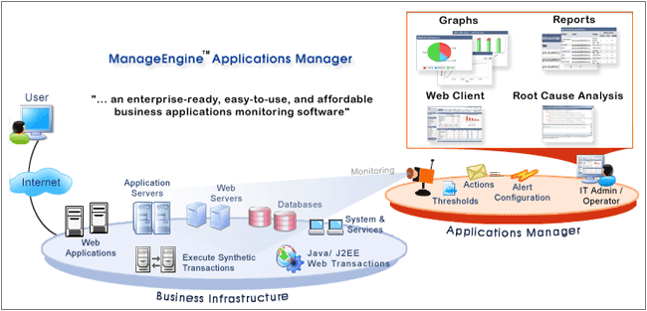
Agentless Monitoring of Heterogeneous Infrastructure

Slide 7
Monitoring
  JMX Consoles / Application Servers
  Websites & Web Applications
  Java Runtime
  J2EE Transactions : URL to SQL Query
  SOA : SOAP Web Services
  Databases
  Systems and Services
  Custom Applications

Slide 8
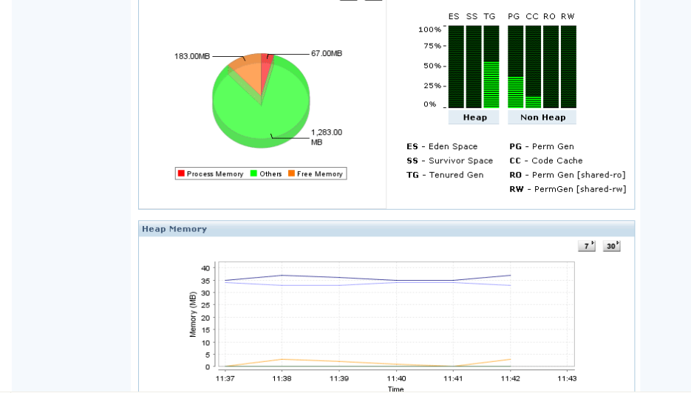
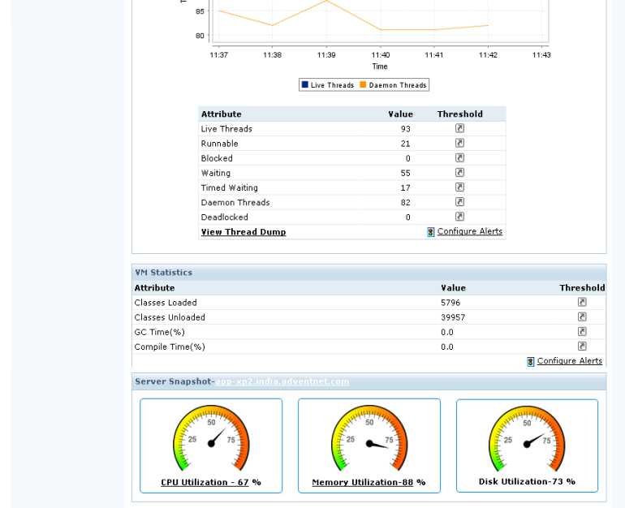
Application Servers
J2EE Application Servers
Build JMX Consoles from JMX MBeans : Glassfish etc
JMX MBean Notifications
Monitor JVM, Threads etc

Slide 9
Java Applications Support
JMX Dashboards for J2EE Applications / Application Servers
Java Runtime Monitoring (JVM )
J2EE Web Transaction Monitoring (method level stats using bytecode instrumentation)
Record & Playback any Web Application (Simple & Sequences) for Monitoring Performance & Availability

Slide 10
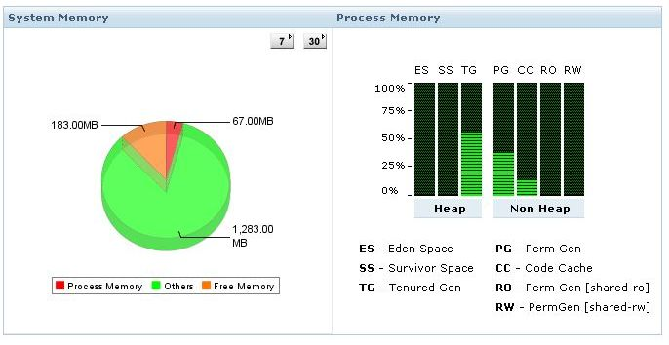
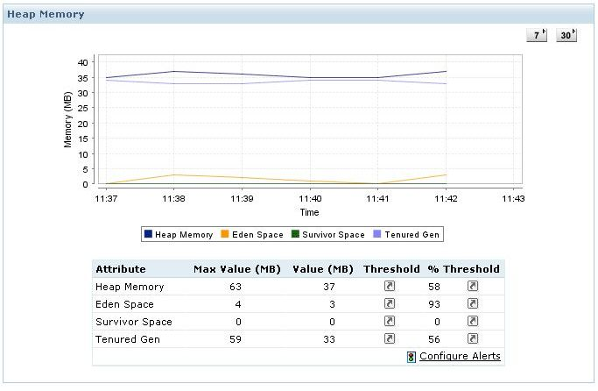
Monitor Glassfish Java Runtime

Slide 11
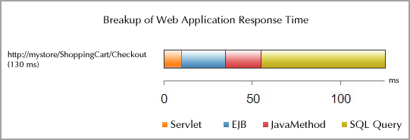
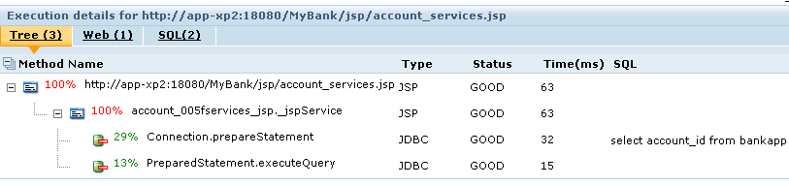
J2EE Web Transactions
Notes:
J2EE Web Transactions Monitor helps to better visualize J2EE Web Transactions end to end, with performance metrics of all components starting from URLs to SQL queries.
With this feature, application teams can quickly identify the Performance metrics of WEB components, EJB, Java and SQL statements in production. They can view trace that will chart the sequence of the internal invocations (methods) of the URL

Slide 12
Servers and Services
Sun Solaris
Linux, Windows
MS Exchange & other mail Servers
Web Servers – Apache, IIS, PHP
WMI Performance Counters

Slide 13
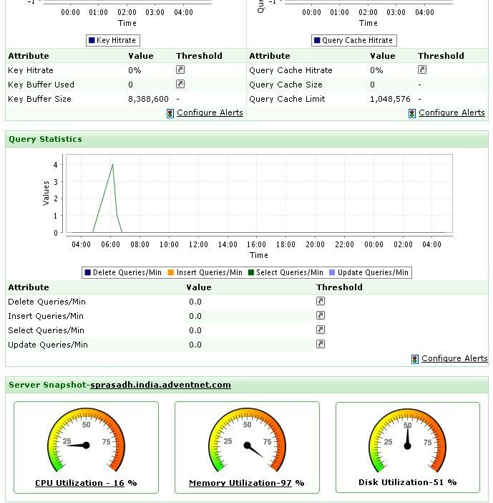
Databases
Oracle
MySQL
Microsoft SQL Server
IBM DB2
Sybase
PostgreSQL
Memcached

Slide 14
Monitor Custom Applications
Monitor
SNMP, Trap Listeners
JMX(Java Management Extensions), MBean Notifications
Custom Monitoring (Java, Perl, .NET)
Windows WMI
Web Apps (URL Sequences)
Notes:
Write Custom Code in Java, .NET, Perl etc and Integrate Application Performance Metrics
Custom Applications: The custom Application monitoring capability is very powerful. It provides an easy mechanism to monitor metrics exposed via SNMP, WMI, JMX by default. In addition to that users can also add custom monitoring capability by writing Java. .NET, Perl etc code and integrate the metrics in to Applications Manager. The benefit is users automatically get alerting, reporting, grouping behavior without any extra effort.

Slide 15
End User Experience Measurement
Measure What Your End Users Experience
Simulate Web Application Browsing Behavior
Define Acceptable Response Time
(say, 2 secs)
Set SLAs
(Gold SLA)
Monitor Response Times
Notes:
With support for simulating HTTP or HTTPS Web Transactions, ManageEngine Applications Manager can help you measure the End User Experience for your Web Applications. With powerful Record and playback GUI, setting up a Web Transaction Monitor is easy. This capability can help you visualize, how web pages respond for your end users.
The Record and playback GUI is like an Internet Explorer Browser and users can do the recording or configuration via a simple tool, and update the same in to Applications Manager seemlessly. There is no need for any sort of scripting etc.
Additionally the ability to define acceptable thresholds and SLAs for Page Response Times can ensure the needs of your end users are met.
What time of the day your web application is slow or which day of the week is my Application the slowest are some of the important metrics that you can derive. Additionally with content checks and page change notifications, you can be alerted when problematic changes are done to your critical web pages.

Slide 16
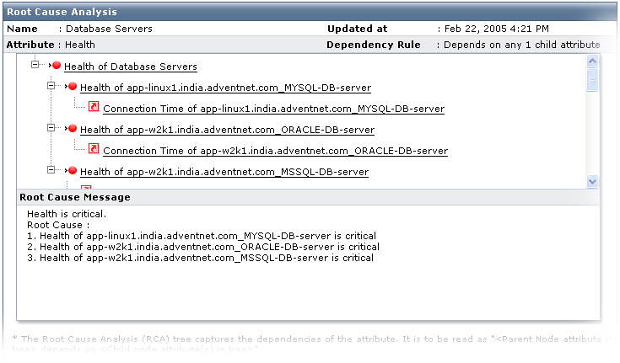
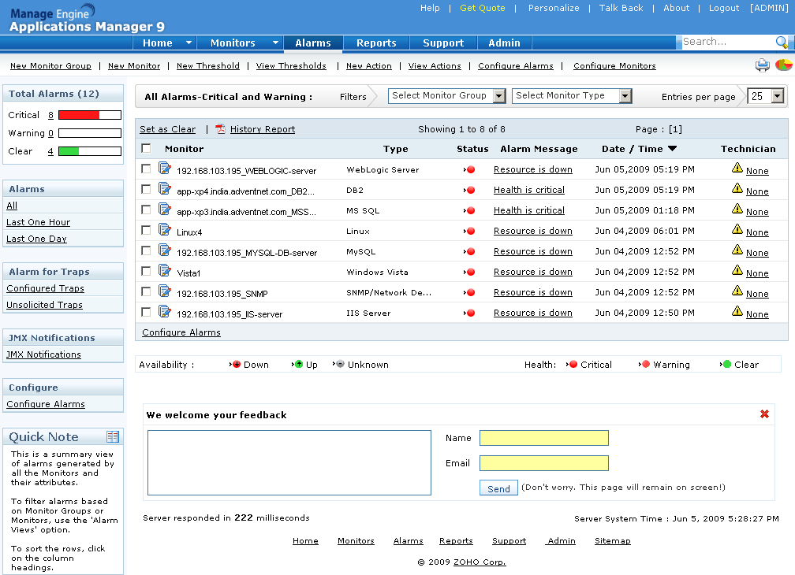
Fault Management
Alert View
Root Cause Analysis
Notes:
When an error is detected, it can be notified immediately by configuring an action. There are many ways by which alert Notifications are done. Applications manager supports the following actions:
Send Email, SMS, Execute custom scripts, sending SNMP Traps to third-party consoles,
Logging a ticket in ManageEngine ServiceDeskPlus which is a Help Desk and Asset Management software.
The Root Cause Analysis Window helps users to quickly identify where the bottleneck is. From a high level Business Application View, users can know which business application is currently affected and know what the problem is quickly. For example, users can know that the CRM Application has an Oracle database whose tablespace is reaching a critical thresholds and will run out of space etc.

Slide 17
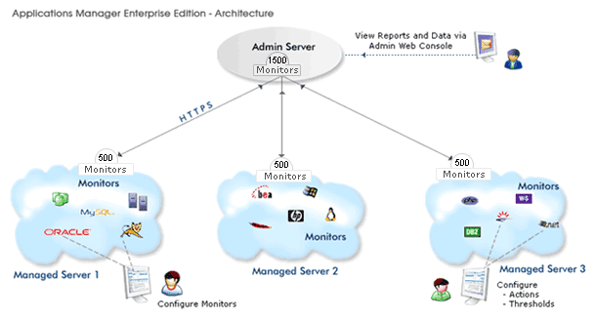
Applications Manager Enterprise Edition
Scalable Monitoring Architecture
Distributed Monitoring Capability
Notes:
ManageEngine® Applications Manager Enterprise Edition is a scalable solution. It supports a distributed architecture and hence helps to monitor thousands of servers and applications.
The Enterprise Edition comprises of a distributed data collector (Managed Servers) setup. It also provides a Single Console (Admin Server) for consolidated reports and monitoring of alerts. The Admin Server facilitates a single view to all data and reports from the various distributed data collectors (Managed Servers).
Additionally, the Enterprise Edition uses HTTPS as the mode of communication between the Admin Server and the Managed Server. This has an added advantage for users with a very secure environment where only HTTPS is allowed across different networks. This architecture hence helps them over come any restrictions on their monitoring capability.

Slide 18
Technical Benefits
Out-of-the-box Support for Heterogeneous Applications and Servers
Standards based Approach to Managing IT Resources
Agentless Monitoring Ensures Low Cost of Maintenance
Distributed architecture for High Scalability
Web Client Ensures High Usability

Slide 19
Free Edition
Free Edition : Supports Monitoring up to 5 Servers /
Application Servers / Databases etc.
Fully Functional
No extra Plug-in Required
Professional Edition: Pricing Starts at $795 for Monitoring 25 Servers, application servers or DBs etc.
Enterprise Edition: Pricing Starts at $7995 for Monitoring 250 Servers, application servers or DBs etc.

Slide 20
Customer List
AC Nielsen
American Honda
Continental Airlines
Cummins
Dupont
Deutsche Bank
EDS
GE Finance
JPMorgan Chase
McKesson
MetLife
Pfizer
Seagate
SDAC Harvard
Walgreens
Yamaha Motor Corporation

Slide 21
More Info
Website:
http://www.manageengine.com/applications_manager/
Download:
http://www.manageengine.com/applications_manager/download.html
Live Demo: http://demo.appmanager.com/
Pricing: https://store.manageengine.com/
Product Editions:
Free Edition : 5 Monitors: Applications, Servers, etc. Never Expires
Professional Trial Edition : 30 day evaluation. No restrictions on Monitor Instances
Enterprise Edition : Distributed set up for scalability
Contact: appmanager-support@manageengine.com
Toll-Free: +1 925 924 9500
+1 888 720 9500

